Slide 1
Psychology: From Inquiry to Understanding
Fourth Edition
Chapter 9
Intelligence and IQ Testing
Controversy and Consensus

Slide 2
What Is Intelligence? LO 9.1a Identify different models and types of intelligence.
Psychologists can’t agree on a precise definition of intelligence.
Boring’s “intelligence is whatever intelligence tests measure.”
Not a useful definition, though
Notes:
LO 9.1

Slide 3
Intelligence as Abstract Thinking LO 9.1a Identify different models and types of intelligence.
Binet and Simon’s 1905 intelligence test
Focused on higher mental processes—reasoning, understanding, judgment
Most now agree that intelligence has something to do with the capacity to understand hypothetical concepts (abstract thinking).
Notes:
LO 9.1

Slide 4
Intelligence as General versus Specific Abilities LO 9.1a Identify different models and types of intelligence.
Positive correlations among items on IQ tests led to Spearman’s development of g and s.
General intelligence accounts for overall differences in intellect among people.
Our particular skills are reflected in our specific abilities.
Notes:
LO 9.1

Slide 5
Fluid and Crystallized Intelligence LO 9.1a Identify different models and types of intelligence.
Cattell and Horn theorized that “intelligence” is a mix of two capacities:
The capacity to learn new ways of solving problems, or fluid intelligence
The accumulated knowledge of the world we gain over time, or crystallized intelligence
Notes:
LO 9.1

Slide 6
Multiple Intelligences (1 of 4) LO 9.1a Identify different models and types of intelligence.
Several theorists argue that there are entirely different domains of intellectual skill.
Gardner’s “frames of mind”—ways of thinking about the world
Argued that autistic savants provide support for these different types of intelligence
Notes:
LO 9.1

Slide 7
Table 9.1 Howard Gardner’s Multiple Intelligences
Intelligence Type | Characteristics of High Scorers
Linguistic | Speak and write well
Logico-mathematical | Use logic and mathematical skills to solve problems such as scientific questions
Spatial | Think and reason about objects in three-dimensional space
Musical | Perform, understand, and enjoy music
Bodily-kinesthetic | Manipulate the body in sports, dance, or other physical endeavors
Interpersonal | Understand and interact effectively with others
Intrapersonal | Understand and possess insight into oneself
Naturalistic | Recognize, identify, and understand animals, plants, and other living things

Slide 8
Multiple Intelligences (2 of 4) LO 9.1a Identify different models and types of intelligence.
Mixed scientific reaction to this model, as it is virtually impossible to falsify
Also not clear why only certain abilities classify as intelligences
No good evidence that these intelligences are truly independent
Notes:
LO 9.1

Slide 9
Multiple Intelligences (3 of 4) LO 9.1a Identify different models and types of intelligence.
The triarchic model
Sternberg theorized three largely distinct types of intelligence.
Believes that having one does not ensure you have the others
Analytical intelligence is the ability to reason logically, or “book smarts.”
Practical intelligence is the ability to solve real-world problems, or “street smarts.”
Creative intelligence is the ability to come up with novel and effective answers.
Notes:
LO 9.1

Slide 10
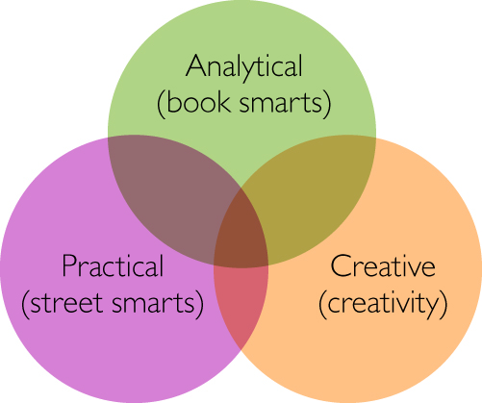
Figure 9.3 Sternberg’s Triarchic Model of Intelligence
Notes:
LO 9.1

Slide 11
Biological Bases of Intelligence (1 of 3) LO 9.1b Describe the connection between intelligence and brain size and efficiency.
Brain volume correlates positively with measured intelligence.
But .3–.4 correlations don’t explain everything, and the relationship may not be causal.
Evidence suggests cerebral cortex development is slower in gifted children.
Notes:
LO 9.2

Slide 12
Biological Bases of Intelligence (2 of 3) LO 9.1b Describe the connection between intelligence and brain size and efficiency.
Intelligence may reflect efficiency of mental processing.
Persons with higher intelligence show quicker reaction times.
Working memory is also closely related to intelligence.
Notes:
LO 9.2

Slide 13
Biological Bases of Intelligence (3 of 3) LO 9.1b Describe the connection between intelligence and brain size and efficiency.
Prefrontal cortex is especially active during highly “g-loaded” tasks
But other areas of the brain are also important.
Central theme is that people who think quickly tend to be more intelligent.
Notes:
LO 9.3

Slide 14
9.2: Intelligence Testing: The Good, the Bad, and the Ugly
9.2a Determine how psychologists calculate IQ.
9.2b Explain the history of misuse of intelligence tests in the United States.
9.2c Describe tests of intelligence used today and evaluate the reliability and validity of IQ scores.
9.2d Distinguish the unique characteristics of mental retardation and genius.

Slide 15
How We Calculate IQ (1 of 2) LO 9.2a Determine how psychologists calculate IQ.
The development of norms allows us to compare one person’s test results to another’s.
Binet’s concept of mental age led to the development of the intelligence quotient (IQ).
Mental age $÷$chronological age $×$ 100 $=$ IQ
Notes:
LO 9.3

Slide 16
How We Calculate IQ (2 of 2) LO 9.2a Determine how psychologists calculate IQ.
Modern IQ tests compare each person’s score to what is normal for his or her own age group
Notes:
LO 9.4

Slide 17
The Eugenics Movement LO 9.2b Explain the history of misuse of intelligence tests in the United States.
Soon after IQ tests were developed, they began to be abused.
Led to worry about “low IQ” in certain groups and the eugenics movement
Forcible sterilization and immigration laws were the most visible impacts on society.

Slide 18
Figure 9.7 A Sterilization Map of the United States
Source: Based on data from http://www.uvm.edu/~lkaelber/eugenics/
Notes:
LO 9.5

Slide 19
IQ Testing Today (1 of 3) LO 9.2c Describe tests of intelligence used today and evaluate the reliability and validity of IQ scores.
The most commonly used IQ test for adults is the Wechsler Adult Intelligence Scale.

Slide 20
IQ Testing Today (2 of 3) LO 9.2c Describe tests of intelligence used today and evaluate the reliability and validity of IQ scores.
Consists of 15 subtests that give 5 scores:
Overall IQ
Verbal comprehension
Perceptual reasoning
Working memory
Processing speed

Slide 21
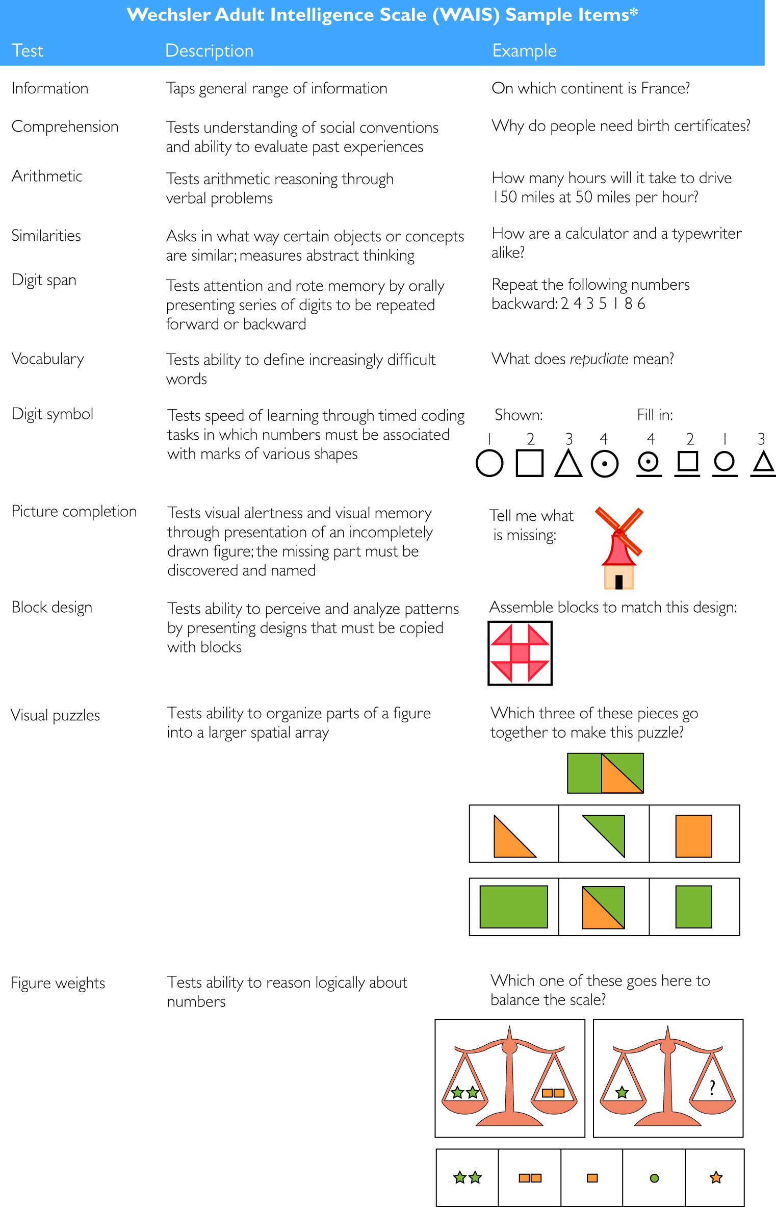
Figure 9.8 Sample Items from WAIS

Slide 22
IQ Testing Today (3 of 3) LO 9.2c Describe tests of intelligence used today and evaluate the reliability and validity of IQ scores.
Culture-fair IQ tests
Consist of abstract-reasoning items that don’t depend on language
Notes:
LO 9.5

Slide 23
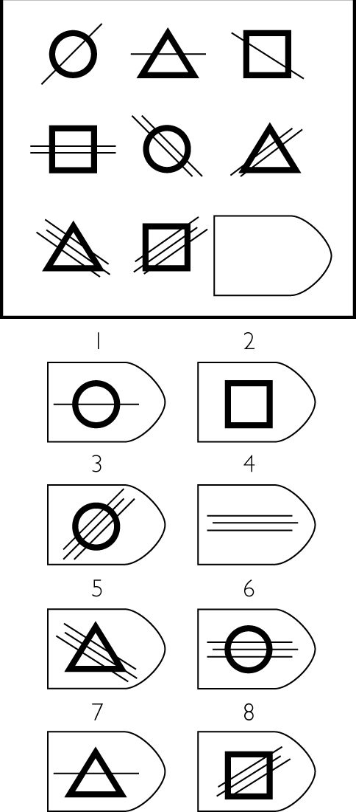
Figure 9.9 Item Similar to that on Raven’s Progressive Matrices
Source: Based on Raven, J., Raven, J. C., & Court, J. H. (1998). Manual for Raven’s Advanced Progressive Matrices
Notes:
LO 9.5

Slide 24
College Admissions Tests LO 9.2c Describe tests of intelligence used today and evaluate the reliability and validity of IQ scores.
Designed to test overall competence in a specific domain or predict academic success
They correlate highly (.7–.8) with IQ.
Coaching courses appears to have very small effects, especially when practice effects are taken into account.
Notes:
LO 9.5

Slide 25
Reliability of IQ Scores LO 9.2c Describe tests of intelligence used today and evaluate the reliability and validity of IQ scores.
In adults, scores tend to be highly stable over long periods of time.
Prior to age three, though, IQ tests are very unstable and poor predictors of adult IQ.
Notes:
LO 9.5

Slide 26
Validity of IQ Scores LO 9.2c Describe tests of intelligence used today and evaluate the reliability and validity of IQ scores.
Moderately successful at predicting grades
Predict performance across wide variety of occupations and are associated with health-related outcomes (health literacy)
Relationships hold up even when social class is taken into account.
Notes:
LO 9.6

Slide 27
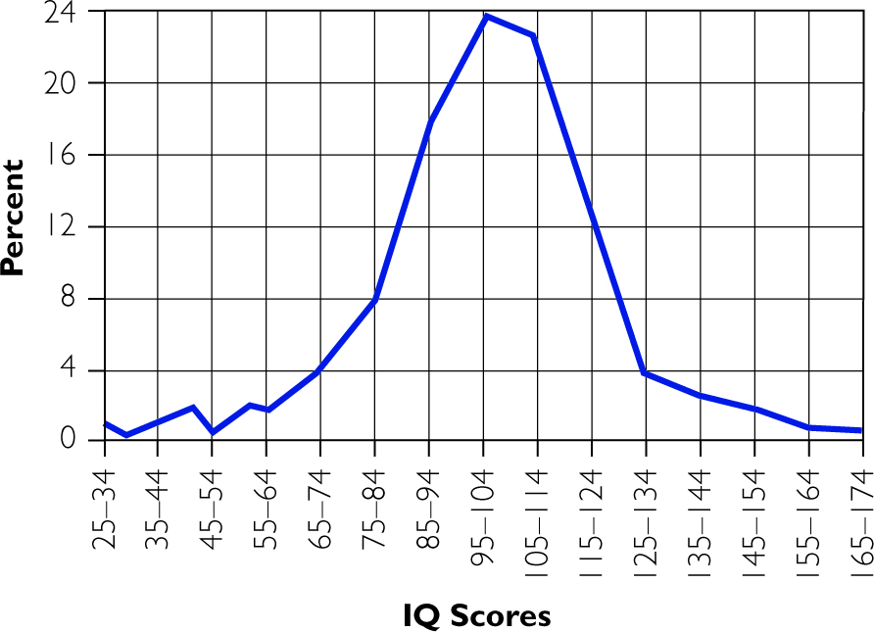
Figure 9.11 Distribution of IQ Scores in the General Population
Notes:
LO 9.6

Slide 28
A Tale of Two Tails (1 of 3) LO 9.2d Distinguish the unique characteristics of mental retardation and genius.
Intellectual disability
Characterized by childhood onset of low IQ (below about 70) and inability to engage in adequate daily functioning
Around 1 percent of US population (mostly males)
Four levels: mild, moderate, severe, profound
The more severe the intellectual disability, the less likely it is to run in families.
Over 200 different causes; most common are Fragile X syndrome and Down syndrome
ADA and IDEA acts have greatly impacted lives of those with intellectual disability.
Notes:
LO 9.6

Slide 29
A Tale of Two Tails (2 of 3) LO 9.2d Distinguish the unique characteristics of mental retardation and genius.
Genius and exceptional intelligence
Refers to the top 2 percent of IQ scores
Large portion occupy certain professions: doctors, lawyers, engineers, professors
Terman’s “Termites” showed that prodigies do not “burn out” or have higher rates of mental illness.
Notes:
LO 9.6

Slide 30
9.4: Group Differences in IQ: The Science and the Politics
9.4a Identify similarities and differences in mental ability between men and women.
9.4b Evaluate the evidence concerning racial differences in IQ.

Slide 31
Sex Differences in IQ and Mental Abilities (1 of 3) LO 9.4a Identify similarities and differences in mental ability between men and women.
Most research finds few or no average differences between males and females.
But, males are more variable in their scores.

Slide 32
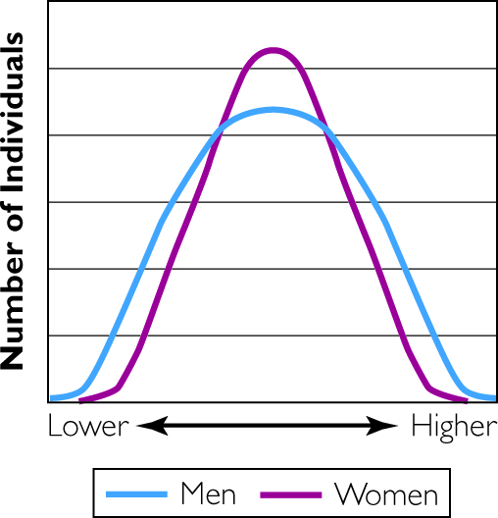
Figure 9.16 Distributions of Men and Women in IQ Tests
Notes:
LO 9.9

Slide 33
Sex Differences in IQ and Mental Abilities (2 of 3) LO 9.9 Identify similarities and differences in mental ability between men and women.
Research shows consistent differences in terms of specific mental abilities.
Females tend to do better on some verbal tasks and recognizing emotions in others.
Males tend to do better on spatial ability tests, like mental rotation and geography.
Notes:
LO 9.9

Slide 34
Sex Differences in IQ and Mental Abilities (3 of 3) LO 9.4a Identify similarities and differences in mental ability between men and women.
Potential causes of sex differences
Some, like spatial ability, may be biological.
Most appear to be due to environmental differences.
Infants show few or no differences.
Sex differences in problem-solving strategies
Notes:
LO 9.10

Slide 35
Racial Differences in IQ (1 of 3) LO 9.4b Evaluate the evidence concerning racial differences in IQ.
African Americans and Hispanic Americans score lower than Caucasians.
Asian Americans score higher than Caucasians.
Jews score slightly higher than non-Jews.
Why do these differences exist?
Notes:
LO 9.10

Slide 36
Racial Differences in IQ (2 of 3) LO 9.4b Evaluate the evidence concerning racial differences in IQ.
Racial “superiority” is not the answer.
IQ differences appear to be shrinking.
Substantial overlap in IQ distribution
Instead, differences appear to be largely or completely environmental in origin.

Slide 37
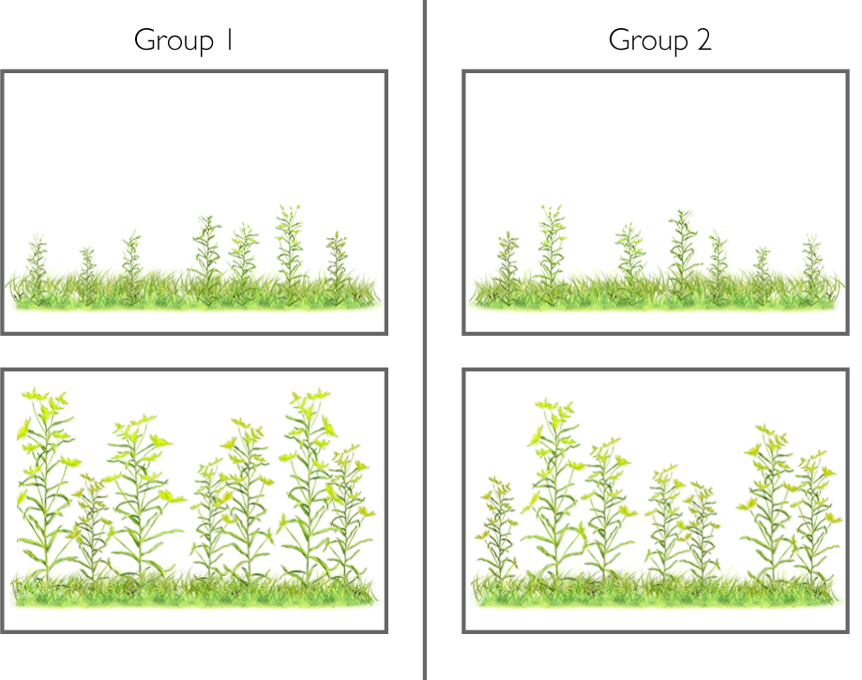
Figure 9.19 Drawings of Two Groups of Plants

Slide 38
9.5: The Rest of the Story: Other Dimensions of Intellect
9.5a Describe how creativity and emotional intelligence relate to intelligence.
9.5b Identify reasons why intelligence doesn’t protect us from errors in thinking.

Slide 39
Creativity (1 of 2) LO 9.5a Describe how creativity and emotional intelligence relate to intelligence.
Often measured using tests of divergent thinking, “outside the box” thinking
“Uses of an Object” test
But we also need to be good at convergent thinking: finding the single best answer to a problem.
Notes:
LO 9.11

Slide 40
Creativity (2 of 2) LO 9.5a Describe how creativity and emotional intelligence relate to intelligence.
mildly correlated with IQ (.2–.3)
Notes:
LO 9.11

Slide 41
Emotional Intelligence LO 9.5a Describe how creativity and emotional intelligence relate to intelligence.
The ability to understand our own and others’ emotions, then apply that information
Not clear that emotional intelligence differs much from personality
May not predict job performance beyond general IQ
Notes:
LO 9.11

