Slide 1
1
Psychology and Scientific Thinking
A FRAMEWORK FOR EVERYDAY LIFE
Slides prepared by Matthew Isaak

Slide 2
Lecture Preview
What is psychology?
Psychological pseudoscience
Psychology’s past and present

Slide 3
True or False? LO 1.1 Explain why psychology is more than just common sense.
Most people use only about 10% of their brain capacity.
Hypnosis enhances the accuracy of our memories.
People tend to be romantically attracted to individuals who are opposite to them in personality and attitudes.
ALL OF THE ABOVE ARE FALSE!
So why do most people believe them?

Slide 4
What is psychology? LO 1.1 Explain why psychology is more than just common sense.
First off, it’s not very easy to define.
Our definition will be that psychology is the scientific study of the mind, brain, and behavior.
As a discipline, psychology spans many levels of analysis.
Runs from biological to social influences

Slide 5
What is psychology? LO 1.1 Explain why psychology is more than just common sense.
We can’t understand psychology by focusing on only one level of analysis – instead we need to examine all of them.

Slide 6
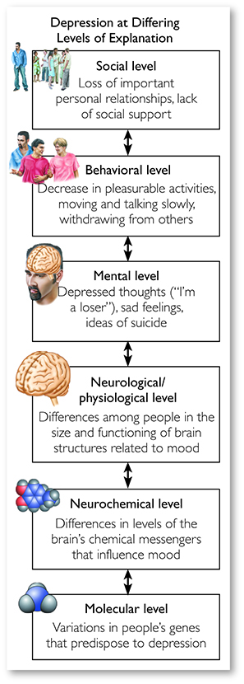
Figure 1.1 Levels of Analysis in Depression. We can view psychological phenomena, in this case the disorder of depression, at multiple levels of analysis, with lower levels being more biological and higher levels being more social. Each level provides unique information and offers a distinctive view of the phenomenon at hand. (Based on data from Ilardi, Rand, & Karwoski, 2007)

Slide 7
Challenging and Fascinating LO 1.1 Explain why psychology is more than just common sense.
Five factors make the study of psychology very difficult, but very rewarding.
Human behavior is difficult to predict.
Actions are multiply determined.
Psychological influences are rarely independent of each other.
People display individual differences in thinking, emotion, and personality.

Slide 8
Challenging and Fascinating LO 1.1 Explain why psychology is more than just common sense.
Five factors make the study of psychology very difficult, but very rewarding.
People influence one another.
Reciprocal determinism
Behavior is shaped by culture.
Emic vs. etic approaches

Slide 9
Psychology as a Science LO 1.2 Explain the importance of science as a set of safeguards against biases.
Science is not a body of knowledge (e.g. chemistry or physics).
Science is an approach to evidence, one designed to keep us from fooling ourselves.
Science begins with empiricism, but then tests those observations using rigorous methods.

Slide 10
Psychology as a Science LO 1.2 Explain the importance of science as a set of safeguards against biases.
In psychology (and all science) we must abandon relying on opinions.
Instead we find out which explanations best fit the evidence or data.

Slide 11
Popular Psychology LO 1.3 Describe psychological pseudoscience and distinguish it from psychological science.
About 3500 self-help books are published each year – only 5% are tested!
The quality of the information can be good, misleading, or even harmful.
Many websites may offer helpful advice, but others may contain erroneous information.
Notes:
LO 1.3

Slide 12
What is Pseudoscience? LO 1.3 Describe psychological pseudoscience and distinguish it from psychological science.
A set of claims that seem scientific, but aren’t
Pseudoscience lacks the safeguards against confirmation bias and belief perseverance that characterize science.
Testable beliefs that that are not supported by the evidence

Slide 13
Warning Signs of Pseudoscience LO 1.3 Describe psychological pseudoscience and distinguish it from psychological science.
Ad hoc immunizing hypotheses
Escape hatches to protect against falsification, usually a loophole or exception for negative findings
Lack of self-correction
Overreliance on anecdotes
Anecdotes are often not representative, but can’t tell us about cause and effect and are often difficult to verify.

Slide 14
Why Pseudoscience? LO 1.4 Identify reasons we are drawn to pseudoscience.
Our brains are predisposed to make order out of disorder and make sense out of nonsense.
Apophenia is the tendency to find connections among unrelated or random phenomena.
Pareidolia is seeing meaningful images in meaningless visual stimuli.

Slide 15
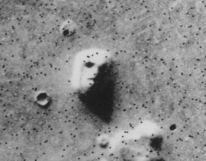
The “Face” on Mars LO 1.4 Identify reasons we are drawn to pseudoscience
Original photo
Higher resolution photo

Slide 16
Why Pseudoscience? LO 1.4 Identify reasons we are drawn to pseudoscience.
We believe what we want to believe.
Many pseudoscientific beliefs offer control over an uncontrollable world.
Terror management theory and mortality salience – Pseudoscientific beliefs help counter our fear of death.

Slide 17
Psychology’s Early History LO 1.7 Identify the major theoretical frameworks of psychology.
For many centuries, psychology was indistinguishable from philosophy.
In 1879, William Wundt developed the first psychology laboratory in Germany.
But psychology had to break away from another influence as well—spiritualism.

Slide 18
From Séance to Science LO 1.7 Identify the major theoretical frameworks of psychology.
In the 1800’s, Americans were obsessed with spiritualism and mediums.
The public saw psychology and spiritualism as inextricably linked.
Psychology ultimately distanced itself from spiritualism.
Notes:
LO 1.7

Slide 19
Great Theoretical Frameworks LO 1.7 Identify the major theoretical frameworks of psychology.
What unifying theoretical perspective best explains behavior?
Five primary schools of thought have shaped modern psychological responses to this question.

Slide 20
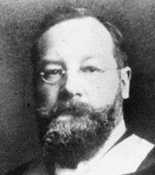
Great Theoretical Frameworks LO 1.7 Identify the major theoretical frameworks of psychology.
Structuralism
Major figures were Wundt and E.B. Titchener.
Aimed to identify the most basic elements of psychological experience
E.B. Tichener.
Notes:
LO 1.7

Slide 21
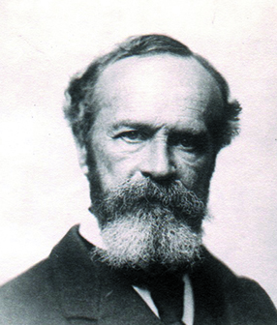
Great Theoretical Frameworks LO 1.7 Identify the major theoretical frameworks of psychology.
Functionalism
Its major figure was William James, heavily influenced by Charles Darwin.
Hoped to understand the adaptive purposes of thought and behavior
William James
Notes:
LO 1.7

Slide 22
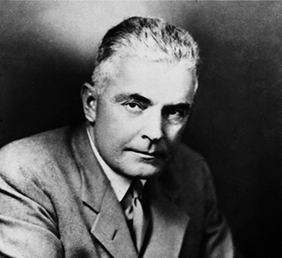
Great Theoretical Frameworks LO 1.7 Identify the major theoretical frameworks of psychology.
Behaviorism
Major figures were Watson and Skinner.
Focuses on uncovering the general laws of learning by looking outside the organism
John Watson
Notes:
LO 1.7

Slide 23
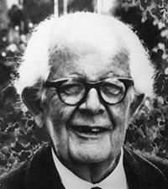
Great Theoretical Frameworks LO 1.7 Identify the major theoretical frameworks of psychology.
Cognitivism
Major figures were Piaget and Neisser.
Focuses on the mental processes involved in different aspects of thinking
Jean Piaget
Notes:
LO 1.7

Slide 24
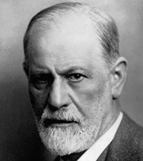
Great Theoretical Frameworks LO 1.7 Identify the major theoretical frameworks of psychology.
Psychoanalysis
Major figures were Freud and Jung.
Focused on internal psychological processes of which we’re unaware
Sigmund Freud
Notes:
LO 1.7

Slide 25
Contributions to Scientific Psychology LO 1.7 Identify the major theoretical frameworks of psychology.
Structuralism
Encouraged systematic data collection and empiricism
Functionalism
Influenced evolutionary perspectives in modern psychology
Behaviorism
Helped to understand how we learn and improved psychology’s scientific rigor
Notes:
LO 1.7

Slide 26
Contributions to Scientific Psychology LO 1.7 Identify the major theoretical frameworks of psychology.
Cognitivism
Highlighted the role of thought and our interpretation of events in behavior
Psychoanalysis
May have actually retarded scientific advance of psychology, but theories of mental processing outside of conscious awareness are holding up
Notes:
LO 1.7

Slide 27
Psychology Today LO 1.8 Describe different types of psychologists and identify what each of them does.
Very diverse, as reflected in the 500,000 psychologists worldwide
There are many types of psychologists who work in many settings.
Notes:
LO 1.8

Slide 28
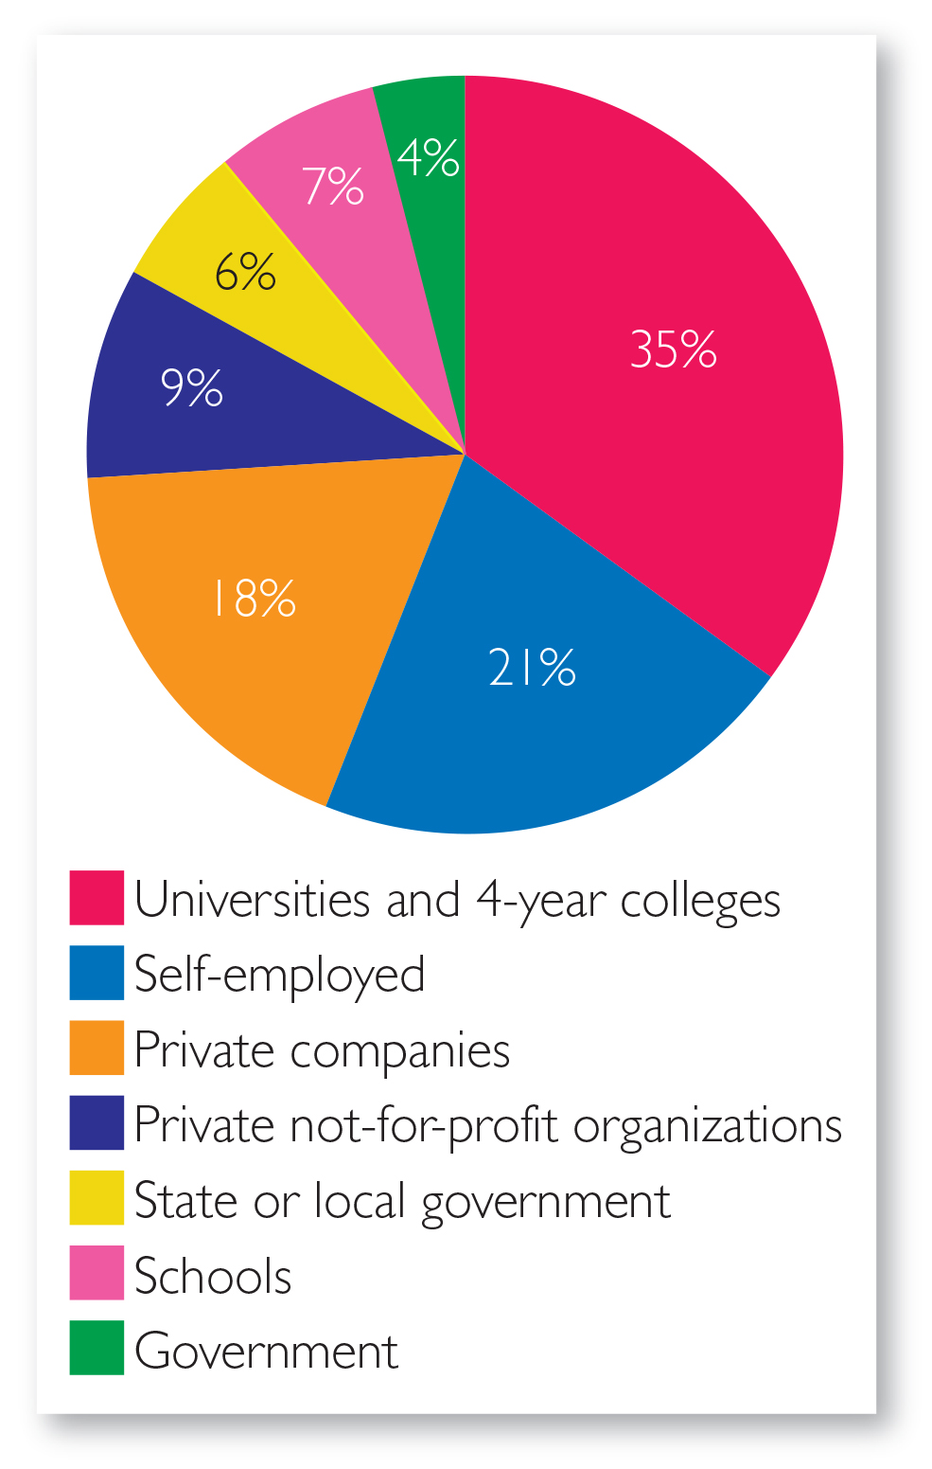
Figure 1.9 Approximate Distribution of Psychologists in Different Settings. Psychologists are employed in a diverse array of settings. (Based on data from the National Science Foundation, 2003)
Notes:
LO 1.8

Slide 29
Types of Psychologists LO 1.8 Describe different types of psychologists and identify what each of them does.
Clinical
Work with people who have mental disorders
Therapists may have different degrees (Psy.D., M.S.W., Ph.D., etc.).
Notes:
LO 1.8

Slide 30
Types of Psychologists LO 1.8 Describe different types of psychologists and identify what each of them does.
Counseling
Work with people experiencing temporary or self-contained problems (e.g., marital or occupational difficulties)
Notes:
LO 1.8

Slide 31
Types of Psychologists LO 1.8 Describe different types of psychologists and identify what each of them does.
School
Assess and develop intervention programs
Differs from educational psychology
Developmental
Study why and how people change over time
Most work with infants and children.
Notes:
LO 1.8

Slide 32
Types of Psychologists LO 1.8 Describe different types of psychologists and identify what each of them does.
Experimental
Use sophisticated research methods to study memory, language, and thinking of humans
Biopsychologists
Examine physiological bases of behavior
Most work in research settings.
Notes:
LO 1.8

Slide 33
Types of Psychologists LO 1.8 Describe different types of psychologists and identify what each of them does.
Forensic
Assess, diagnose, and assist with rehabilitation and treatment of prison inmates
Others conduct research on eyewitnesses or juries.
Notes:
LO 1.8

Slide 34
Great Debates in Psychology LO 1.9 Describe the two great debates that have shaped the field of psychology.
Two great debates have shaped the field of psychology, both currently and in the past.
Nature-nurture
Are our behaviors attributable mostly to our genes or our rearing environments?
Free will-determinism
To what extent are our behaviors freely selected, rather than caused by factors outside of our control?

Slide 35
How Psychology Affects Our Lives LO 1.10 Describe how psychological research affects our daily lives.
Two broad categories of research:
Basic research
Examines how the mind works.
Applied research
Examines how we use basic research to solve real world problems.

Slide 36
How Psychology Affects Our Lives LO 1.10 Describe how psychological research affects our daily lives.
Yellow fire engines, cars with three brake lights, sequential police lineups, and standardized college entrance tests are examples of the application of psychology.

Slide 37
Conclusions LO 1.10 Describe how psychological research affects our daily lives.
Learning to think scientifically will help you make better decisions not only in this course, but in everyday life.
When confronted with claims from popular psychology and popular culture, remember to “insist on evidence.”

