Slide 1
Socialization
Directions to view PowerPoint presentation:
First: if, when you open the PowerPoint, there appears along the top
a “Security Warning” that states that external media objects have
been blocked, click on the “Enable Content” button to the right.
Click on the icon circled
to the right (you will find
it at the bottom on the
right)p
The slides are not timed – they will not move from one to the
next until you either press “Return” on your keyboard or press
the arrows on the bottom right of your keyboard
© 2013, Professor Larry Stern, Department of Sociology, Collin College
All material on this powerpoint presentation is for Collin College class use only. Any unauthorized
duplication or distribution is prohibited.

Slide 2
Socialization
Socialization is a life-long process whereby cultural
beliefs, values, attitudes, norms, customs and traditions
are transmitted in a social setting and, in varying degrees,
are “learned” by the members of cultures and sub-cultures.
Each of the component parts of the culture are internalized
by individuals, as are the appropriate manners in which
one is to act and behave.
Socialization occurs in each stage of your life-course. It
begins on day one, the moment the newborn baby is
wrapped in either a pink or blue blanket, and continues
through childhood, adolescence, and adulthood.

Slide 3
Socialization
Each time you take on or occupy a new status, or social
position –a student, a husband or wife, a father or mother,
a teacher (or whatever occupation you choose), a retiree,
a widow – a process of socialization occurs.
Throughout the process, the socialization process helps you
develop a sense of “self.”

Slide 4
Socialization
The socialization process is universal, and the “process” is
exactly the same regardless of the actual content of the
culture that is being transmitted and learned.
In other words, the social process that shapes the beliefs,
values, attitudes, norms, customs and traditions of an
eagle scout is exactly the same process that shapes a
member of a juvenile gang.

Slide 5
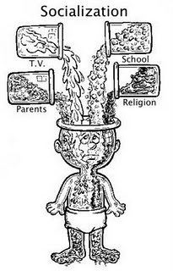
Socialization
There are various “agents” of socialization. Family, friends,
significant others, peers, primary, secondary and
reference groups, educators, and equally important, the
mass media – as you will see when you watch the trailer
for Jean Kilbourne’s “Killing Us Softly, 4: Advertising’s
Image of Women.”

Slide 6
Socialization
The movie that I have assigned, “Death in Gaza,” illustrates
the process and agents of socialization by examining the lives
of three children growing up along the Gaza strip – Ahmed
and his best friend Mohammud – two twelve-year-old boys –
and Najla – a sixteen-year-old girl. As you watch the film
after completing this power point, pay particular attention
to the processes and agents of socialization.

Slide 7
Socialization
To guide your thinking, apply the sociological concepts of
looking-glass self, role-models, significant and generalized
others, and primary, secondary, and reference groups.
Think, also, about how these children are being socialized by
the different institutions that make up society – how they
are learning about and from their families at home, their
teachers in schools, and their political and religious leaders.

Slide 8
Socialization
Next, consider how the process whereby Ahmed's and/or
Najla's learned about and came to embrace their culture’s
beliefs, values, attitudes, norms, customs and traditions no
different from the one you have experienced half a world
away in the United States.

Slide 9
Revisiting the
Interaction of
Nature and Nurture

Slide 10
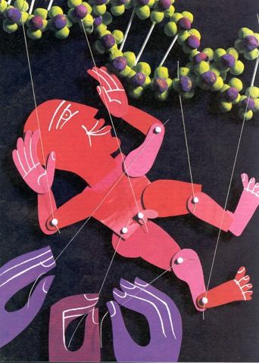
The Interaction of Nature and Nurture
As mentioned in the lecture on culture,
scholars today are more apt to give both
nature and nurture their due and
investigate how the two of them interact.

Slide 11
The Interaction of Nature and Nurture
The underlying assumption of these
scholars is that you simply cannot
disentangle the two – both: nature and
nurture work together simultaneously to
produce behavior.
They often use one of the two following
analogies:

Slide 12
The Interaction of Nature and Nurture
Which is more important in determining the area of
a rectangle? The length or the width?
Area = length X width
The typical answer is that they are equally important,
that each contributes 50% to the answer. But it is not
that simple. The important fact is that a “length” cannot
even exist without a “width,” and vice-versa. And, as a
result, it is impossible to measure one without the other
being present simultaneously.

Slide 13
The Interaction of Nature and Nurture
Similarly, consider this question: Which is more
responsible for the sound that is heard when a judge
hits his gavel on a table? Is it the gavel making contact
with the table, or the table vibrating upon being hit?
The answer, of course, is that both must occur
simultaneously – in unison – for the sound to be made.

Slide 14
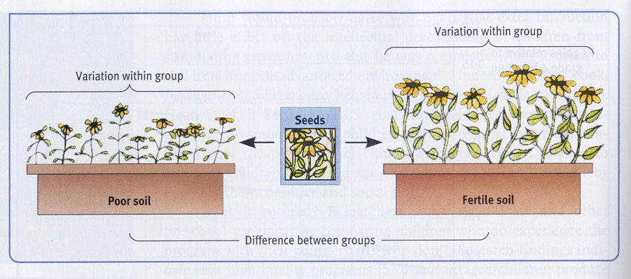
The Interaction of Nature and Nurture
When genetically identical seeds are planted in different
types of soil – one poor, the other fertile – although there
will be variation within groups – those seeds planted in
fertile soil, in the aggregate, will reach more of their genetic
potential that the identical seeds planted in poor soil.
Nourishment – from the environment – is necessary for
development.

Slide 15
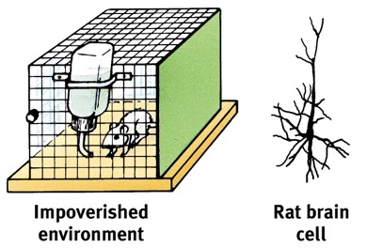
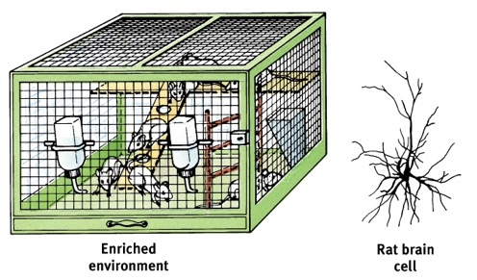
The Interaction of Nature and Nurture
Genetically identical rats are placed in either an impoverished
environment – the rat is isolated with nothing but a source of
food – or an enriched environment where the rats have
playmates as well as ramps and ledges to run and jump
about.
Look, now, at the brain cells of the rats when they
were sacrificed after spending roughly three months in
their cages. Notice the increased density of the dendrites in
their brains.

Slide 16
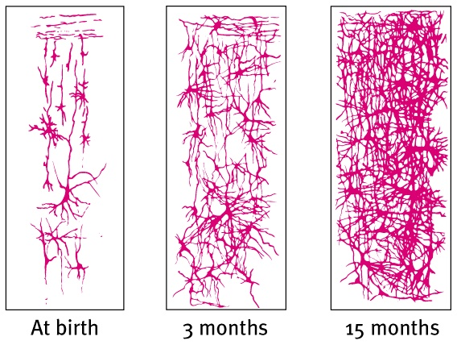
The Interaction of Nature and Nurture
The cerebral cortex of infants – provided that they have
sufficient nutrition and stimulation

Slide 17
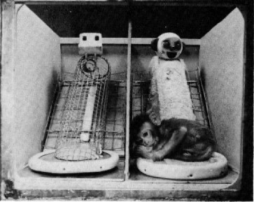
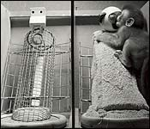
Social Isolation
A great deal of research indicates that depriving children
from social interaction causes developmental harm.
Read about Harry Harlow’s work with infant rhesus monkeys
in the beginning of the chapter on Socialization in the textbook.

Slide 18
Social Isolation
A great deal of research indicates that depriving children
from social interaction causes developmental harm.
Read, too, about the cases of Anna, Isabelle, and Genie.

Slide 19
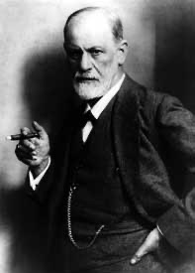
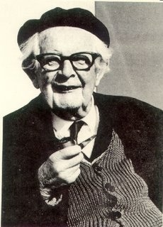
The Interaction of Nature and Nurture
As mentioned before, all major scholars who take human beings as
their subject matter – not just sociologists – incorporate both nature
and nurture into their theories.
Consider these two important figures in psychology: Sigmund
Freud and Jean Piaget.
Sigmund Freud
1856 - 1939
Jean Piaget
1896-1980

Slide 20
Sigmund Freud (1856 – 1939)
Theory of Personality Development
Freud’s model of personality has three analytically
separate part that interact.
The “id” refers to the person’s basic biological
drives – the nature part of the equation – which
are unconscious and demand immediate satisfaction.
The “superego” represents the demands of one’s
culture – the values and norms that the individual
learns and internalizes – the nature part of the
equation.
The “ego” is “the self”: It is the negotiated outcome
of conflicts that arise between one’s “id” and the
“superego.”

Slide 21
Sigmund Freud (1856 – 1939)
Theory of Personality Development
Id Superego
[Nature] [Nurture]
Ego
[Self]
Sometimes, the id takes precedence, in other
circumstances it is the superego. In still other
cases there is a compromise between the two.
Taken together, how internal conflicts are resolved
Make up the individual’s personality of self.

Slide 22
Jean Piaget (1896 – 1980)
Cognitive Theory of Development
Here is how Piaget incorporates both nature and
nurture: According to Piaget, children proceed
through four separate stages of cognitive development
and at each stage different cognitive capabilities
emerge.
In other words, at earlier stages, children have not
yet developed to the stage – this is the nature part of
the equation – where they can comprehend certain
important concepts and aspects of the world and
their environment – the nurture part.

Slide 23
Jean Piaget (1896 – 1980)
Cognitive Theory of Development
For example, “object permanence”: the understanding that objects
continue to exist even when they cannot be seen. This does not begin
to emerge until the child is between 4– 7 months of age and is usually
completed by 18 months.

Slide 24
Jean Piaget (1896 – 1980)
Cognitive Theory of Development
Or, “conservation”: when you present a child with two identical
glasses with the same amount of liquid, they will say that the amount
in each glass is the same. But if you pour the contents of one glass
into a taller – though more narrow glass, they will say that the narrow
glass has more liquid.
Read about each of Piaget’s stages in the textbook.

Slide 25
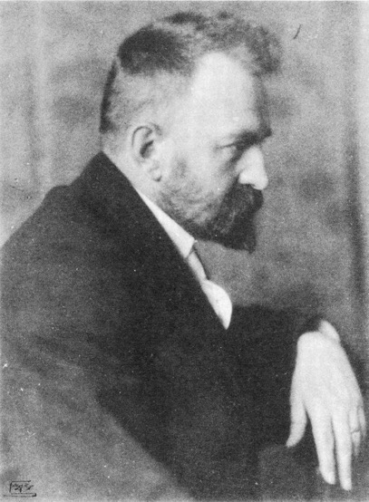
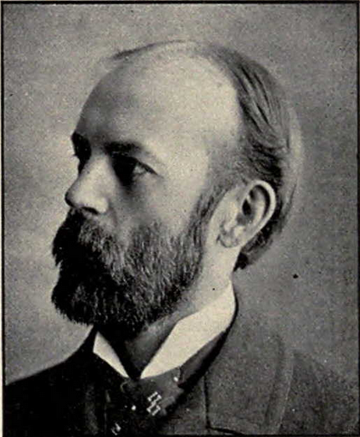
The Sociological Development of Self
George Herbert Mead & Charles Horton Cooley
George Herbert Mead
1863 - 1931
Charles Horton Cooley
1864-1929

Slide 26
George Herbert Mead
Development of Self
The “self”
That part of an individual’s personality that
includes self-awareness and self-image.
Mead rejected both the Freudian notion that
one’s personality is guided by biological drives
and Piaget’s argument that it’s a matter of
biological maturation.
Mead argues, instead, that the self develops
only with social experience

Slide 27
George Herbert Mead
Development of Self
The “self”
Our social experience depends upon
communication with others using shared
symbols: words, hand gestures, facial
expressions.
Human beings – social beings – find meaning in
actions by imagining other people’s underlying
intentions.
A dog responds to what you do, but a human
responds to what you have in mind as you do it.

Slide 28
George Herbert Mead
Development of Self
The “self”
We can train a dog using reward and
punishment – the behaviorist approach
advocated by Watson – but the dog does not
attach meaning to its actions.
If you train a dog to fetch your umbrella from
the hallway, but he can’t find it, not under-
standing what your true intention is, the dog
won’t bring your raincoat which is in plain view.

Slide 29
George Herbert Mead
Development of Self
“Taking the Role of the Other”
Understanding intention requires imagining a
Situation from the other’s point of view.
We imagine ourselves in another person’s
shoes and see ourselves as we think that other
person does.
This helps us anticipate how others will
respond to us even before we act.

Slide 30
George Herbert Mead
Development of Self
The “I” and the “Me”
By taking the role of others we become self-aware
– and the “self” has two parts:
The “I” is active, spontaneous, idiosyncratic,
and creative.
The “me” represents the social self. It is
acquired – learned in interaction with others
and one’s environment.
Other peoples’ attitudes, values, etc, once
internalized, become one’s “me.”

Slide 31
George Herbert Mead
Development of Self
“Significant Others”
One’s sense of “self” emerges through various
forms of social interaction with others and one’s
capacity to take the role of others.
Initially, a sense of self emerges in the form of
play, which involves taking on the roles of
significant others – people such as parents,
who have special importance.
Playing “house” and the role of either mommy
or daddy teaches children how to imagine the
world from a parents’ point of view.

Slide 32
George Herbert Mead
Development of Self
“Significant Others”
Gradually, children learn to take the role of
several others at once – now they learn
through playing games – where they learn to
anticipate others’ actions and attempt to
fit their actions into concert with these others.
Examples: playing baseball, football, basketball

Slide 33
George Herbert Mead
Development of Self
“Generalized Others”
Everyday life is much more complicated and
demands that we see ourselves how countless
others within our culture might see us.
Mead used the term generalized other to refer
to widespread cultural norms and values we
use as references in choosing to act one way
rather than another and in evaluating ourselves.

Slide 34
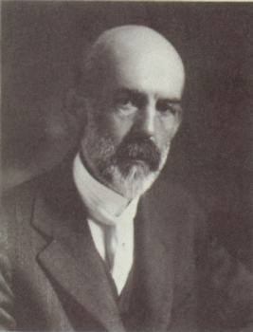
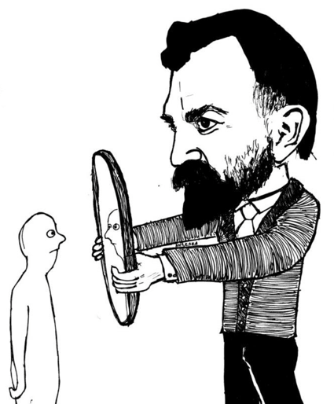
Charles Horton Cooley
“The Looking- Glass Self”
Our self-image is based on how we think others see us.

Slide 35
Charles Horton Cooley
“The Looking- Glass Self”
How do we acquire a sense of “self?”
According to Cooley there are three steps:
Based on the responses – the feedback –
individuals in a social situation receives from
others – especially significant others – they
imagine how they appear to others.
Next, they imagine how these others judge or
evaluate that appearance; positively or negatively.
Then, the they internalize the perceived
evaluative judgments of others and begin to
think of themselves in the same way.

Slide 36
Charles Horton Cooley
“Primary and Secondary Groups”
“By primary groups I mean those characterized by
intimate face-to-face associations and cooperation.
They are primary in several senses, but chiefly in
that they are fundamental in forming the social
nature and ideals of the individual.”

Slide 37
Charles Horton Cooley
“Primary and Secondary Groups”
Primary Groups Secondary Groups
Personal Impersonal
Expressive Instrumental
Small in Size Larger in Size
Stable, durable Less durable
Family Classmates
Close Friends Colleagues

Slide 38
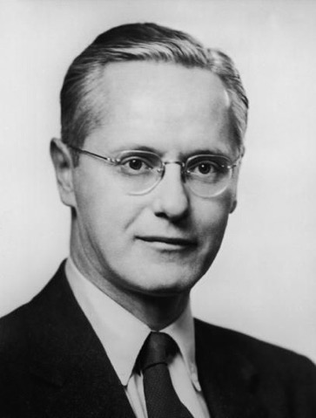
Robert K. Merton (1910 – 2002)
Reference Groups
A social group is two or more people who
Identify with and interact with one another.
A reference group is a social group that
serves as a point of reference when deciding
how one should behave, and then how well one
is doing when they behave.
These “groups” may or may NOT be groups
to which one claims membership or belongs.

Slide 39
Robert K. Merton (1910 – 2002)
Reference Groups
There are two types of reference groups.
Normative Reference Group: How should
I behave? What are norms and behavioral
expectations of the group?
If already a member of the group, processes of
“peer pressure” operate.
If not yet a member, but you would like to
belong, you start conforming to the norms to
make yourself more attractive to the group.
Here, a process known as anticipatory
socialization occurs.

Slide 40
Robert K. Merton (1910 – 2002)
Reference Groups
There are two types of reference groups.
(2) Comparative Reference Group: How am I
doing?
In this case, you use members of the group in which
you belong – or the group you would like to join –
as a frame of reference to evaluate yourself as
compared to them.
In some instances, even though by objective
measures you are doing quite well, you feel
inadequate when you compare yourself to others
who are doing better than you – you experience
relative deprivation.

Slide 41
Robert K. Merton (1910 – 2002)
Reference Individuals & Role – Models
The person who identifies with a reference individual
seeks to approximate a wide array of behavior and
values of that individual taken together in their
several social roles.
A role-model is more restricted in scope and refers
to the behavior and values of an individual in a
single specified role.

Slide 42
Robert K. Merton (1910 – 2002)
Reference Individuals & Role – Models
For example, if I were to say that I admire and would
like to be the person my father is as a total person –
the way he deals with life in general, his kindness,
his understanding, his curiosity – then I am using
him as a reference individual.
If I were to say, instead, that I would like to be the
kind of father to my children that my father was to
me and my sister, am referring to him as a
role-model.

Slide 43
Agents of
Socialization

Slide 44
Agents of Socialization
The Family
Each of the major institutions in society plays an important role in the
socialization process.
Thinking back to the main theoretical perspectives that we are covering –
functional analysis, conflict, and symbolic interaction – you should
remember that each focuses attention on different aspects of the social
world.
The functional approach will focus on how the family contributes to the
stability of society. In addition to providing safety, nutrition and
nurturance to infants, it teaches children the beliefs, values, attitudes,
norms, customs and traditions that are appropriate in their particular
culture; the difference between right and wrong.
As another way of seeing the importance attributed to the family, consider
that many analysts blame what they perceive to be the “breakdown of the
family” for many of society’s problems.

Slide 45
Agents of Socialization
The Family
The conflict approach reminds us that different sub-cultures exist in a
society and that some of the beliefs, values, attitudes, norms, customs
and traditions of one sub-culture are bound to be somewhat different
than others. Think, for a moment, about cultural differences among
people of different races, social classes, and geographical location.
The symbolic interaction perspective tends to focus upon the “how”
of socialization. How, for example, should parents discipline their
children? Sending them to “time out” in their room? Give them a
spanking? Hitting them with a “switch?” When does discipline shade
over into child abuse?

Slide 46
Agents of Socialization
Education
Our primary schools are designed primarily to teach the basic skills
needed to live in society –the three “Rs” of reading writing and
arithmetic (even though the latter two do not begin with the letter “R.”
But more, of course, is involved. Some of life’s lessons are taught as
well: share, play fair, don’t hit, don’t take things that aren’t yours,
clean up your own mess, and don't run with scissors. It is also
usually the first setting where children meet others who are
different from them in some way.
Some sociologists have examined what they refer to as the hidden
curriculum in primary schools. This refers to unwritten, unofficial,
and often unintended lessons, values, and perspectives that students
learn in school: learning to be prompt; conformity to authority;
learning to follow orders . . . All needed to be a good “worker” rather
than owner . . .

Slide 47
Agents of Socialization
Education
As seen in the short, required reading, “Children’s Books and Segregation
in the Workplace” by Steven Vallas, children’s books often reinforce the
conventional cultural attitudes in mainstream society by providing biased
and stereotypical depictions of males and females.
The same criticism was leveled at the popular series, Dick and Jane which
were used in classroom in the United States for nearly four decades, reaching
the height of their popularity in the 1950s, when 80 percent of first-grade
students in the United States were learning to read through these stories.
Class, gender, and racial biases were noted. Little girls were depicted as
passive and dependent, while "Mother" stayed at home, did housework,
and raised the children.

Slide 48
Agents of Socialization
Education

Slide 49
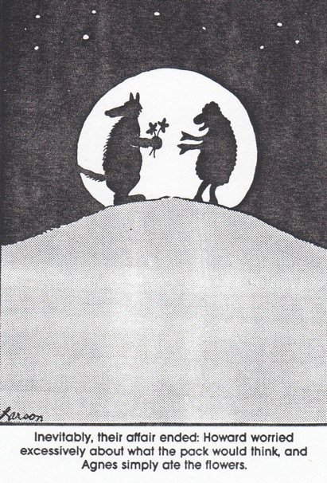
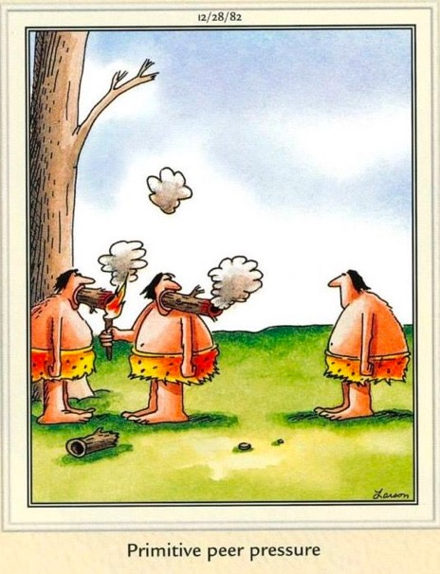
Agents of Socialization
Social Groups & Peer Pressure
Have you ever done something against your better judgment because you
were concerned about how your friends would respond?

Slide 50
Agents of Socialization
The Mass Media
The mass media is a powerful agent of socialization. The next two slides contain short
videos discussing how women are portrayed in advertising and the impact of these
depictions. The following two contain videos on how African Americans have been
portrayed in popular culture. The last one, a tour of The Jim Crow Museum, not only
indicates the impact of these depictions on the self-image of African Americans during
the Jim Crow era, but also serves as a tool to educate – or-re-socialize – members of the
dominant group so that they might re-interpret the portrayals they have seen.
What impact do you think that these depictions have? How have they shaped both the
self-image of women and African Americans and the way that they are perceived and
treated by others?

Slide 51
Agents of Socialization
The Mass Media
Jean Kilbourne’s “Still Killing Us Softly 4:
Advertising’s Image of Women”
(Make sure that the powerpoint is in presentation slide show mode).

Slide 52
Agents of Socialization
The Mass Media
Jean Kilbourne’s “Slim Hopes”

Slide 53
Agents of Socialization
The Mass Media
“Ethnic Notions”
Please notice the cartoons that appear during the first few minutes.
Cartoons . . . for children who are impressionable . . . white children . . .

Slide 54
Agents of Socialization
The Mass Media
“The New Jim Crow Museum”
Guided Tour

Slide 55
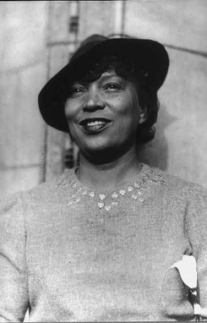
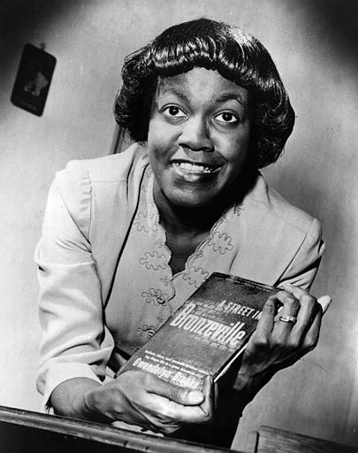
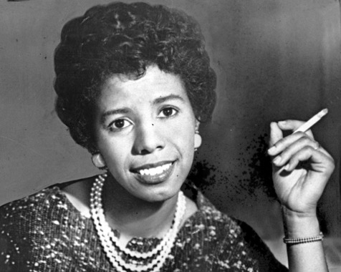
Agents of Socialization
The Mass Media
These troubling depictions of African Americans have also appeared on
television. During the 1950s, the following women provided important
role-models and reference individuals in the black community. Zora Neale
Hurston is considered one of the pre-eminent writers of twentieth-century.
An African-American poet, Gwendolyn Brooks won the Pulitzer Prize for
Poetry in 1950. And an American playwright and writer, Lorraine
Hansberry’s A Raisin in the Sun made her the first African-American woman
to produce a drama on Broadway in 1959.

Slide 56
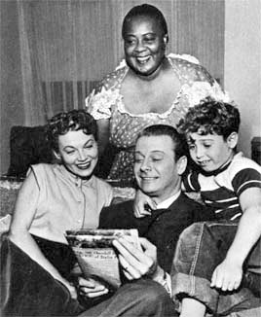
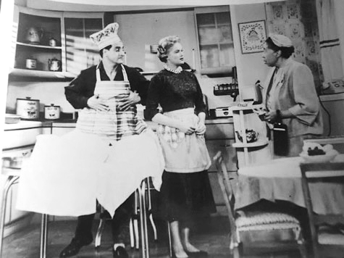
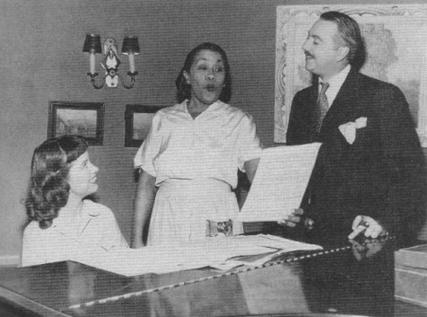
Agents of Socialization
The Mass Media
But throughout the 1950s the only roles available to black women were
housekeepers, or Mammys. Louise Beavers played the role of Beulah, “the
Queen of the kitchen,” in the first nationally broadcast weekly television
series starring an Afro-American in the leading role (1950-1952). Next
came Amanda Rudolph who played a housekeeper on the popular show
with Danny Thomas, Make Room for Daddy (1954-1964). Amanda’s sister
played Birde, the “good natured housekeeper on The Great Gildersleeve
(1955).

Slide 57
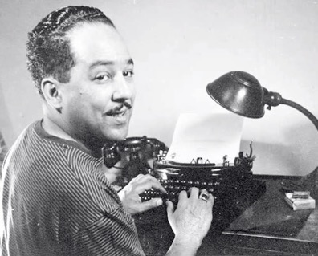
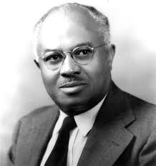
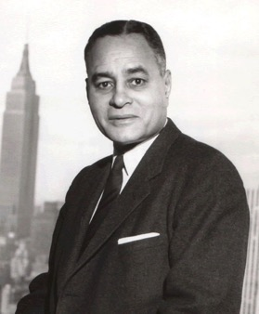
Agents of Socialization
The Mass Media
There were also many prominent black role-models in the black
community at the time: An important American poet, novelist, playwright,
and columnist, Langston Hughes was recognized as an important literary figure
during the 1920s, a period known as the “Harlem Renaissance.” E. Franklin
Frazier was a prominent sociologist. His book, The Negro Family in the United
States,was awarded the 1940 Anisfield-Wolf Book Award for the most
significant work in the field of race relations. And Ralph Bunche, an American
political scientist, academic, and diplomat, received the 1950 Nobel Peace Prize
for his role as mediator in the dispute over Palestine.

Slide 58
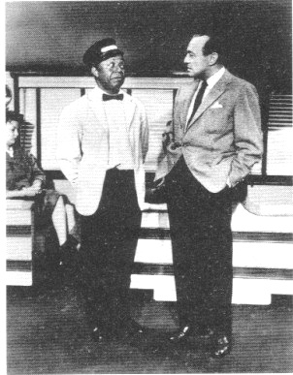
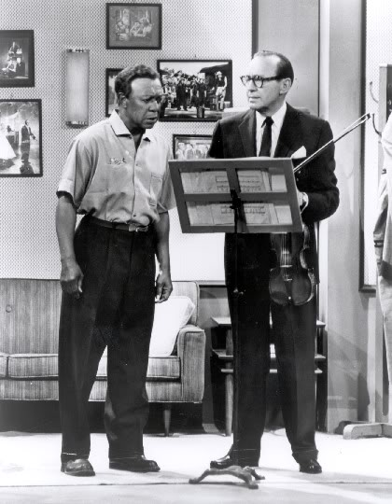
Agents of Socialization
The Mass Media
And yet, the roles available to black men portrayed them as servants,
lazy and shiftless, menial workers, child-like, incompetent characters
or con-artists.
On the Jack Benny Show, which ran for seventeen years from 1950 to 1966,
Eddie “Rochester” Anderson played Benny’s valet and driver.

Slide 59
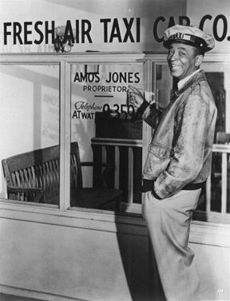
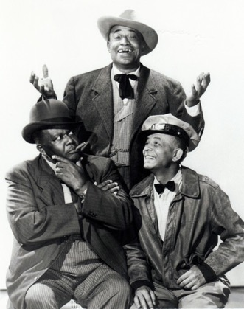
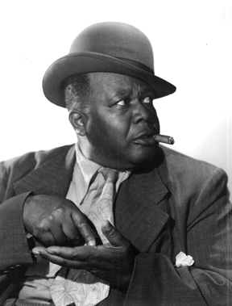
Agents of Socialization
The Mass Media
When Amos ‘N’ Andy – which was a major hit on radio – aired aired in 1951,
the NAACP immediately protested, claiming that “Amos ‘n’ Andy depicts the
Negro in a stereotyped and degrading manner . . . . It strengthens the
conclusion among uninformed or prejudiced people that Negroes and other
minorities are inferior, lazy, dumb, and dishonest.” Characters on the show
are portrayed as “quacks and thieves, slippery cowards ignorant of their
professions.”

Slide 60
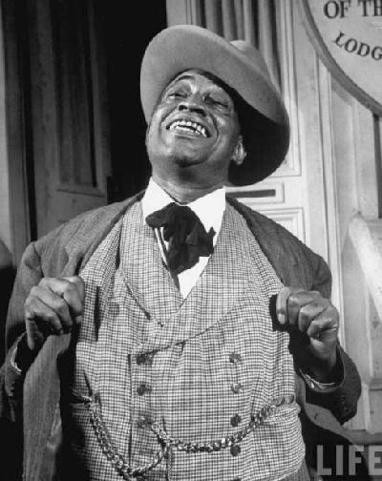
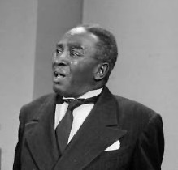
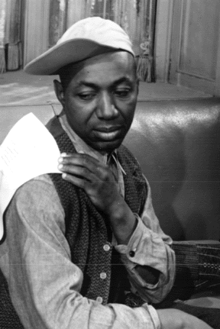
Agents of Socialization
The Mass Media
And, in fact, the show had as main characters Tim Moore as the lying,
scheming George Stevens, a.k.a. “The Kingfish,” Johnny Lee as the
incompetent lawyer Algonquin J. Calhoon, and Willie Best as the lazy
janitor named Lightnin.’

Slide 61
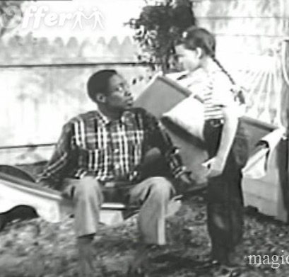
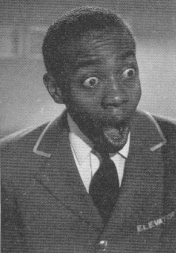
Agents of Socialization
The Mass Media
After Amon ‘N’ Andy was cancelled, Willie Best landed two roles: one as
a likeable childlike dunce and handyman for a family in The Trouble With
Father, and then as ‘Charlie,” the constantly startled and “bug-eyed”
elevator “boy” in My Little Margie.

Slide 62
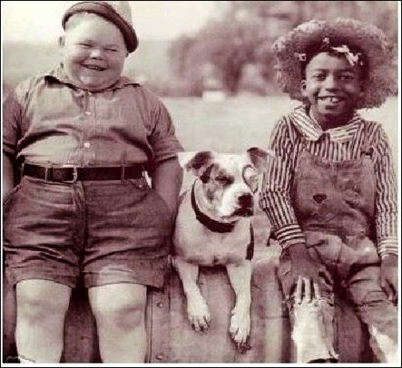
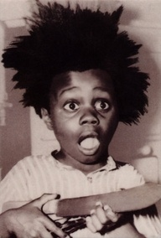
Agents of Socialization
The Mass Media
And, of course, let’s not forget Buckwheat on ‘Lil Rascals.
During our next unit, on Race, Prejudice, and Discrimination, we will
continue this discussion and examine how these images can lead to
prejudicial attitudes and discriminatory actions.

