Slide 1
The Sociological Study of Collective Behavior
and Social Movements
© 2020, Professor Larry Stern, Department of Sociology, Collin College
All material on this PowerPoint presentation is for Collin College class use only. Any unauthorized
duplication or distribution is prohibited.

Slide 2
The Sociological Study of Collective Behavior
and Social Movements
Collective Behavior refers to a wide series of behaviors that involve large numbers of people
that are typically – but not always – spontaneous, unorganized and unpredictable. As shall
be seen, there are many behaviors that share these features but, at the same time, have very
little in common with one another. Examples include various types of crowd behavior, mobs,
panics, riots, mass hysteria, rumors, fads and fashions, and crazes.
Although most collective behavior is unpredictable and thus extremely difficult to study,
sociologists have uncovered some important conditions that affect their emergence as well
as patterns concerning their life-course and those drawn into them.
Social movements, on the other hand, are organized effort by a large number of people to
bring about or impede social, political, economic, or cultural change. Examples include the
civil rights movements, the women’s movement, the Chicano movement.

Slide 3
The Sociological Study
of Collective Behavior

Slide 4
Types of Collective Behavior: Crowds
A crowd is a temporary gathering of people who share a common focus of attention:
examples are attendees of rock-concerts, sporting events, political demonstrations.
In some instances, crowd behavior turns into a riot; i.e. soccer events in Europe.

Slide 5
Types of Collective Behavior: Riots
A riot is a social eruption that is highly emotional, violent, and undirected –
it usually has no clear goal, except to express dis-satisfaction. The cause is typically
some longstanding grievance. It is usually ignited by a particular incident.

Slide 6
Types of Collective Behavior: Mobs
A mob is a highly emotional crowd that pursues a violent or destructive goal.

Slide 7
Types of Collective Behavior: Mass Hysteria
Salem Witch Trials: Mass hysteria refers to widespread, intense fear of and concern for a
danger that turns out to be false or greatly exaggerated.

Slide 8
Types of Collective Behavior: Mass Hysteria
Toilet Paper Shortages

Slide 9
Types of Collective Behavior: Panics
On October 30, 1938, actor and director Orson Welles aired a radio adaptation of this famous
story by H. G. Wells, which involved a Martian invasion of Earth. The show depicted the invasion
occurring in New Jersey and New York, and thousands of listeners reportedly thought that an
invasion was really occurring.

Slide 10
Types of Collective Behavior: Raves
A rave (from the verb: to rave) is an organized dance party at a nightclub, an outdoor festival,
warehouse, or other private property or public spaces, typically featuring performances by DJs,
playing a seamless flow of electronic dance music. Raves usually take place in dark rooms filled
with laser lights and strobes. They typically last for 24 hours. Law enforcement agencies suspect
a lot of drugs, including Ecstacy, are used by participants and have tried to make raves illegal.

Slide 11
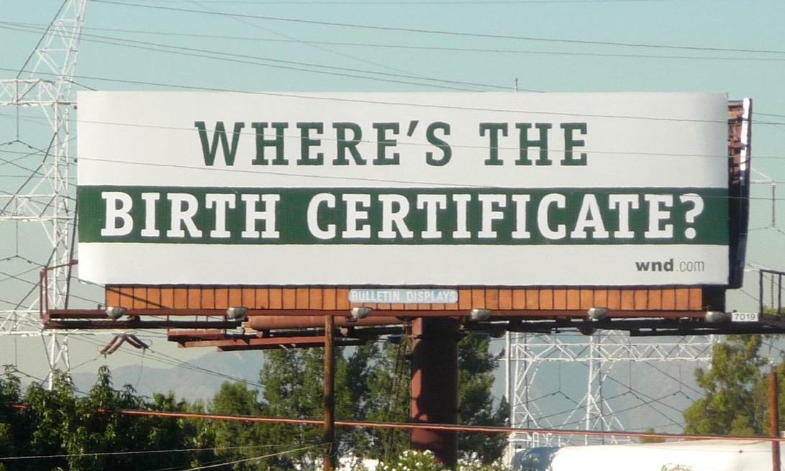
Types of Collective Behavior: Rumors
A rumor refers to “unconfirmed information that people spread informally, by word of mouth or
by using electronic devices. In today’s electronic age, rumors can be spread very quickly over the
internet and via Facebook, Twitter, and other social media. Rumor thrives in a climate of uncertainty,
when people care about some issue but are unsure of the facts.

Slide 12
Types of Collective Behavior: Fads & Crazes
A fad is a rather insignificant activity or product that is popular for a relatively short time, while
a craze is a temporary activity that attracts the obsessive enthusiasm of a relatively small group
of people. Fads and crazes throughout the years include goldfish swallowing, stuffing people into
a telephone booth, and the notorious campus behavior known as streaking. Products that became
fads include Rubik’s Cube, Pet Rocks, Cabbage Patch dolls, and Beanie Babies.

Slide 13
Types of Collective Behavior: Fashion
Fashion refers to social objects favored by a particular segment of the population, such as taste
in clothing, music, automobiles, the next techno-device and certain types and ideas.

Slide 14
Explaining Collective Behavior Contagion Theory
Sociologists focus their attention of two different theories to explain collective behavior – but
keep in mind that there are several different types of collective behavior and no one theory
can provide a definitive explanation of each.
Contagion Theory: Developed by French scholar Gustave Le Bon, this
theory stresses that when individuals are by themselves they act
rationally, but when they are in a crowd, they come under its almost
hypnotic influence and act irrationally and emotionally. They no
longer can control their unconscious instincts and become violent
and even savage. In short, contagion theory argues that collective
behavior is irrational and results from the contagious influence of
the crowds in which individuals find themselves.
(1841–1931)

Slide 15
Explaining Collective Behavior Convergence Theory
Sociologists focus their attention of thwo different theories to explain collective behavior – but
keep in mind that there are several different types of collective behavior and no one theory
can provide a definitive explanation of each.
Convergence Theory: This theory states that the way people act in crowds or publics is an
expression or outgrowth of who they are ordinarily. It argues that like-minded people come
together in, or converge on, a certain location where collective behavior can and will take
place, where individuals can act out tendencies or traits they had in the first place.
Convergence theory does not deny that people may do something in a crowd that they would
not do by themselves, but it does say that what a crowd does largely reflects the individuals
who compose it. If we think of a mob or at least a small group of people who commit a hate
crime—for example, gay bashing—we can see an application of convergence theory. The
individuals who form this group are people who hate homosexuality and who hate gays
and lesbians. The group violence they commit reflects these pre-existing beliefs.

Slide 16
The Sociological Study
of Social Movements

Slide 17
The Sociological Study of Social Movements
Neil Smelser introduced what has been called the “structural strain” theory to explain the
emergence of social movements. He identified six different conditions that are present
and the problems that each poses that must be solved if the movement is to get off
the ground and succeed. As shall be seen, John McCarthy and Mayer Zald extended this
approach by focusing exclusively on stage 5, resource mobilization.
Structural Strain – Grievance
Structural Conduciveness
Generalized Beliefs
Precipitating Factors
Resource Mobilization
Mechanisms of Control
Neil Smelser
1930 - 2017

Slide 18
The Sociological Study of Social Movements
Structural Strain
A structural strain refers to a social problem – or set of circumstances –
in society that causes difficulties for certain segments of society. But
notice that the strain is “structural, which is to say that the circumstance
that is of concern is not a random event but, instead, “patterned” and has
occurred over time. In many instances, the “strain” is caused by the
institutional arrangements of society that privilege some groups while
victimizing others.
But, as we saw in the last unit on social problems, rarely does a
complete consensus exist in society on whether or not a given condition
is a social problem. What constitutes a social problem, then, is the
outcome of an extended set of social negotiations between different
groups with markedly different sets of legitimate beliefs, values,
attitudes, perceptions, interests, and power.
This first hurdle, then, is quite formidable and difficult to navigate.
Neil Smelser
1930 - 2017

Slide 19
The Sociological Study of Social Movements
2. Structural Conduciveness
Structural Conduciveness refers to the socially patterned – structural –
aspects of the social setting are conducive to getting a social movement
started; for “spreading the word” and trying to convince others of the
reality and significant implications of a problematic state of affairs.
Consider, for example, the difficulties that organizers would face in a
totalitarian society where the public expression of dissent is punished,
as compared to an “open” society where the flow of information is
facilitated by an open press and social media such as Facebook and
twitter.
Social media played a significant role during the so-called “Arab
Spring,” a revolutionary wave of demonstrations and protests in the
Middle East and North Africa between 2010 and 2012. Protesters used
social media to organize demonstrations and disseminate information
about their activities and raise local and global awareness of ongoing events.
Neil Smelser
1930 - 2017

Slide 20
The Sociological Study of Social Movements
3. Generalized Beliefs
“Spreading the word” about the existence of circumstances that should
be defined as a social problem – with the intent of recruiting others to
help form a social movement – is not an easy matter even if one has
access to various channels of communication. Long, involved, and
specific messages are often unsuccessful in generating interest,
especially when others have other concerns.
So, rather than using detailed arguments, the goal at this stage is to
outline a set of generalized beliefs, typically involving short slogans
that describe the main issues and makes the situation meaningful to
others. The slogan sensitizes others that a problem exists, even if a
movement has not yet formed. Examples include the “Me Too”
Movement, “Black Lives Matter,” “Occupy Wall Street,” “Yes, We Can,”
“Speed Kills,” “Just Say No,” ‘No means NO.”
Neil Smelser
1930 - 2017

Slide 21
The Sociological Study of Social Movements
4. Precipitating Factor
A precipitating factor refers to a specific event – usually a dramatic event –
that acts as a catalyst or “trigger” that brings renewed attention to the
structural strain that has been previously identified. An example would
be an accident at a nuclear plant, which spurs action by those who
have already been sensitized to the potential dangers of nuclear energy.
It is at this point that leaders begin to emerge and the next step in the
formation of the movement is seriously undertaken: the mobilization
of resources.
Neil Smelser
1930 - 2017

Slide 22
The Sociological Study of Social Movements
5. Resource Mobilization
There will always be structural strains in society, as well as access
to channels of communication through which generalized beliefs can
be formed. In addition, nearly any major event can become a precipitating
factor that might set a new movement in motion. But the majority of
structural strains and potential social problems that exist in society do
not lead to the formation of social movements.
According to John McCarthy and Mayer Zald, the main stumbling
block is the inability to acquire the resources – the time and energy of
individuals and the money needed to meet expenses – that are necessary
for a movement to grow. People are needed to fill leadership roles, devise
tactics and strategies in the pursuit of the movement’s goals, write articles
or go door-to-door to recruit others, and fill bureaucratic positions so that
web pages can be maintained, phones can be answered and materials can
be printed and sent out through the mail. In addition, funds are needed to
pay the bills to rent office space and other expenses.
John McCarthy
Mayer Zald

Slide 23
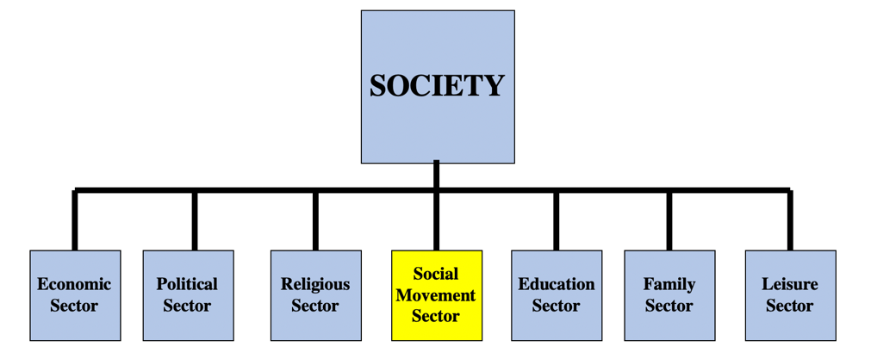
The Sociological Study of Social Movements
5. Resource Mobilization
McCarthy and Zald argue that the mobilization of resources always occurs in a competitive
setting. As seen above, society is broken down into separate sectors (or parts). The Social
Movement Sector (SMS), that part of society that encompasses all social movements and social
movement activity, competes with other sectors – i.e., economy, polity, religion, education,
family, entertainment/leisure – for an individual’s scarce time and material resources. Think
about the statuses – the social positions – that you occupy in each of these sectors, each making
a legitimate claim on your time and energy. These other sectors are typically given priority
leaving little if any time to join a social movement even if you readily support its goals.

Slide 24
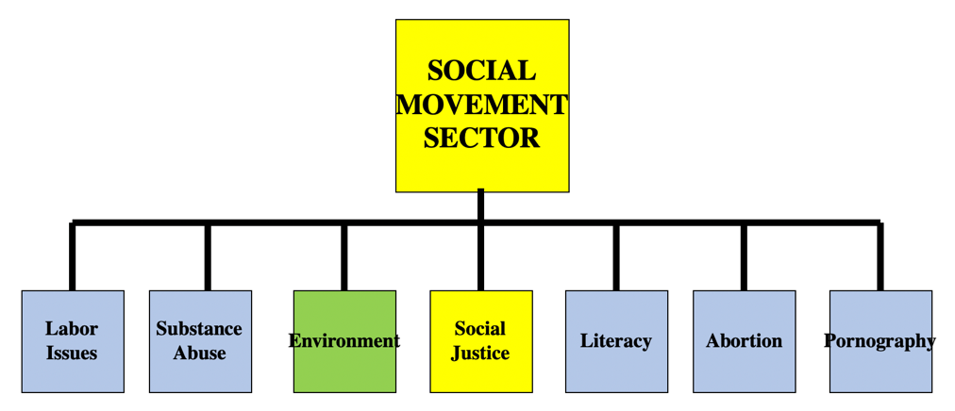
The Sociological Study of Social Movements
5. Resource Mobilization
The Social Movement Sector can itself be broken down into different parts, which McCarthy
and Zald refer to as Social Movement Industries (SMIs), with each one devoted to a specific
set of issues and problems. Here, as before, there exists a competitive setting, with each SMI
competing for the attention and contributions of potential recruits. So, if an individual decides
to carve out and devote some of their scarce time to a social movement, which type will they
choose? Those focused on issues of social justice? The environment? Abortion?

Slide 25
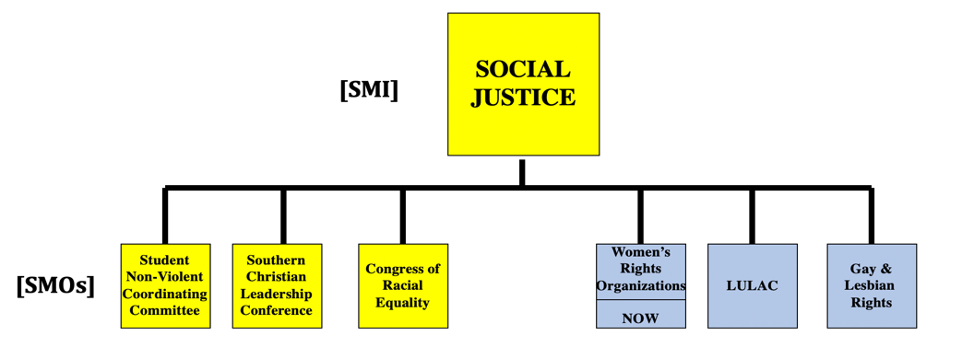
The Sociological Study of Social Movements
5. Resource Mobilization
Let’s say that an individual has decided to participate in a social movement that focuses upon
issues of social justice. Within that social movement industry there are several specific Social
Movement Organizations (SMOs), and here, once more, competition for resources – people, funds –
is rampant and a serious concern.
As seen above, there are many different issues that fall under the heading of social justice: race
relations, women’s rights, LGBT rights. Which will an individual choose? And here, we often find
social movement organizations that typically agree on the same set of goals – the Student
Non-Violent Coordinating Committee, the Southern Christian Leadership Conference, the Congress
of Racial Equality – that nevertheless must compete with each other for needed resources.

Slide 26
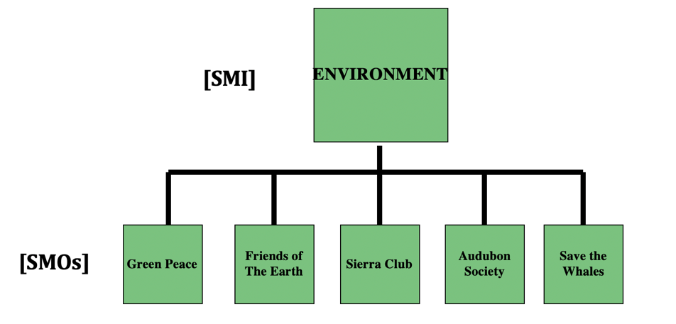
The Sociological Study of Social Movements
5. Resource Mobilization
Or, instead, an individual chooses to work for environmental change. Each of the specific
Social Movement Organizations (SMOs) listed above must develop the organizational capacity
to mobilize resources (money, people, and skills) to successfully compete with other organizations
that share their overall goals.

Slide 27
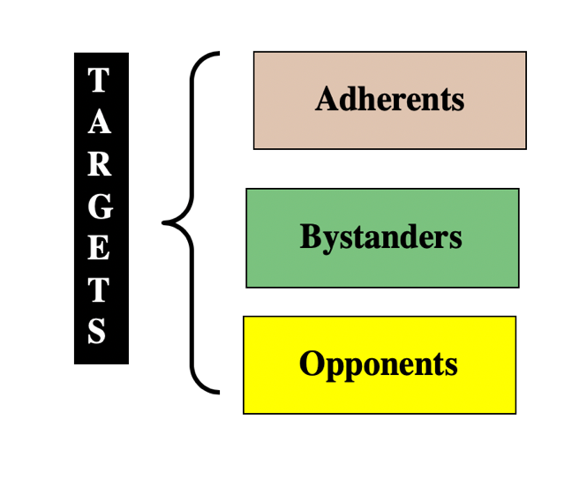
Potential Recruits & the Tactics and Strategies
used to Convince Them to Join
To be successful, social movements must develop the organizational
capacity to mobilize resources (money, people, and skills) and compete
with other organizations to reach their goals.
There are three different “audiences” or targets, and each typically
requires a different set of tactics and strategies to gain their support.
“Opponents” are generally antagonistic to the goals and principles
of the movement and will be the most difficult to reach; the goal here
is to counter their beliefs and attitudes concerning the issue at hand;
they need to be converted to the cause.
“Bystanders” are typically indifferent to the movement or ignorant
of the issues involved; they need to be informed.
“Adherents” agree in principle with the goals but have not contributed
resources to the movement; they need to be moved to action.

Slide 28
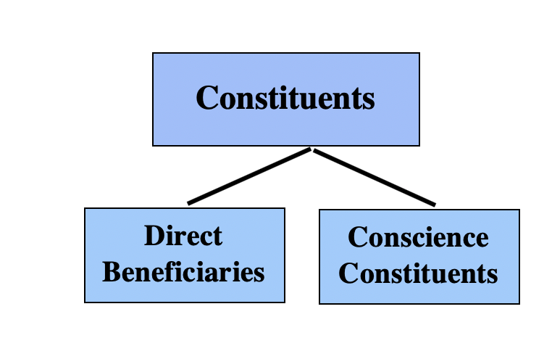
Members of Social Movements
There are two types of social movement members or
“constituents.”
“Direct Beneficiaries” are those members who will directly
benefit should the social movement attain its stated goals;
i.e., minorities in the Civil Rights movement; women in the
Women’s movement
“Conscience Constituents” are those members who do not
stand to benefit if the social movement attains its stated
goals. They join because the goals are compatible with their
values. Since they do not benefit, their participation adds
Legitimacy to the movement which, without their support,
would be a mere ”interest group.”

Slide 29
Categories of People Involved in
The Analysis of Social Movements
Constituents
“Constituents” devote varying amounts of either their time,
energy, or material resources to the movement; “activists” vs.
“mere supporters;” some join because they will benefit if the
movement is successful, others join because it is compatible with
their values.
Direct
Beneficiaries
Conscience
Constituents
“Adherents” agree in principle with the goals but have not
contributed resources to the movement; they need to be moved to
action.
T
A
R
G
E
T
S
Adherents
Bystanders
“Bystanders” are typically indifferent to the movement or ignorant
of the issues involved; they need to be informed.
Opponents
“Opponents” are generally antagonistic to the goals
and principles of the movement; they need to be converted.

Slide 30
Types of Social Movements
Sociologists classify social movements according to several variables – no one scheme is
universally accepted. The scheme presented below takes into account who is being changed
by the social movement – specific individuals such as men who join the “promise keepers”
movement or ”alcoholics anonymous – and and the degree of change – whether it is radical
or more limited – that is sought.
Degree of Change
Limited Radical
Alternative
Social
Movement
(Promise Keepers)
Redemptive
Social
Movement
(Alcoholics
Anonymous)
Specific
Individuals
Who is
Changed
Reformative
Social
Movement
(NOW, SNCC, MADD)
Transformative
Social
Movement
(Millennial,
Communist)
Everyone

Slide 31
Types of Social Movements
Aldon Morris and Naomi Braine use a different scheme, based on the specific goals of social
movements, and identifies three different types:
Liberation Movements: populated by members of oppressed groups who draw on
pre-existing “oppositional culture” and organizations; i.e., black churches were a primary
source of movement leadership and the participatory tradition and cultural forms of the
Church were the backbone of the civil rights movement.
Equality-based Special Issue Movements: focus on specific issues that affect particular
oppressed groups; i.e., the abortion rights movement.
Social Responsibility Movements: challenge certain conditions that affect the general
population; “suddenly imposed grievances” such as nuclear accidents, oil spills, Mothers
Against Drunk Driving (MADD).

Slide 32
Stages and Life Cycle of Social Movements
Other sociologists, like Herbert Blumer and Charles Tilly, have identified specific stages in
the life-cycle of social movements: Emergence, Coalescence, Bureaucratization, and Decline.
Emergence
Coalescence
Bureaucratization or Institutionalization
Decline
In the first preliminary stage, referred to as emergence, people first become aware of an issue and
leaders emerge. This is followed by the coalescence stage when people join together and organize
in order to publicize the issue and raise awareness. During the third stage, referred to as either
The bureaucratization or institutionalization stage, the movement no longer requires grassroots
volunteerism: it has become an established organization, typically peopled with a paid staff. The
final stage is one of decline, which may occur for several reasons: the success of the movement,
organizational failure, Co-optation by other movements, or Repression by powerful authorities.

Slide 33
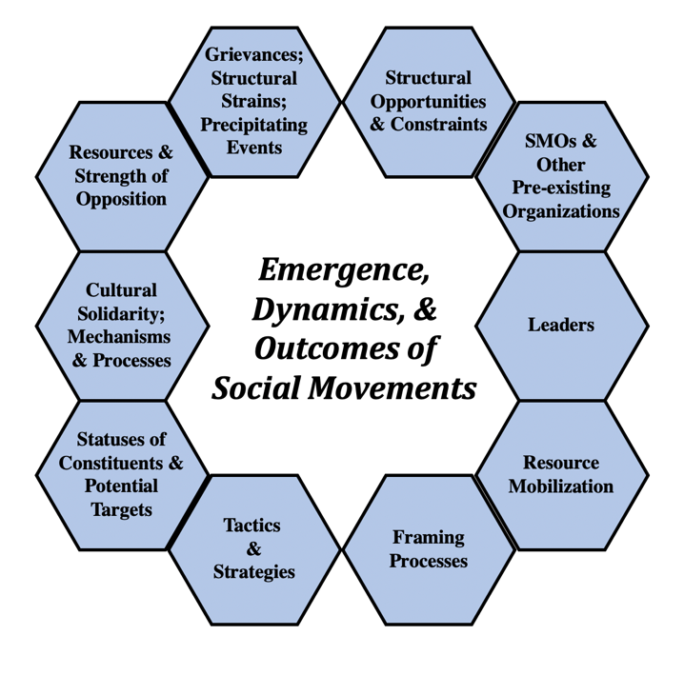
Emergence, Dynamics, & Outcomes
of Social Movements
Given the diversity of social movements it is no easy task
to study their emergence, dynamics (how they operate),
and outcomes (success or failure). As always, things get
complicated.
The figure on the right consolidates many of the key
elements involved in such an analysis. A few of these –
structural strains, precipitating events, structural
opportunities (or structural conduciveness), resource
mobilization, and the different types of constituents and
potential targets for recruitment – have already been
discussed.
In what follows I will provide examples of four more of these
elements: the role of leaders, tactics and strategies, the strength
of the opposition and last how music leads to the social solidarity
of movement members.

Slide 34
Leaders of Social Movements

Slide 35
Social Movement Leaders: Questions
What social processes are involved in the emergence of leaders in social movements?
What social factors– all apart from personality and leadership style – affect the likelihood
that one or another person is elevated to that position?
How do leaders gain legitimate authority in social movements once they attain that position?
Is leadership democratic, autocratic, charismatic?
What are the different types of functional roles that leaders fill?
Are their different levels of leadership, each with specific goals and spheres of influence?
How are differences in opinion over goals, tactics, and overall strategy – which invariably
occur – managed?
How does all this – and more – affect the emergence, dynamics, and outcomes of social
movement processes?

Slide 36
Leaders
Leaders are critical to social movements: they inspire commitment, mobilize resources, create
and recognize opportunities, devise strategies frame demands, and influence outcomes.
Any approach to leadership in social movements must examine the actions of leaders within
social contexts that both limit and facilitate opportunities, recognize the different levels
of leadership, and understand the various functional roles filled by different types of
movement leaders at different stages in movement development.
Four ideal types of leadership tiers often exist within movements:
Formal Leaders
Leadership Team
Bridge Leaders
Organizers

Slide 37
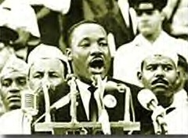
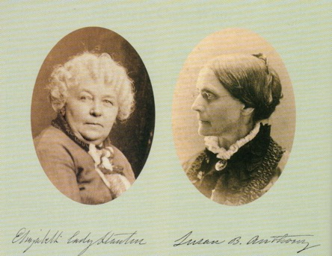
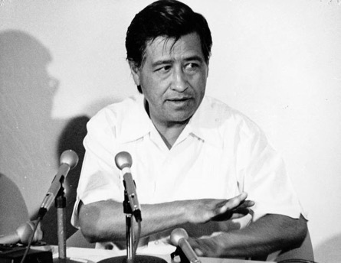
Formal Leaders
The first tier consists of leaders who occupy the top formal leadership positions. The formal
leaders typically the most visible members and the spokesperson of any given movement –
they provide the public face of the movement.
In addition to articulating the main positions of the movement, devising movement strategies,
and rallying the movement base, successful leaders are able to capitalize on connections to elites
in other sectors such as political parties, unions, and mass media and turn them into allies.
Martin Luther King
Elizabeth Cady Stanton
Susan B. Anthony
Cesar Chavez

Slide 38
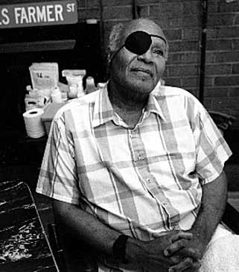
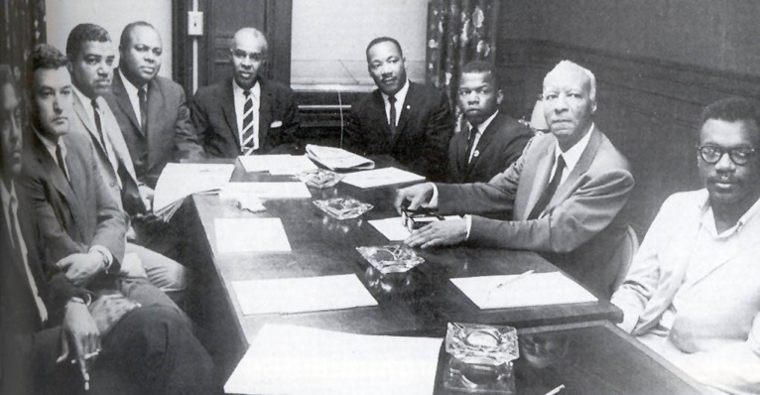
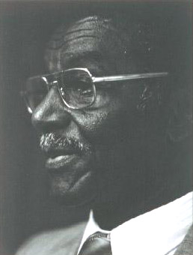
Leadership Team
The second tier consists of those who constitute the immediate leadership team chosen by
formal leaders. Such leaders often occupy secondary formal positions within movements.
Social movement leaders in these two tiers tend to come from the educated middle and upper
classes, are disproportionately male, and usually share the race or ethnicity of their supporters.
James Farmer
Congress of Racial Equality
Fred Shuttlesworth
Southern Christian Leadership Conference

Slide 39
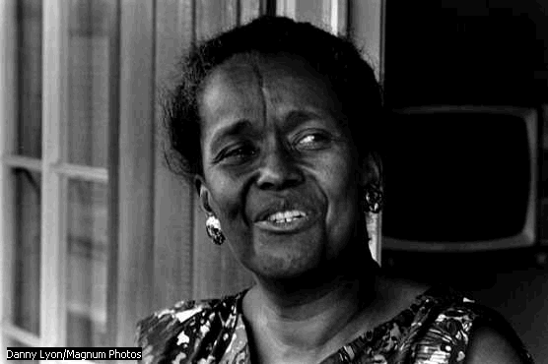
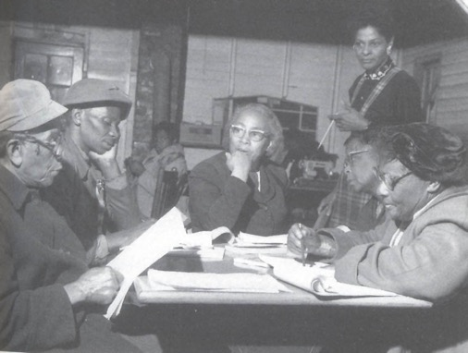
Bridge Leaders
The third leadership tier consists of bridge leaders. Bridge leaders are those neighborhood and
community organizers who mediate between top leadership and the vast bulk of followers.
Such leaders also perform the bulk of a movement’s emotional work and may play dominant
roles during periods of crisis and spontaneity. During the civil rights movement, many women
who were previously active in churches and in community organizations became bridge leaders
who connected other members of the community to the movement.
Ella Baker
1903-1986
Septima Clark
1898 - 1987

Slide 40
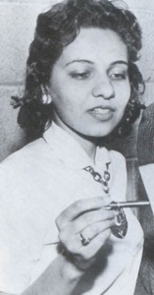
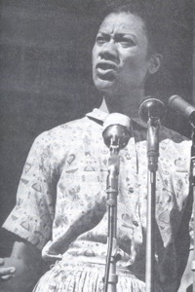
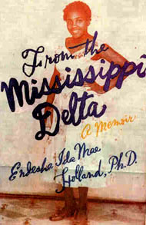
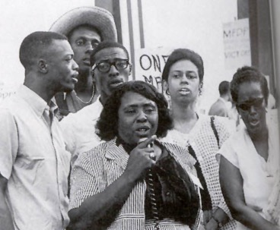
Organizers
The fourth tier of leadership consists of those organizers who, in addition to building
connections between members of the local movement and helping them develop organizations,
also routinely engage in leadership activity.
Bridge leaders and organizers typically learn “what works” through on the job hands-on
experience. They affect movement success through their work within the movement, mobilizing
the support necessary to carry out collective action tactics, which result in concrete gains for
the movement.

Slide 41
Tactics and Strategies
Used in Social Movements
Litigation
Legislation
Direct Action:
Sit-Ins
Boycotts
Forcing Compliance with Federal Law
Demonstrations and Marches
Voter Registration Drives

Slide 42
Tactics and Strategies
Tactics and strategies will vary depending upon the immediate goal – i.e., attracting members
and mobilizing resources, publicizing grievances to reach a national audience, confronting the
perceived cause or those responsible for the grievance.
Tactics and strategies will change during the life-course of the movement as it matures.
Tactics and strategies will change in response to both local and national circumstances – i.e.,
past successes and failures of movement tactics and the response of the targeted group.
Tactics and strategies are affected by the ongoing social constraints and opportunities of the
situation – the rise and importance of mass media; the schism in the Democratic Party
once President Johnson signed the Civil Rights Act.

Slide 43
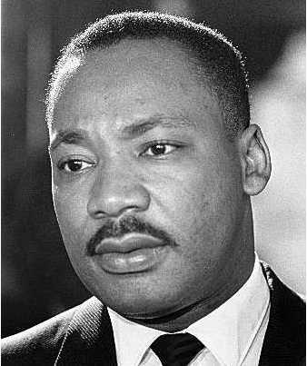
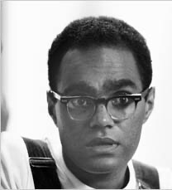
Tactics and Strategies
There will be times when leaders of different Social Movement Organizations, sensitive to
their local constituents and concerns, will advocate different tactics and strategies, causing
strains and fractures in the larger movement.
For example, during the Civil Rights Movement, Martin Luther King and
the Southern Christian Leadership Conference favored mobilizing the
community around a particular campaign to capture national attention
and, as a result, SCLC members stayed in communities for short periods
of time – arriving to set up marches and press conferences and then
leaving once the demonstrations were concluded.
In marked contrast Bob Moses, the leader of the Student Non-Violent
Coordinating Committee, made certain that SNCC members remain
for the long haul, looking to develop local leadership and address the
issues of concern to local people.

Slide 44
Litigation
In the early days of the civil rights movement, litigation and lobbying for legislative change
were the focus of civil rights efforts. The goal was to get the Supreme Court to rule that
existing institutional arrangements targeting minority group members were in violation
of the constitution. Here’s a sampling of cases heard and the Court’s decisions – remember,
each of these cases were brought to trial in response to real-life situations:
Moore v. Dempsey, 1923
The Supreme Court interpreted the due process clause of the 14th Amendment to forbid
criminal convictions obtained while howling mobs surrounded courthouses demanding
that the defendant(s) be turned over for lynching.
Powell v. Alabama, 1932
The Supreme court ruled that the due process clause requires state appointment of counsel
for indigent defendants in capital cases and overturned convictions where defense counsel
had been appointed the morning of the trial.

Slide 45
Litigation
Norris v. Alabama, 1935
The Supreme Court, invoking the equal protection clause, revised the rules that had
previously made it nearly impossible to prove that blacks had been intentionally excluded
from juries.
Brown v. Mississippi, 1936
The Supreme Court construed the due process clause to forbid convictions based on
confession extracted through torture.
Chambers v. Florida, 1940
Broadening the Brown decision, the Supreme Court overturns convictions of four young
black defendants accused of murdering an elderly white man, holding that they were
based on confessions obtained under circumstances that were inherently coercive.

Slide 46
Litigation
Smith v. Allwright, 1944
The Supreme Court ruled that exclusion of African Americans from voting in Texas primary
elections violates the Fifteenth Amendment.
Morgan v. Virginia, 1946
The Supreme Court outlawed state requirements for segregated seating on interstate buses.
[As shall be seen, this court ruling led to the Freedom Rides.]
Patton v. Mississippi, 1947
The Supreme Court ruled against strategies that excluded African Americans from criminal
juries, and reverses a conviction obtained from one such jury.
Shelley v. Kraemer, 1948 & Barrows v Jackson, 1953
In these cases the Supreme Court established that the federal Constitution prohibited state
courts from enforcing racially restrictive covenants, either by attempting to bar the
transfer of property in violation of the covenants or by awarding damages, if the transfer
was permitted.

Slide 47
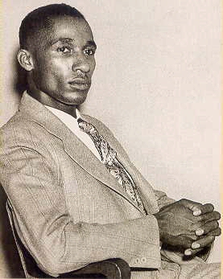
Litigation
Missouri ex rel. Gaines v. Canada (1938)
Beginning in the 1930s, the National Association for the Advancement
of Colored People decided to begin a legal campaign to eliminate segregation
in education. Initially, they focused on segregated graduate and professional
schools, believing that these schools were most vulnerable to change. These
cases eventually led to the Brown v Board of Education decision in 1954.
After the University of Missouri refused to admit Lloyd Gaines to its law
school, the Supreme Court invalidated state laws that required African-
American students to attend out-of-state graduate schools rather than
admit them to their states’ all-white facilities. The Court left open, however,
the question of whether, if Missouri had a separate law school for African-
Americans, the state could have fulfilled its constitutional requirements.
As a result, southern states quickly began to set up separate graduate
programs for minorities. The next goal for the NAACP legal team was to
prove that these hastily assembled programs could not possibly be equal
to the long established programs that existed for white students.
Lloyd Gaines

Slide 48
Litigation
Sipuel v. Board of Regents of the University of Oklahoma, 1948
The Supreme Court ruled that the state of Oklahoma must provide
instruction for Blacks equal to that of whites. In order to comply, the
state of Oklahoma created the Langston University School of Law,
located at the state capital.
Further litigation was necessary to prove that this law school was
inferior to the University of Oklahoma law school. Finally, in 1949,
Sipuel was admitted to the University of Oklahoma law school
becoming the first African American woman to attend an all white
law school in the South.
However, he law school gave her a chair marked "colored," and roped
it off from the rest of the class. In addition, Sipuel had to eat in a separate
chained-off guarded area of the law school cafeteria.
Ada Lois Sipuel

Slide 49
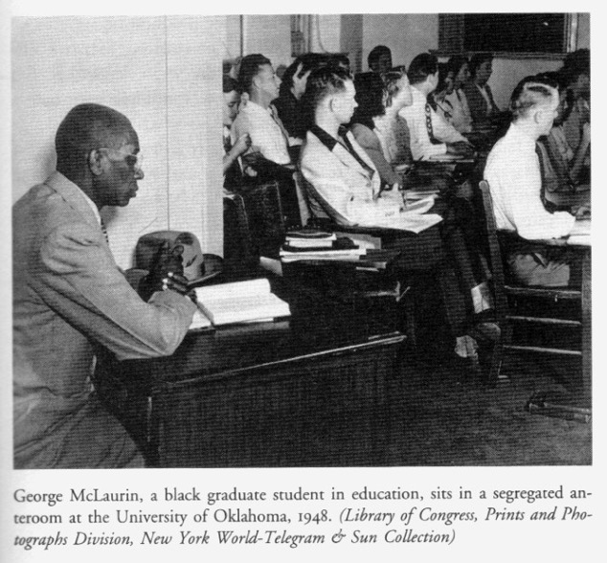
Litigation
McLaurin v. Oklahoma State Regents, 1950
The Supreme Court holds that an African-American student admitted to a formerly all-white
graduate school could not be subjected to practices of segregation that interfered with
meaningful classroom instruction and interaction with other students, such as making a
student sit in the classroom doorway, isolated from the professor and other students.

Slide 50
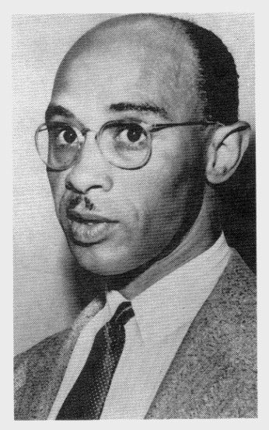
Litigation
Sweatt v. Painter, 1950
The Supreme Court rules that a separate law school hastily established for
black students to prevent their having to be admitted to the previously
all-white University of Texas School of Law could not provide a legal
education "equal" to that available to white students. The Court ordered
the admission of Herman Marion Sweatt to the University of Texas Law
School.
Herman Sweatt

Slide 51
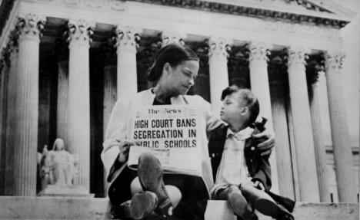
Litigation
Brown v. Board of Education, 1954

Slide 52
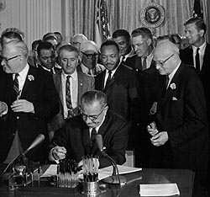
Legislation
The Civil Rights Act of 1964

Slide 53
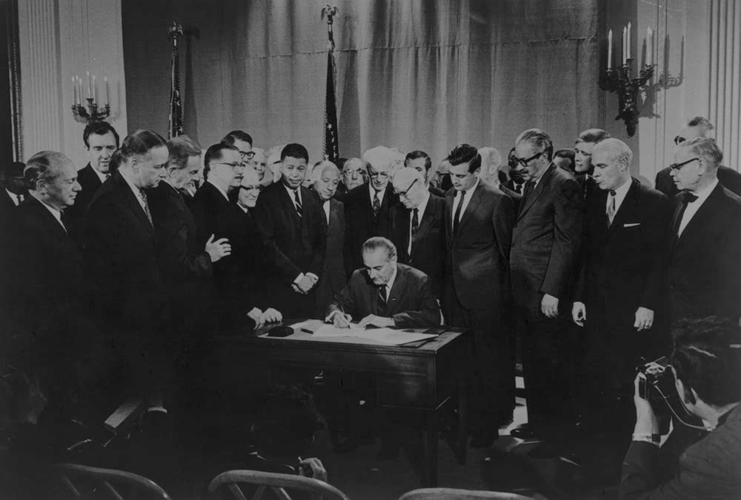
Legislation
The Voting Rights Act of 1965

Slide 54
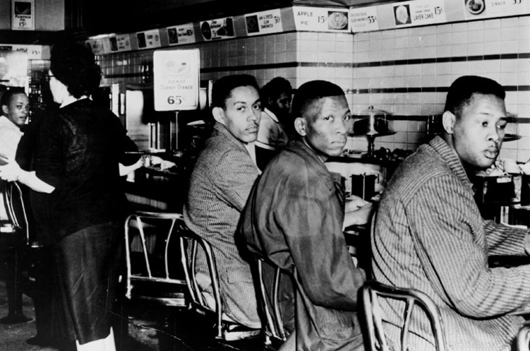
Direct Action – Sit-Ins
Greensboro, North Carolina Sit-in, February 1, 1960
A group of Negro students from North Carolina A&T College, who were refused service at
a luncheon counter reserved for white customers, staged a sit-down strike at the F. W.
Woolworth store in Greensboro. Ronald Martin, Robert Patterson and Mark Martin are
shown here as they stayed seated throughout the day. The white woman at left came to the
counter for lunch but decided not to sit down.

Slide 55
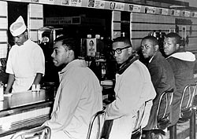
Direct Action – Sit-Ins
Greensboro, North Carolina Sit-in, February 1, 1960
Hundreds of students, civil rights organizations, churches, and members of the community
joined in a six-month-long protest at the lunch counter and, later, organized an economic
boycott of the store. Their defiance heightened many Americans' awareness of racial
injustice and ultimately led to the desegregation of the F. W.Woolworth lunch counter on
July 25, 1960.

Slide 56
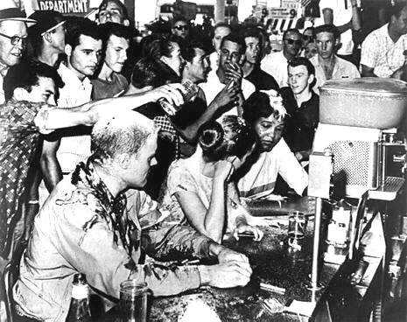
Direct Action – Sit-Ins
Greensboro, North Carolina Sit-in, February 1, 1960
On several occasions, angry white young men physically attacked the protesters. By the end
of 1960, nearly seventy thousand people had participated in sit-ins in 150 cities. Roughly
three thousand six hundred people had been arrested. At least 50 percent of those who
participated were women.

Slide 57
Direct Action – Bus Boycott
Rosa Parks & the Montgomery, Alabama, Bus Boycott, 1955
Although the name Rosa Parks is fairly well-known and linked to the 381-day Montgomery,
Alabama bus boycott of 1955, much of what most Americans think they know about this
important event is incorrect.

Slide 58
Direct Action – Bus Boycott
Rosa Parks & the Montgomery, Alabama, Bus Boycott, 1955
It is true that Parks was arrested for refusing to give up her seat and move
to the back of the bus. But she hadn’t been sitting in an area designated for
whites-only. Montgomery municipal buses each had 36 seats. The first 10
were reserved for whites only. The last 10 seats were theoretically reserved
for blacks. The middle 16 seats were first-come-first-serve, with the bus
driver retaining the authority to rearrange seats so that whites could be
given priority. Parks was sitting in the front row of a middle section of the
bus and it was only after the “whites-only” section became filled on
subsequent stops and a white man was left standing, that the driver
demanded that Parks and three others in the row leave their seats.

Slide 59
Direct Action – Bus Boycott
Rosa Parks & the Montgomery, Alabama, Bus Boycott, 1955
Nor was Parks, as some accounts portray her, a typical working-class
woman – she was a seamstress at the Montgomery Fair Department
Store – who was simply tired after a long’s day work and who, in a
moment of spontaneity, finally decided to take a stand. In actuality, Parks
was a long-time member of the Montgomery chapter of the National
Association for the Advancement of Colored People (NAACP), which she
joined in 1943. At the time of her arrest, she was a secretary of the local
NAACP chapter, under the Presidency of E. D. Nixon. The previous
summer she had attended a workshop for social and economic justice at
Tennessee’s Highlander Folk School. The summer before her arrest,
Parks was involved in several meetings with city officials that focused
on the black community’s concerns about bus segregation that, in her
words, resulted in nothing but “vague promises” and “the run-around.”

Slide 60
Direct Action – Bus Boycott
Rosa Parks & the Montgomery, Alabama, Bus Boycott, 1955
Nor was Parks the first black citizen in Montgomery to challenge its segregationist policy on
city buses. Nine months before Parks’ arrest, on March 2, 1955, 15-year-old Claudette Colvin
refused to relinquish her bus seat and was arrested. The black community initially mounted
some resistance – Parks, in fact, served as a fundraiser for Colvin’s case – but the community
leaders ultimately decided against a full-blown campaign on Colvin’s behalf, seeing her as too
young, feisty, and emotional to be the “face” of the movement. Although this episode did not
become a precipitating factor, it was the court case brought by Colvin and three others – Mary
Louise Smith, Aurelia Browder, and Susie McDonald who had also refused to give up their seats
months before Parks’ actions – that made its way up to the Supreme Court which, in 1956, declared
city bus segregation laws unconstitutional, thereby ending the 381-day Montgomery bus boycott.

Slide 61
Direct Action – Bus Boycott
Rosa Parks & the Montgomery, Alabama, Bus Boycott, 1955
Nor was Parks the driving force behind the bus boycott. Although it is
true that E. D. Nixon, looking for a case to attack bus segregation, put
his full weight behind Parks and convinced Rev. Martin Luther King, a
new minister in town, to allow a meeting of community members and
local ministers at his church, Jo Ann Robinson, then a professor of
English at Alabama State, played a crucial role in the episode.
In the years preceding the boycott, the most active and assertive Black
civic group in Montgomery had been the Women’s Political Council
(WPC), which was headed by Jo Ann Robinson. In May 1954, more
than eighteen months before the arrest of Rosa Parks but just several
days after news of the U.S. Supreme Court's Brown v. Board of
Education decision, Robinson wrote to Montgomery's mayor in her
capacity as WPC president, gently threatening a Black boycott of city
buses if abuses were not curtailed.
Jo Ann Robinson
1910 - 1992

Slide 62
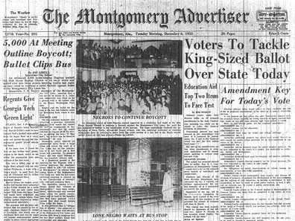
Direct Action – Bus Boycott
Rosa Parks & the Montgomery, Alabama, Bus Boycott, 1955
Following Rosa Park’s arrest in December 1955, Robinson played a central role in the start of
the protest by producing the leaflets that spread word of the boycott among the Black citizens
of Montgomery. She became one of the most active board members of the Montgomery
Improvement Association, but she remained out of the limelight in order to protect her
teaching position at Alabama State.
At first, the WPC called for a one-day boycott - on the day Parks was arraigned in court. That
night, however, five thousand people attended a mass meeting, formed the Montgomery
Improvement Association (MIA) and voted to continue the boycott which was to last
for 381-days.

Slide 63
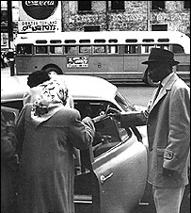
Direct Action – Bus Boycott
Rosa Parks & the Montgomery, Alabama, Bus Boycott, 1955
Faced with having to walk long distances to and from their jobs, Black taxis made regularly
scheduled stops and charged black riders bus fare rather than the full taxi-fare in order to
get them to work. In addition, many blacks - and some whites - who had cars volunteered
to drive people to and from work.
Trying to break the boycott, the city outlawed the carpools and ruled that taxis could not
charge cheap fares. Ninety were arrested for their roles in the carpools.
The movie, The Long Walk Home, streaming online and starring Sissy Spacek, Whoopi Goldberg,
and Dwight Schultz provides a reasonably accurate depiction of these events.

Slide 64
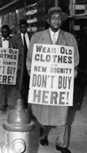
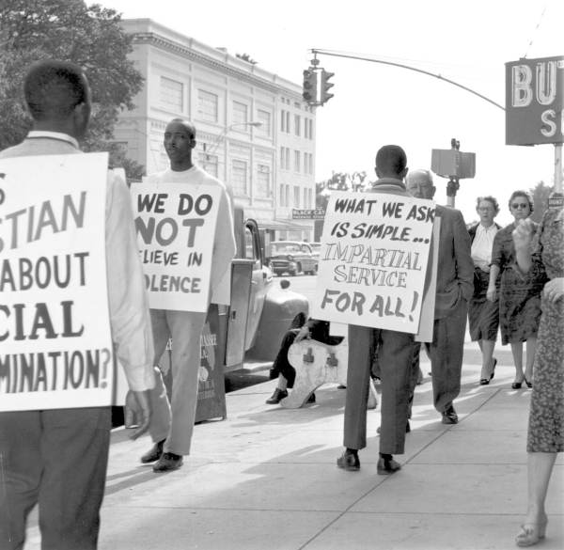
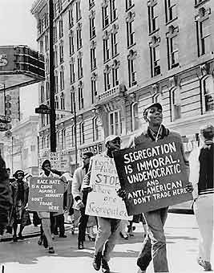
Direct Action – Economic Boycotts
Nashville, TN & Jackson, MS
Although most families were poor and, individually, did not spend much in these businesses
during the year, collectively, the amount of money spent – and now lost to the white owners
due to the boycotts – made up a significant portion of their profits and forced some businesses
to change their policies.

Slide 65
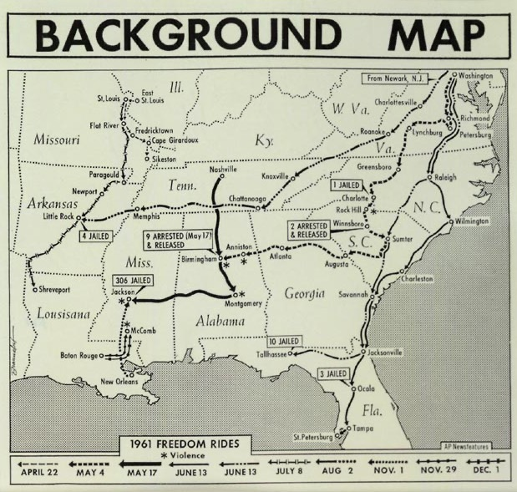
Direct Action – Forcing Compliance with Federal Law
The Freedom Rides, 1961
In Morgan v. Virginia, 1946, the Supreme Court outlawed
state requirements for segregated seating on interstate
buses. Since few Southern states were enforcing the
Morgan decision – they still mandated separate seating
and waiting rooms – leaders of the Congress of Racial
Equality (CORE) decided to challenge the practice of
segregated buses by purposely violating the local Jim Crow
laws. Since Greyhound buses crossed state lines on their
routes, they were governed by federal rather than local
laws. And since federal law “trumped” state law, they
believed that if they created a confrontation between local
Jim Crow laws and federal laws as established by the 1946
Supreme Court decision, the Supreme Court would be forced
to rule the Jim Crow law unconstitutional.

Slide 66
Direct Action – Forcing Compliance with Federal Law
The Freedom Rides, 1961
As James Farmer put it,
“Federal law said that there should be no segregation in
interstate travel. The Supreme Court had decided that.
But still state laws in the southern states and local ordinances
ordered segregation of the races on those buses. Why didn’t
the federal government enforce its law? We decided it was
because of politics. If we were right in assuming that the
federal government did not enforce federal law because of
its fear of reprisals from the South, then what we had to do
was to make it more dangerous politically for the federal
government not to enforce federal law. And how would we
do that? We decided the way to do it was to have an interracial
group ride through the South . . .
James Farmer
Congress of Racial Equality
1920 - 1999

Slide 67
Direct Action – Forcing Compliance with Federal Law
The Freedom Rides, 1961
As James Farmer put it,
“This was not civil disobedience, really, because we would be
doing merely what the Supreme Court said we had a right to
do. The whites in the group would sit in the back of the bus,
the blacks would sit in the front of the bus, and would refuse
to move when ordered. At every rest stop, the whites would
go into the waiting room for blacks, and the blacks into the
waiting room for whites, and would seek to use all the
facilities, refusing to leave. We felt that we could then count
upon the racists of the South to create a crisis, so that the
federal government would be compelled to enforce federal
law. That was the rationale for the Freedom Ride . . .
James Farmer
Congress of Racial Equality
1920 - 1999

Slide 68
Direct Action – Forcing Compliance with Federal Law
The Freedom Rides, 1961
As James Farmer put it,
Following the Gandhian program of advising your adversaries
or the people in power just what you were going to do, when
you were going to do it, and how you were going to do it, so
that everything would be open and above board, I sent letters
to the president of the United States, John Kennedy; the attorney
general, Robert Kennedy; the director of the FBI [Federal Bureau
of Investigation], Mr. J. Edgar Hoover; the chairman of the
Interstate Commerce Commission, which regulated interstate
travel; and the president of Greyhound Corporation and the
president of Trailways Corporation. Those were the carriers
that we would be using on this bus ride. We got replies from
none of those letters. We hoped that there would be protection.
Indeed, that was one of the reasons we sent a letter to the FBI.
We had thought that the FBI would provide protection for us,
would see to it at each stop that we were not brutalized or killed.”
James Farmer
Congress of Racial Equality
1920 - 1999

Slide 69
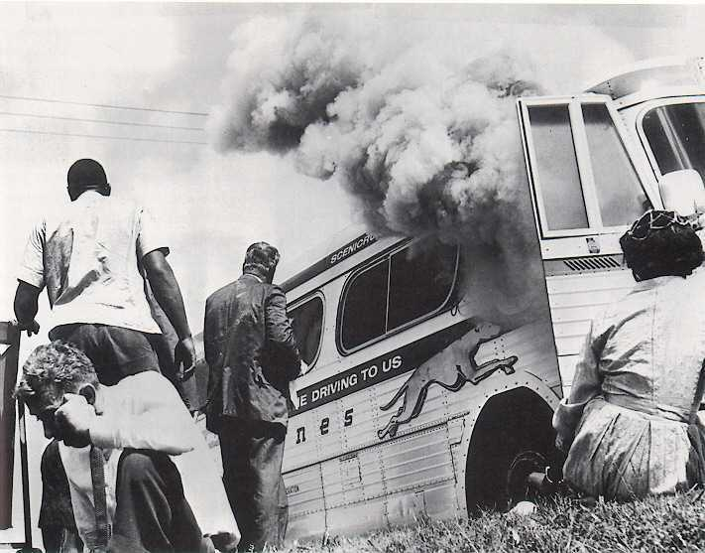
Direct Action – Forcing Compliance with Federal Law
The Freedom Rides, 1961
Buses carrying Freedom Riders came under attack on route to southern cities . . .

Slide 70
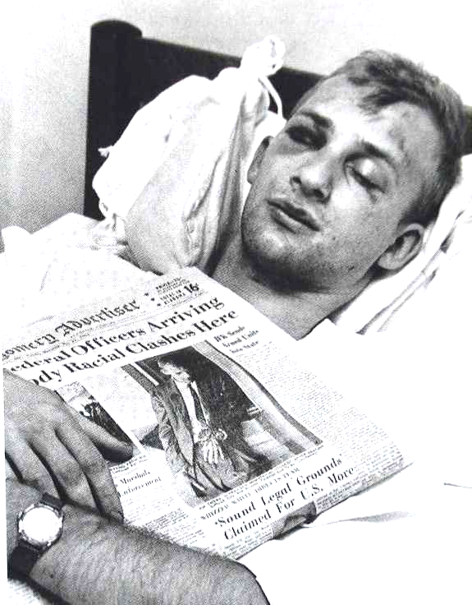
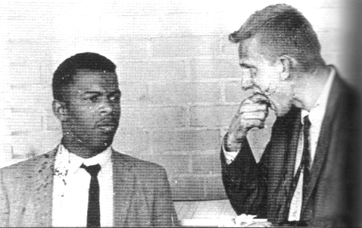
Direct Action – Forcing Compliance with Federal Law
The Freedom Rides, 1961
Freedom Riders were beaten and attacked when buses arrived . . .

Slide 71
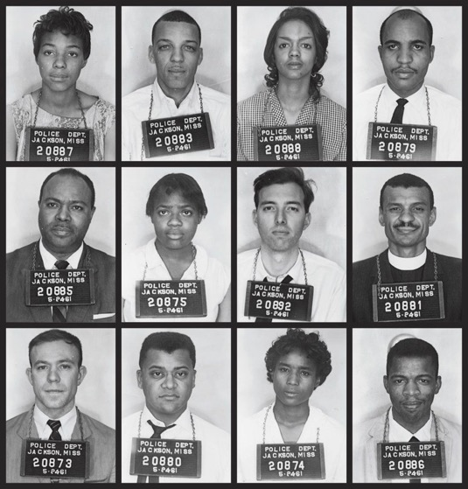
Direct Action – Forcing Compliance with Federal Law
The Freedom Rides, 1961
Freedom Riders were arrested and sentenced to prison . . .

Slide 72
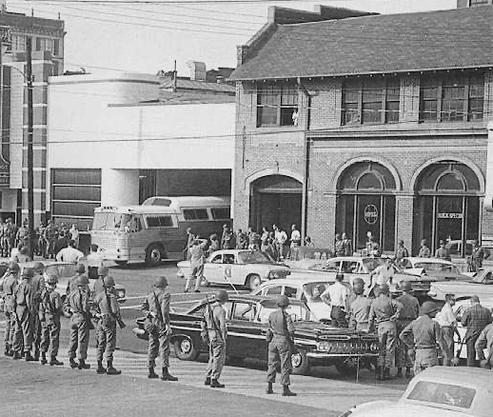
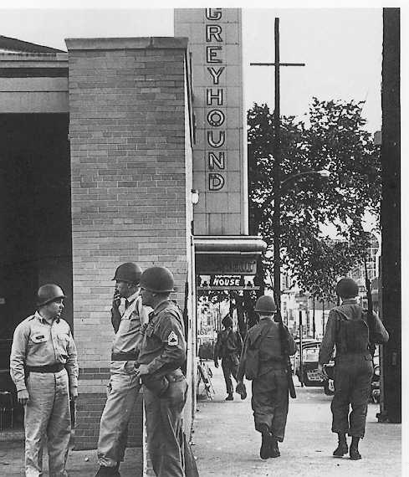
Direct Action – Forcing Compliance with Federal Law
The Freedom Rides, 1961
Eventually the National Guard arrived . . .

Slide 73
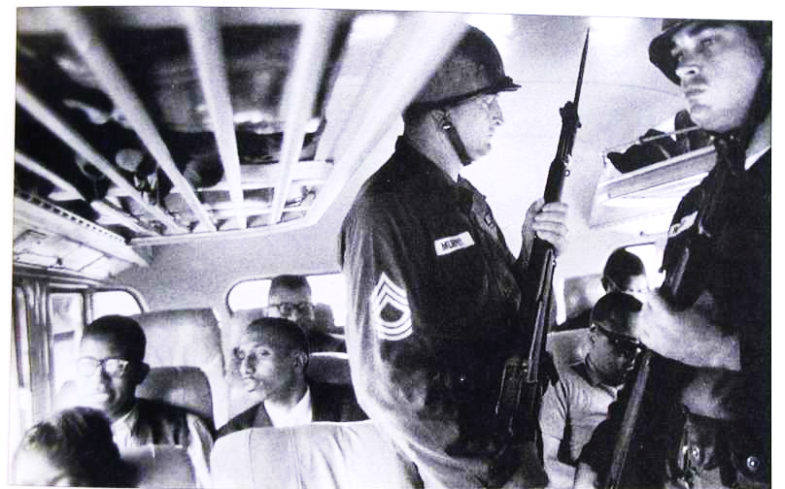
Direct Action – Forcing Compliance with Federal Law
The Freedom Rides, 1961
. . . and the Freedom Riders received safe passage with armed guards on board . . .
As seen in the case of the Freedom Riders, tactics and strategies don’t always yield desired results . . . .

Slide 74
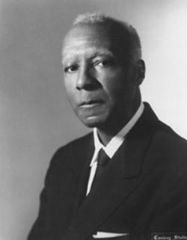
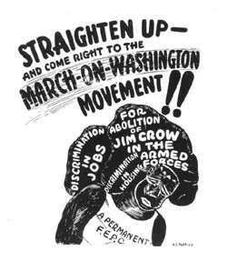
Direct Action – Mass Demonstrations
March on Washington, 1941
A. Philip Randolph, who had earlier founded the Black newspaper
the Messenger and had helped organize a union for black railroad
porters, began organizing a March on Washington in 1941 to publicize
demands that the federal government end racial discrimination in the
armed services and in the hiring practices of defense contractors.
Fearful of the negative international publicity of a mass march of
blacks on Washington, President Roosevelt met with Randolph and
agreed to prohibit discrimination in war industries and government
positions in exchange for Randolph canceling the march. Roosevelt
issued Executive Order 8802 and established the Fair Employment
Practices Commission.

Slide 75
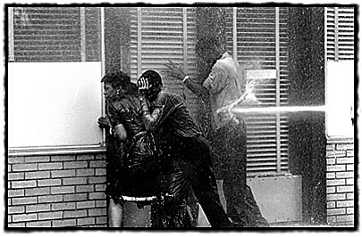
Direct Action – Mass Demonstrations
Schoolchildren Demonstration in Birmingham, Alabama, 1963
In May of 1963, hundreds of schoolchildren and teenagers marched with other demonstrators to Kelly
Ingram Park to protest segregation. In a move recorded by national and international news, Police
Commissioner Eugene “Bull” Connor released police dogs and allowed the use of fire hoses on the
marchers whose water pressure could rip the bark off of a tree. As the dogs tore the children's clothing
and the fire hoses knocked them down, Connor arrested thousands of demonstrators.

Slide 76
Direct Action – Mass Demonstrations
March on Washington for Jobs and Freedom, 1963
On August 28, 1963, about a quarter-million people participated in the historic March on Washington
for Jobs and Freedom gathering near the Lincoln Memorial. Originally conceived by labor leader
A. Phillip Randolph and Roy Wilkins, Executive Secretary of the NAACP, the March on Washington
evolved into a collaborative effort amongst major civil rights groups of the day. It was here that
Rev. Martin Luther King gave his “I Have a Dream” speech.

Slide 77
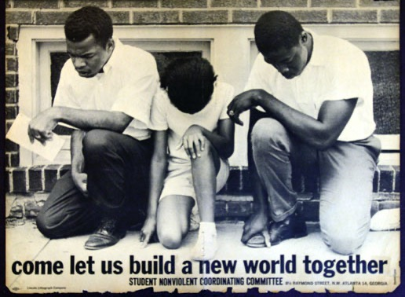
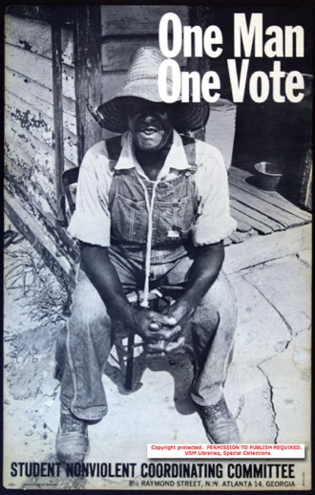
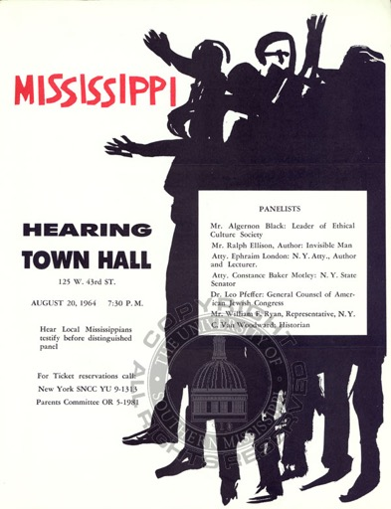
Direct Action – Voter Registration Drive
Freedom Summer, Mississippi, 1964
Freedom Summer, or the Mississippi Summer Project, was a 1964 voter registration drive aimed at
increasing the number of registered black voters in Mississippi. Over 700 mostly white volunteers
joined African Americans in Mississippi to fight against voter intimidation and discrimination at the
polls. The movement was organized by civil rights organizations like the Congress on Racial Equality
(CORE) and the Student Non-Violent Coordinating Committee (SNCC).

Slide 78
Direct Action – Voter Registration Drive
Freedom Summer, Mississippi, 1964
Freedom Summer volunteers were met with violent resistance from the Ku Klux Klan and
members of state and local law enforcement. News coverage of beatings, false arrests and
even murder drew international attention to the civil rights movement. The increased awareness
it brought to voter discrimination helped pass the Civil Rights Act of 1964 and the Voting Rights
Act of 1965.

Slide 79
Direct Action – Voter Registration Drive
Freedom Summer, Mississippi, 1964
That summer, more than 80,000 blacks registered and voted in separate MFDP elections to
select 68 delegates to represent Mississippi at the national Democratic convention in Atlantic
City.

Slide 80
Southern Resistance
to the Civil Rights Movement
Every social movement has opponents; there are always people and social groups who like the
way things are – or benefit from the exiting arrangements.
How, then, do they try to thwart those movements that seek to challenge their vested interests?
Do those seeking to maintain the status quo have more power and influence than those seeking
change? If so, how is power used?

Slide 81
Southern Resistance to the Civil Rights Movement
Opponents of Change & the Role of Power and Force
Resistance to the goals of the Civil Rights movement among southern politicians,
local police chiefs, local businessmen, and the overwhelming majority of citizens
was apparent every step of the way. Five days before the Supreme Court issued
its second ruling in the Brown v. Board of Education de-segregation ruling,
Mississippi Senator James Eastland gave a major speech on school segregation
and had his office send it to more than 300,000 people. It was heavily cited
in southern editorials and by other speakers and became one of the most
important documents of the southern resistance.
The speech concluded,
“It is evident that the decision of the Supreme Court in the school
segregation cases was based on the writings and teachings of
pro-communist agitators and other enemies of the American form
of government.”
James Eastland
1904 - 1986

Slide 82
Southern Resistance to the Civil Rights Movement
The Southern Manifesto, 1956
Also in response to the Brown decision, Senator Strom Thurmond of South
Carolina prepared a draft titled The Declaration of Constitutional Principles
which became known as the “Southern Manifesto.” The document claimed
that the Court ruling violated the constitution, was “creating chaos and
confusion,” and is “destroying the amicable relations between the white and
Negro races that have been created through 90 years of patient effort by the
good people of both races. It has planted hatred and suspicion where there
has been heretofore friendship and understanding . . .”
Both senators and representatives were asked to sign the declaration, pledging
that they would use all lawful means to reverse the Brown decision and to
“prevent the use of force in its implementation.” Nineteen of the twenty-two
southern senators signed the Manifesto; eighty-two of the one-hundred-five
southern representatives signed.
Strom Thurmund
1902 - 2003

Slide 83
Southern Resistance to the Civil Rights Movement
Central High School, Little Rock, Arkansas, 1957
Image courtesy of the Library of Congress, part of the
Visual Materials from the NAACP Records, cph 3c19154
In compliance with court rulings, Central High School in Little Rock, Arkansas was ordered to
allow the enrollment of black students. Although the school board initially approved about 25
students for admission, the parents of only nine students agreed to participate, given the hostile
environment that was created by white opposition.

Slide 84
Southern Resistance to the Civil Rights Movement
Central High School, Little Rock, Arkansas, 1957
On September 2, a day before school was to open, Governor Orval Faubus, who saw the
political benefits of attacking integration, went on radio and television and announced that
he had called out the Arkansas National Guard with instructions to block the admission of black students to Central High School. Faubus's speech set the tone for the hostile reaction that would follow when he declared that, "Blood will run in the streets" if black students were admitted.

Slide 85
Southern Resistance to the Civil Rights Movement
Central High School, Little Rock, Arkansas, 1957

Slide 86
Southern Resistance to the Civil Rights Movement
Central High School, Little Rock, Arkansas, 1957
Arkansas National Guard troops blocking the admission of black students at Little Rock Central High.
(Photographs by Will Counts. Copyright 1997, Little Rock Newspapers, Inc.)

Slide 87
Southern Resistance to the Civil Rights Movement
Central High School, Little Rock, Arkansas, 1957
Hazel Bryan, center, is part of the crowd taunting Elizabeth Eckford as she walks in front of Central High School. After being heckled by protesters, Elizabeth waits for a bus to go home.
She later commented that her dress was so full of spit that she could wring it out.

Slide 88
Southern Resistance to the Civil Rights Movement
Central High School, Little Rock, Arkansas, 1957
After meeting with Governor Faubus, President Eisenhower believed
that the Governor had agreed to changing the orders of the National
Guard to ensure the admission and safety of the nine students.
Instead, Faubus withdrew the National Guard. Without the presence of the guard, the mob took over the streets surrounding Central High School, overrunning the local police force, pelting Northern journalists, and dragging black citizens from their cars.

Slide 89
Southern Resistance to the Civil Rights Movement
Central High School, Little Rock, Arkansas, 1957

Slide 90
Southern Resistance to the Civil Rights Movement
Central High School, Little Rock, Arkansas, 1957
Faubus’ defiance of the federal court order transformed the issue into a challenge of federal
authority and forced Eisenhower to act. He declared in a nationally televised address that
“mob rule cannot be allowed to override the decision of our courts,” and on September 24,
President Eisenhower reluctantly issued a proclamation authorizing the secretary of defense
to federalize the Arkansas National Guard. The secretary sent the National Guard and 1000
paratroopers of the 101st Airborne Division from Fort Campbell, Kentucky into Little Rock to
restore order.

Slide 91
Southern Resistance to the Civil Rights Movement
Central High School, Little Rock, Arkansas, 1957
Although the National Guard no escorted the students into the High School, problems still
persisted. There were “bomb scares” . . .

Slide 92
Southern Resistance to the Civil Rights Movement
Central High School, Little Rock, Arkansas, 1957
. . . and frequent skirmishes between National Guard and protestors.

Slide 93
Southern Resistance to the Civil Rights Movement
Central High School, Little Rock, Arkansas, 1957
The following year, emboldened by continuing white support, Faubus closed
all the Little Rock public schools to avoid continuing with desegregation.
Private schools were built for white students only.
The Supreme Court ruled this action unconstitutional, an “evasive scheme”
to get around desegregation, and the schools were reopened the following year.
Faubus was reelected governor in July 1958 with 69 percent of the vote, and
one Gallup Poll of 1958 found Americans picking him as one of their 10 most
admired men.

Slide 94
Southern Resistance to the Civil Rights Movement
The Freedom Rides, 1961
As mentioned earlier, buses carrying Freedom Riders through the south, challenging Jim
Crow laws were attacked on route and firebombed.

Slide 95
Southern Resistance to the Civil Rights Movement
The Freedom Rides, 1961
Freedom Riders were beaten and attacked when buses arrived in southern cities, while both
the local police and the F.B.I. watched but did not intervene.

Slide 96
Southern Resistance to the Civil Rights Movement
University of Mississippi, October, 1962
After being denied admission to the University of Mississippi in Oxford, MS., James Meredith, with the backing of the NAACP, sued the University.
In September 1962, the Supreme Court ordered that he be granted admission. Governor Ross Barnett ordered state troopers to prevent Meredith from entering the campus. Between Sept. 30 and Oct. 1, riots erupted over Meredith's pending enrollment.
Although Meredith was escorted by Federal Marshals, Lt. Gov Paul Johnson blocked their path.

Slide 97
Southern Resistance to the Civil Rights Movement
University of Mississippi, October, 1962
President John F. Kennedy ordered U.S. marshals to Mississippi to ensure Meredith's safety and
allow him to enter the school. On October 1, after the marshals took control and neutralized those
rioting, Barnett relented and allowed Meredith’s admission after the marshals threatened to arrest
him.

Slide 98
Southern Resistance to the Civil Rights Movement
Police Chief Bull Connor in Birmingham, Alabama, May, 1963
In May of 1963, hundreds of schoolchildren and teenagers marched with other demonstrators to Kelly
Ingram Park to protest segregation. In a move recorded by national and international news, Police
Commissioner Eugene “Bull” Connor released police dogs and allowed the use of fire hoses on the
marchers whose water pressure could rip the bark off of a tree. As the dogs tore the children's clothing
and the fire hoses knocked them down, Connor arrested thousands of demonstrators.

Slide 99
Southern Resistance to the Civil Rights Movement
University of Alabama, June 11, 1963
Vivian J. Malone
James A. Hood
Fulfilling a campaign pledge to stand "in the schoolhouse door" to block integration of Alabama
public schools, on June 11, 1963, Governor George Wallace of Alabama barred the path of two
black students attempting to register at the University of Alabama.
After President Kennedy federalized the Alabama National Guard and ordered some of its units
to the university campus, Wallace stood aside and the black students were allowed to register for
classes.

Slide 100
Southern Resistance to the Civil Rights Movement
President Kennedy’s Address to the Nation, June 11, 1963
During the evening of the day that Governor Wallace barred admission to two students,
President Kennedy addressed the nation responding to the threats of violence and obstruction
on the University of Alabama campus following desegregation attempts. He argued that the
United States was founded on the principle that all men are created equal and thus, all American
students are entitled to attend public educational institutions, regardless of race. He also discussed
how discrimination affects education, public safety, and international relations, noting that the
country cannot preach freedom internationally while ignoring it domestically. The President
asked Congress to enact legislation protecting all Americans' voting rights, legal standing,
educational opportunities, and access to public facilities, but recognizes that legislation alone
cannot solve the country's problems concerning race relations.

Slide 101
Southern Resistance to the Civil Rights Movement
The Murder of Medgar Evans, June 12, 1963
The day following President Kennedy’s address to the nation, Mississippi's NAACP field secretary,
37-year-old Medgar Evers, is murdered outside of his home. Byron De La Beckwith is tried twice
in 1964, both trials resulting in hung juries. Thirty years later, in 1994, Beckwith was tried again
based on new evidence. He was convicted and sentenced to life in prison. He died in prison in 2001.

Slide 102
Southern Resistance to the Civil Rights Movement
University of Alabama, September 1963
In September 1963, Wallace ordered state police to Huntsville, Mobile, Tuskegee and Birmingham
to prevent public schools from opening, following a federal court order to integrate Alabama schools.
Helmeted and heavily armed state police and state National Guard units kept students and faculty
from entering schools.
Following civil disturbances resulting in at least one death, President Kennedy again nationalized
the Guard and saw the schools integrated.

Slide 103
Southern Resistance to the Civil Rights Movement
Church Bombing, Birmingham, Alabama, September 15, 1963
Denise Carole Addie Mae Cynthia
McNair Robertson Collins Wesley
Two-and-one-half weeks after the March on Washington in 1963 where Rev. Martin Luther King
delivered his “I Have a Dream” speech, the 16th Street Baptist Church in Birmingham, Alabama
was bombed killing four young girls. Four known local Klansmen were identified as responsible
but it was not until 1977 that one of the men was tried and convicted. Two others were tried
and convicted in 2002.

Slide 104
Southern Resistance to the Civil Rights Movement
Freedom Summer, Mississippi, 1964
State and local leaders in Mississippi did not take kindly to the Voter
Registration Drive during Freedom Summer.
Samuel Bowers, Imperial Wizard of the Mississippi White Knights of
the Ku Klux Klan, called the Mississippi Freedom Summer Project a
“nigger-communist invasion,” a “crucifixion” of the “innocent people
of God” instigated by “the savage blacks and their Communist masters.”
In a speech delivered in 1964, Mississippi Governor Paul Burnye Johnson
said that the initials of the NAACP stood for “niggers, apes, alligators,
coons, and possums.” This statement, used often, was always greeted with
laughs and applause.

Slide 105
Southern Resistance to the Civil Rights Movement
Freedom Summer, Mississippi, 1964
One event in particular received national coverage during Freedom Summer. Three civil rights activists – twenty-one year old James Chaney, who was black, and twenty-one year old Andrew Goodman and twenty-four-year old Michael Schwerner, both white – were murdered near the town of Philadelphia, Mississippi. They were investigating the burning of Mt. Zion Methodist Church, which had been a site of a Freedom School. The three were arrested for an alleged traffic violation and were taken to the jail in Neshoba County. They were released that evening, without being allowed to telephone anyone.

Slide 106
Southern Resistance to the Civil Rights Movement
Freedom Summer, Mississippi, 1964
On the way back to Meridian, they were stopped by patrol lights and two carloads of KKK members on Highway 19, then taken in Price's car to another remote rural road. The KKK
men shot and killed Schwerner, then Goodman, and finally Chaney, after chain-whipping him.
The three were then buried in an earthen dam for a farm pond was under construction and covered up the bodies by using a bulldozer.

Slide 107
Southern Resistance to the Civil Rights Movement
Freedom Summer, Mississippi, 1964
Within days, U.S. Attorney General Robert F. Kennedy ordered 150 federal agents to be sent
to search for the missing men and then hundreds of sailors from the nearby Naval Air Station Meridian to search the swamps.
It took 44 days for the bodies to be found. The FBI eventually offered a $25,000 reward
(the equivalent of $206,000 in 2019), which led to the breakthrough in the case when an informant passed along a tip to federal authorities.

Slide 108
Southern Resistance to the Civil Rights Movement
Bloody Sunday, Selma, Alabama, May 7, 1965
On May 7, 1965 roughly 600 civil rights marchers began a 4-day walk from Selma to the state capital
in Montgomery. They got only as far as the Edmund Pettus Bridge six blocks away, where state and
local lawmen attacked them with billy clubs and tear gas and drove them back into Selma. Two days
later on March 9, Martin Luther King, Jr., led a "symbolic" march to the bridge. Then civil rights
leaders sought court protection for a third, full-scale march from Selma to the state capitol in
Montgomery which was granted. On Sunday, March 21, about 3,200 marchers set out for
Montgomery, walking 12 miles a day and sleeping in fields. By the time they reached the capitol
on Thursday, March 25, they were 25,000-strong.

Slide 109
The Social Solidarity
of Movement Members

Slide 110
The Social Solidarity of Movement Members
As we have just seen, members of the movement faced beatings . . . .

Slide 111
The Social Solidarity of Movement Members
. . . incarceration, death, and what seemed at the time to be nearly insurmountable odds.

Slide 112
The Social Solidarity of Movement Members
Music
But they persevered by joining together to support one another. There are many ways that
group solidarity and cohesion can be attained, and one that played a major role was music –
which has been called the universal language of mankind.

Slide 113
The Social Solidarity of Movement Members
Music
In many instances, the men and women of the movement sang to each other from their jail cells
to keep up their morale .

Slide 114
The Social Solidarity of Movement Members
Music
I “strongly recommend” that you watch – and listen to – Soundtrack for a Revolution, a part
of the American Experience series. The full movie is 83 minutes and the link is on the
bottom of the web page that lists the materials for this unit.
"The story of the American civil rights movement is told through its powerful music – the
freedom songs that protesters sang on picket lines, in mass meetings, in police wagons, and in
jail cells as they fought for justice and equality. A unique mix of historical documentary and
contemporary musical performance, the film features new performances by top artists
including John Legend, Joss Stone, Wyclef Jean, and The Roots; riveting archival footage; and
interviews with civil rights foot soldiers and leaders, including Congressman John Lewis,
Harry Belafonte, Julian Bond, Andrew Young and dozens more.”
If you do not have the time to view this documentary, please look at the second power point
that I have provided, Civil-Rights-Music. Play the presentation starting with the first picture
slide – it should advance automatically.

Slide 115
The Social Solidarity of Movement Members
Music
You will also see on the web page that lists the materials for this unit links to protest songs that
played an important role in various social movements – the Labor Movement, the Civil Rights
Movement, the Anti-War Movement – as well as songs relevant to issues of social justice.
Last, I suggest that you view some of the videos that I have links for from the organization
Playing for Change. The organization fosters cooperation between different countries and
cultures to affect change, using its profits to build music schools around the world. Each
song/video is sung by a dozen or more performers with segments spliced together.
I highly recommend watching those that I have listed – and then browse through the index of
videos.

