Slide 1
Poverty and Inequality
in the United States
History Matters
© 2020, Professor Larry Stern, Department of Sociology, Collin College
All material on this PowerPoint presentation is for Collin College class use only. Any unauthorized
duplication or distribution is prohibited.

Slide 2
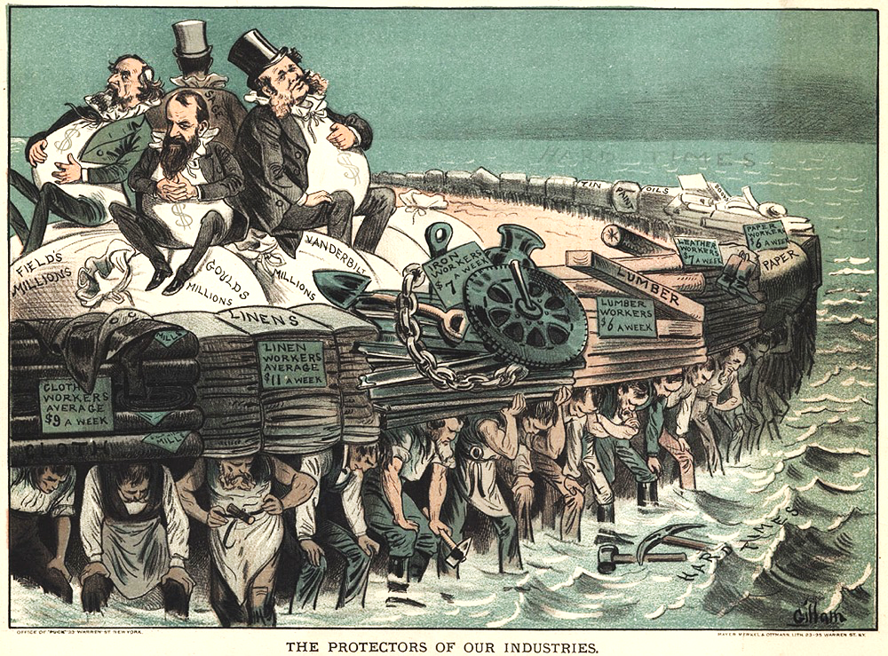
History Matters
Weekly Salaries of Workers who Kept Wealthy Industrialists Afloat
While the wealthy industrialists make millions,
Cloth Workers average $9 a week
Linin workers average $11 a week
Iron Workers average $7 a week
Lumber workers average $6 a week
Leather workers average $7 a week
Paper workers average $6 a week
Labor unions, with collective bargaining, did not
exist. Wages were set by the industrialists and
factory owners.
The Protectors of our Industries

Slide 3
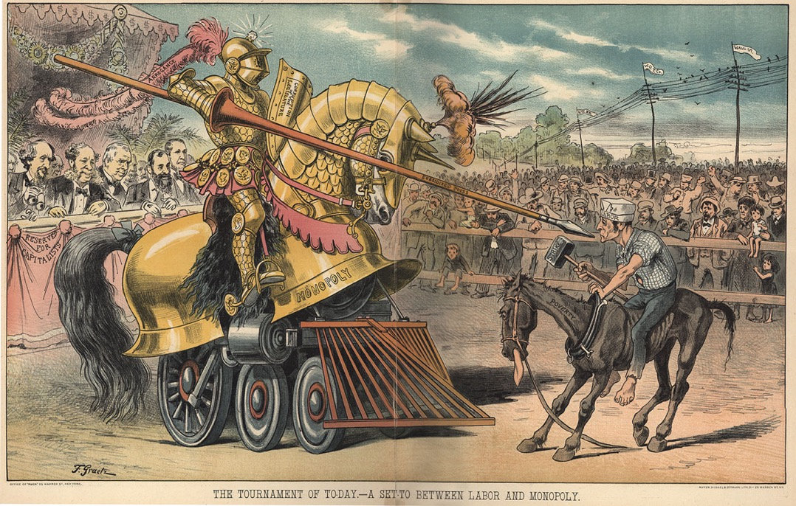
History Matters
Conflicts between Workers and Wealthy Industrialists
A fair fight?
The Tournament of Today - A Set To Between
Labor and Monopoly

Slide 4
History Matters
The Triangle Shirtwaist Factory Fire, 1911
The deadliest industrial accident up to that point in the history of the U.S., the Triangle
Shirtwaist Factory Fire of 1911 clearly indicates the plight of workers in sweatshop
factories. As shall be seen, these sweatshops still exist, and in addition to the meager salaries
paid to workers, accidents still occur today.
Watch the the Ric Burns, Documentary: New York, Episode 4: Power and People, from the
1-hour-10-minute mark until the 1-hour thirty-six-minute mark. The link is on the page that
lists the assignments for the week.

Slide 5
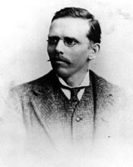
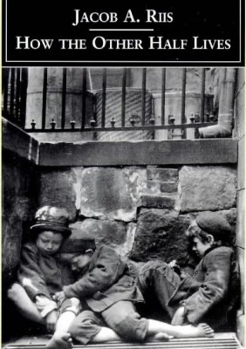
Jacob Riis, How the Other Half Lives
“A picture is worth a thousand words.”
The faces of Poverty
Jacob A. Riis
1849 - 1914
Watch the the Ric Burns, Documentary: New York, Episode 3: How the Other Half Lives.
The link is on the page that lists the assignments for the week.

Slide 6
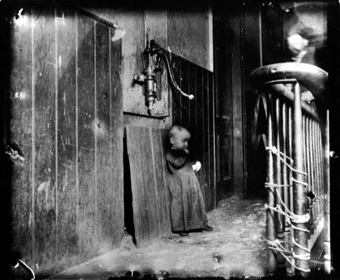
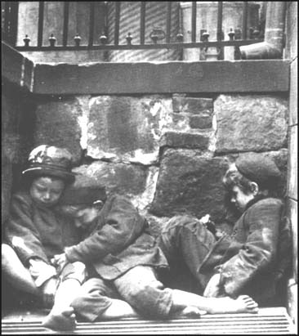
Jacob Riis, How the Other Half Lives

Slide 7
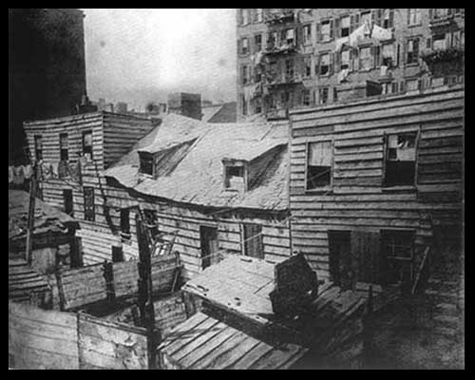
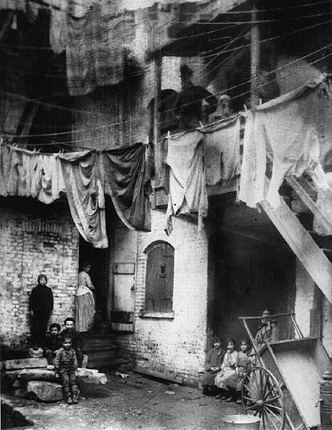
Jacob Riis, How the Other Half Lives

Slide 8
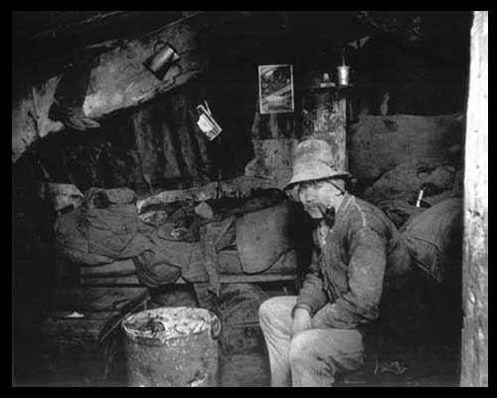
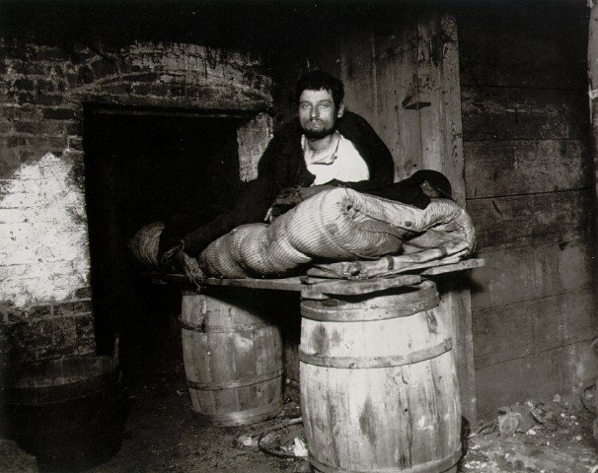
Jacob Riis, How the Other Half Lives

Slide 9
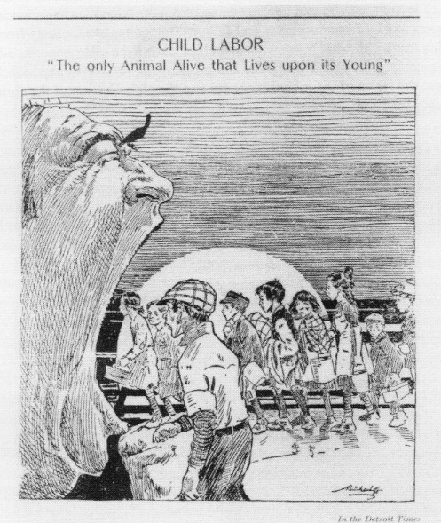
Child Labor
No fledgling feeds the father-bird!
No chicken feeds the hen!
No kitten mouses for the cat -
This glory is for men.
We are the Wisest, Strongest, Race -
Loud may our praise be sung!
The only animal alive
That lives upon its young!
Reprinted from Poems of Child Labor,
NCLC Publication 316, p. 18.

Slide 10
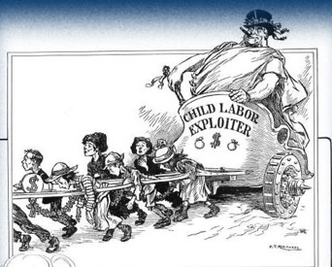
Child Labor
The low salaries of working-class men often made it imperative that their wives and
children contribute to household earnings.
Before the 20th century it was not uncommon for 15-year-olds to work for a living.

Slide 11
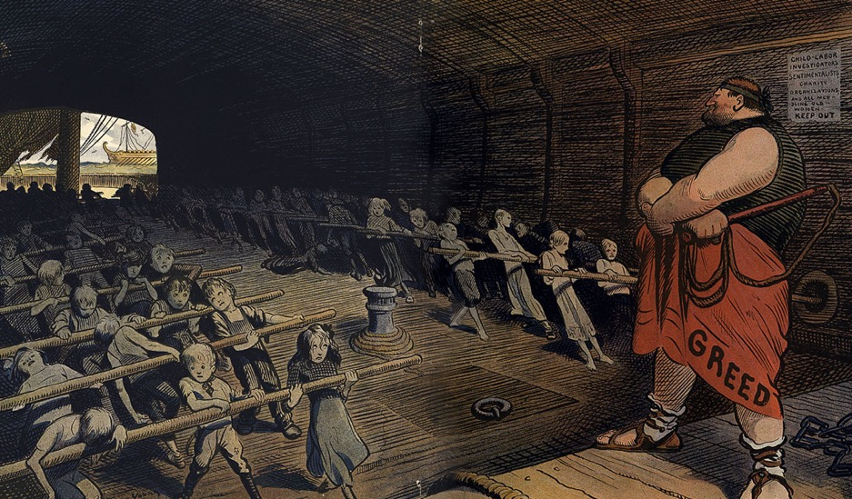
Child Labor
Among urban ethnic groups, children contributed roughly one-third to household
income before 1900.
No federal laws regulated child labor.

Slide 12
Gainful Workers, Aged 10 - 14, in the United States
(in thousands)
Activity
Children rates of
Workers % Population Total as % of children
Year 10 - 14 Nonfarm 10 - 14 Workers workforce (%)
1870 765 47.00 4,786 12,925 5.92 15.98
1880 1,118 50.64 5,715 17,392 6.43 19.56
1890 1,504 57.38 7,034 23,318 6.50 21.38
1900 1,750 62.47 8,080 29,037 6.02 21.66
1910 1,622 68.98 9,107 37,371 4.34 17.81
1920 1,417 73.02 10,641 42,434 3.34 13.32
1930 667 78.55 12,005 48,830 1.37 5.56
Notice how the percentage of children workers no longer working on farms – they are now
mostly in factories – increases each decade.

Slide 13
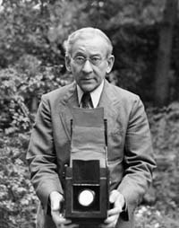
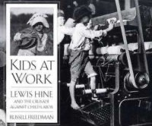
Child Labor
Lewis Hine
1874 – 1940
In 1904, the National Child Labor Committee was founded to work for effective national
legislation to end child labor.
In 1908 it hired photographer Lewis Hine to document the extent of child labor throughout
the country and the children's working conditions in various industries. His photographs
are the most enduring images from the crusade against child labor that began in the
United States in the early 1900s.

Slide 14
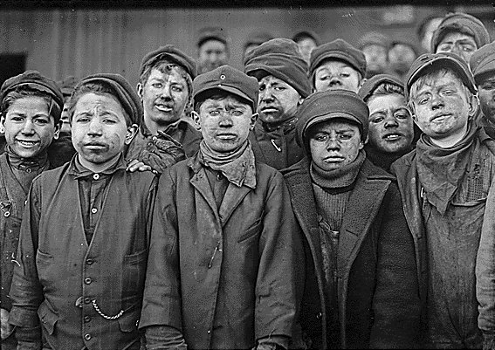
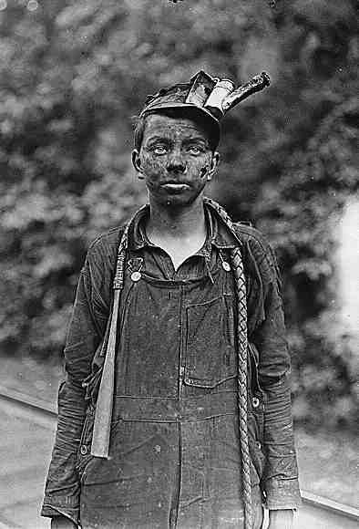
Boys in the Coal Mines
Lewis Hine

Slide 15
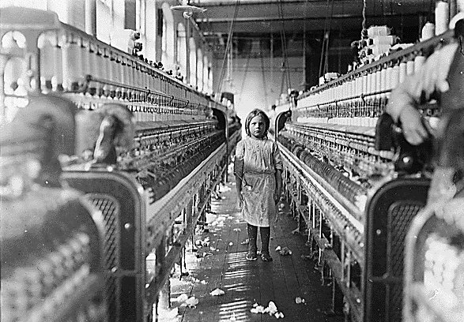
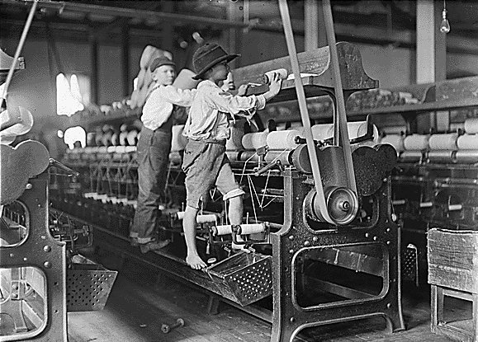
Boys & Girls in the Textile Mills
Lewis Hine
Textile manufacturing employed more children than any other single trade.
One-third of southern mill workers were under age sixteen. Children worked before
dawn until after sunset often until 9:30 p.m. walking home by lantern light.

Slide 16
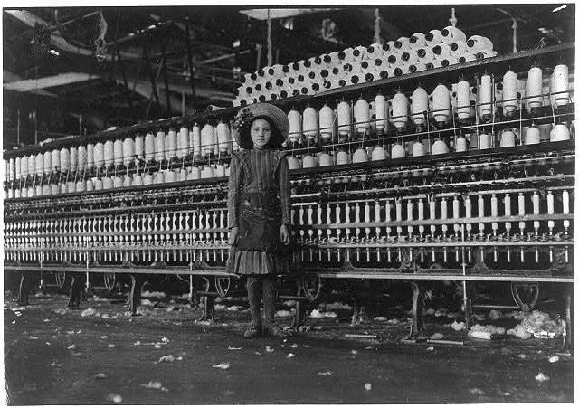
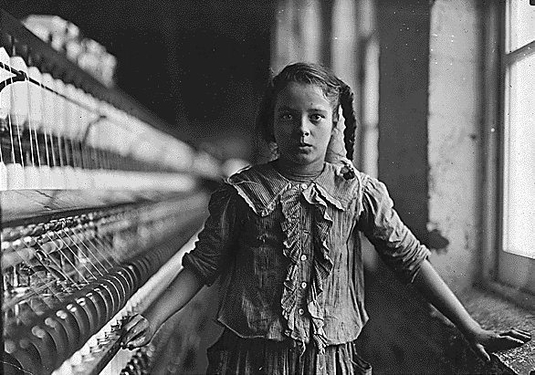
Boys & Girls in the Textile Mills
Lewis Hine

Slide 17
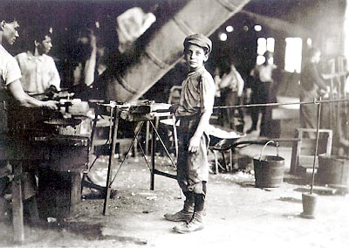
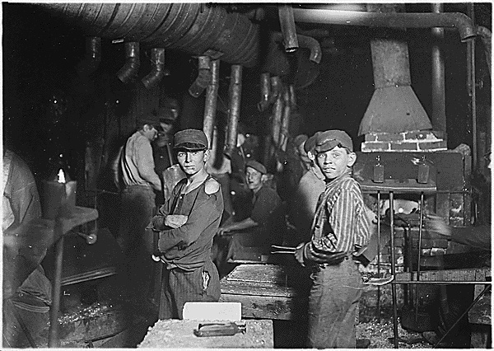
Boys in the Factories
Lewis Hine

Slide 18
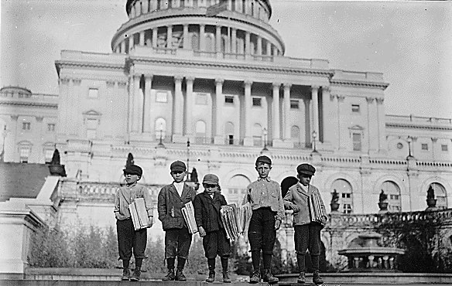
“Newsies” – Newspaper Boys
Lewis Hine

Slide 19
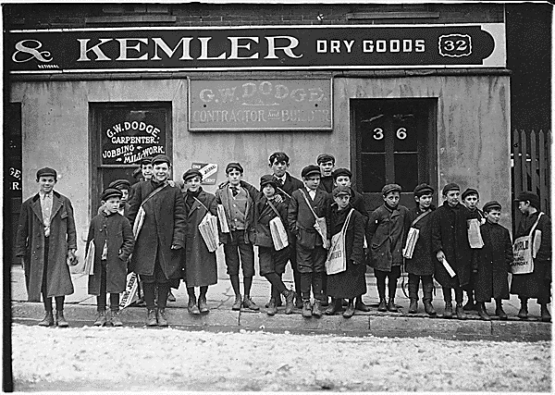
“Newsies” – Newspaper Boys
Lewis Hine

Slide 20
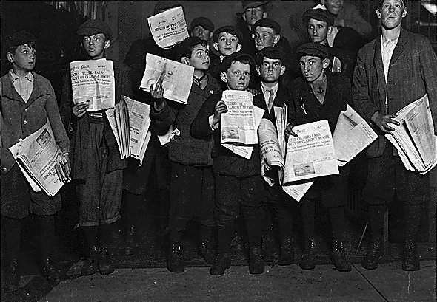
“Newsies” – Newspaper Boys
Lewis Hine

Slide 21
The Farm Security Administration
“A picture is worth a thousand words.”
Between 1935 and 1943, a small group of photographers, in an
unprecedented attempt at social documentation, set out to record
everyday life in the United States during what was generally
considered to be the worst of times.” Farms were closing, the
depression hit with full force, and upwards of 40,000,000 people –
one-third of the nation – were, in the words of President
Franklin D. Roosevelt, “ill-fed, ill-clad, and ill-housed.”
There is nothing pretty in these photographs. They clearly show
the blight of the land and its people – the erosion of the soil,
the faces – even the souls of those affected. Farmers were the
hardest hit of all those devastated by the Great Depression and
the misery of their poverty was compounded by a succession of
dust storms that had finally brought them to their knees.

Slide 22
The Farm Security Administration
“A picture is worth a thousand words.”
The goal of this massive project, directed by the Farm Security
Administration, was to provide a comprehensive record that
would convince the public of the need for federal help in relocating
farmers whose farms had been lost, as much to drought as to
foreclosures. At the same time, the project sought to show the
conditions of the rural poor to the urban poor, in an effort to reunite
and rededicate the country to correct society's ills.
These photographs both convey and elicit more emotion than
any journalist or novelists words.
Go through these next several slides – and remember that more
than 16,000,000 folks have lost their jobs in the United States in
the last three weeks (as of April 10th) due to the COVID-19 pandemic.
Do we need a new series of photographs to get folks to grasp the
individual – as well as the societal – costs and seriousness of the situation?

Slide 23
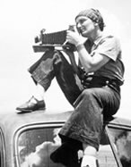
Migrant Workers
Dorothea Lange
Dorothea Lange
1895 - 1965
Dorothea Lange
1895 - 1965

Slide 24
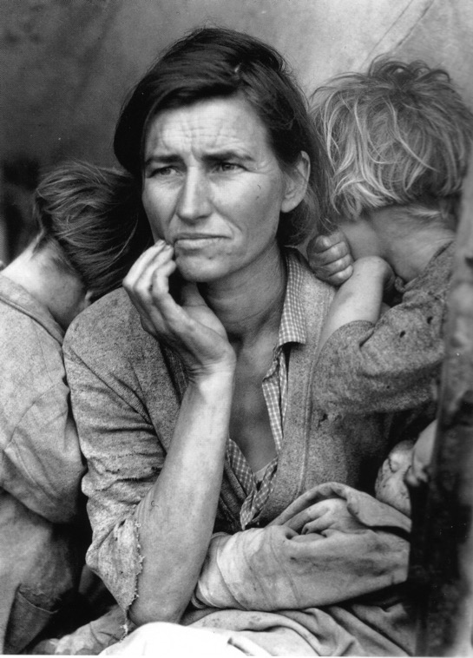
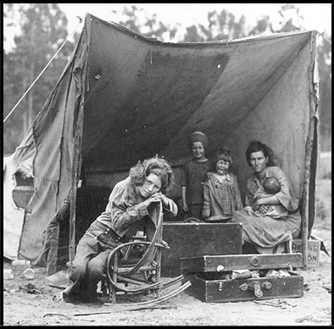
Migrant Workers
Dorothea Lange
Dorothea Lange
1895 - 1965
Dorothea Lange
1895 - 1965

Slide 25
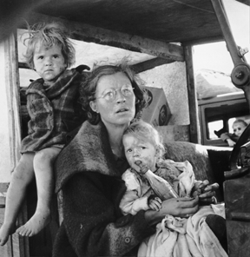
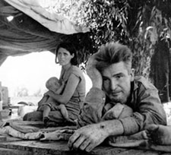
Migrant Workers
Dorothea Lange
Dorothea Lange
1895 - 1965
Dorothea Lange
1895 - 1965

Slide 26
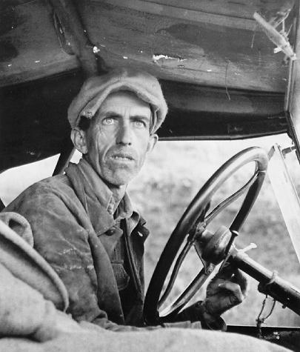
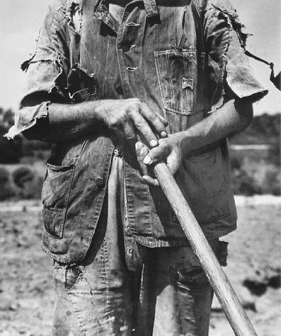
Migrant Workers
Dorothea Lange
Dorothea Lange
1895 - 1965
Dorothea Lange
1895 - 1965

Slide 27
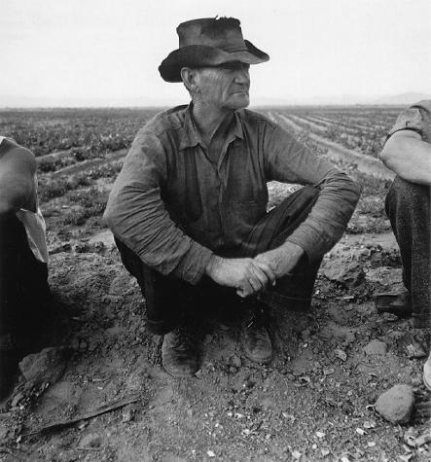
Migrant Workers
Dorothea Lange
Dorothea Lange
1895 - 1965
Dorothea Lange
1895 - 1965

Slide 28
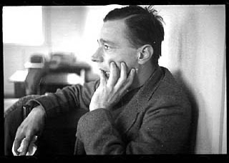
Rural Poverty
Walker Evans
Portrait of Walker Evans
taken by Edwin Locke
February 1937

Slide 29
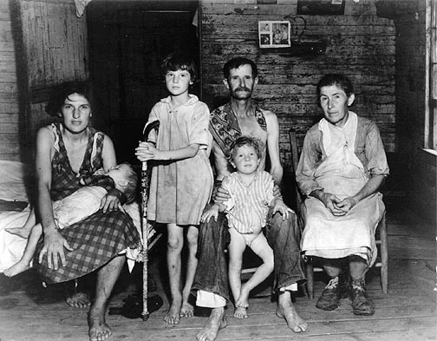
Rural Poverty
Walker Evans

Slide 30
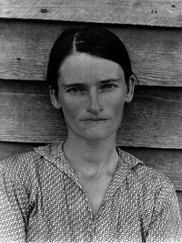
Rural Poverty
Walker Evans

Slide 31
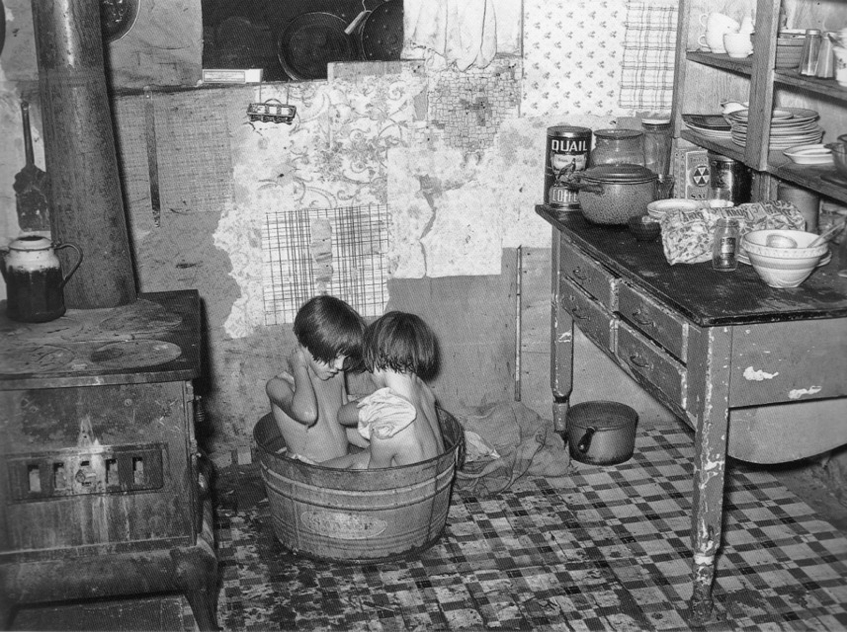
The Great Depression
FSA Photographers – Russell Lee
Russell Lee
1903 - 1986
Oklahoma, 1939

Slide 32
The Great Depression
FSA Photographers – Russell Lee
“Homeschooling, “Louisiana , 1939
Oklahoma, 1939

Slide 33
The Great Depression
FSA Photographers – Marion Post-Wolcott
Marion Post-Wolcott
1910 - 1990

Slide 34
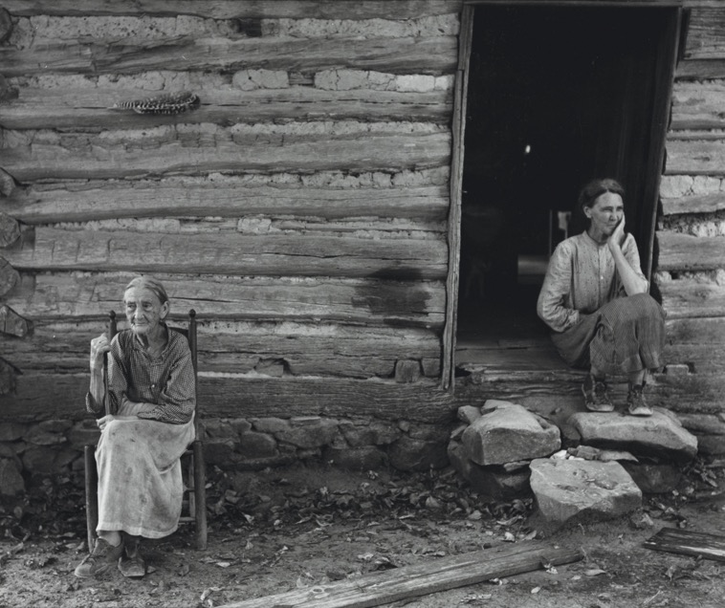
The Great Depression
FSA Photographers – Marion Post-Wolcott
Corn Shucking, North Carolina, 1939

Slide 35
The Great Depression
FSA Photographers – Ben Shahn
Ben Shahn
1898 - 1969

Slide 36
The Great Depression
FSA Photographers – Ben Shahn

Slide 37
The Great Depression
Breadlines & Soup Kitchens

Slide 38
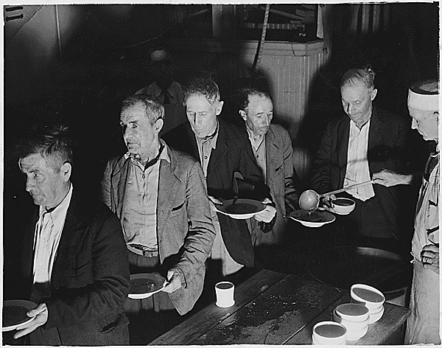
The Great Depression
Breadlines & Soup Kitchens

Slide 39
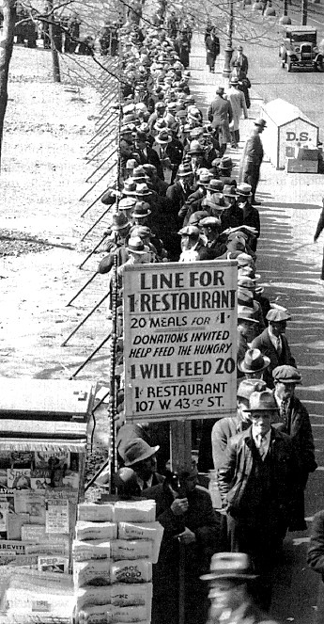
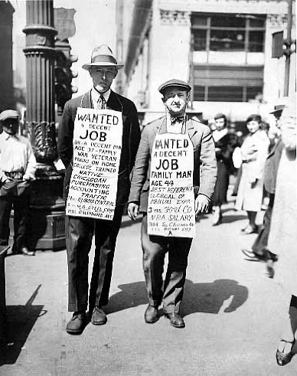
The Great Depression
Breadlines & Soup Kitchens

