Slide 1
Poverty and Inequality in
the United States & Texas
What the Numbers Tell Us
& the Costs of Being Poor
© 2020, Professor Larry Stern, Department of Sociology, Collin College
All material on this PowerPoint presentation is for Collin College class use only. Any unauthorized
duplication or distribution is prohibited.

Slide 2
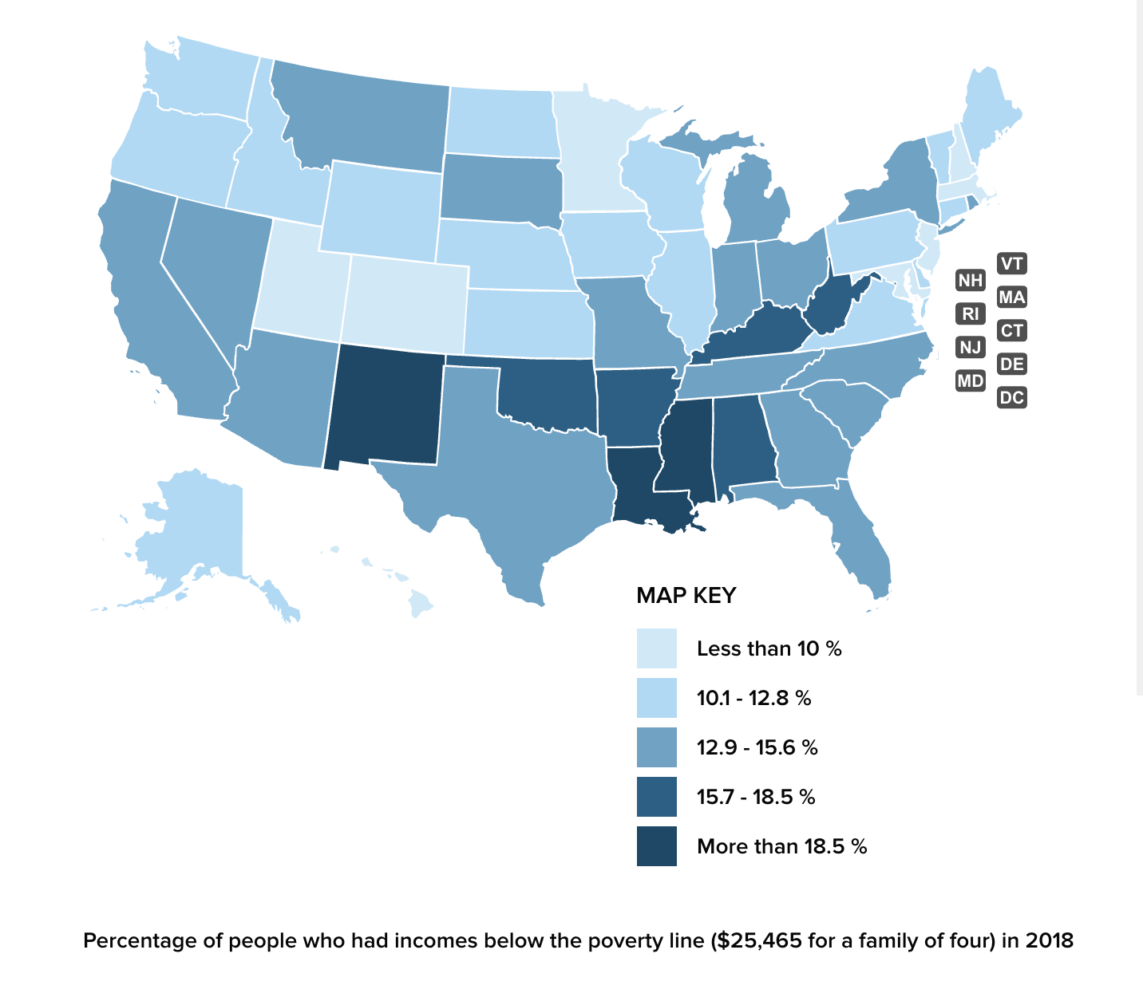
Poverty Rates in the U.S. , 2019

Slide 3
Federal Poverty Guidelines, 2020

Slide 4
Federal Poverty Guidelines, 2020
The poverty guidelines were originally designed to reflect
the minimum amount of income that American households
need to subsist. This amount was derived by multiplying by
three the cost of food for each family size. This method for
determining household budget needs was established in
the early 1960s based on the assumption that the cost of
food accounted for one-third of household spending, and
This remains the same today, despite significant shifts in
household expenses.
For example, the cost of housing as a share of household
income has increased significantly since the 1960s, and
families today are more likely to have child-care expenses
and pay a much higher share of health care costs than
was typical in the 1960s. Except in the case of Alaska and
Hawaii, the guidelines do not take into account geographical
differences in the cost of living, or the effects of a rising
standard of living.

Slide 5
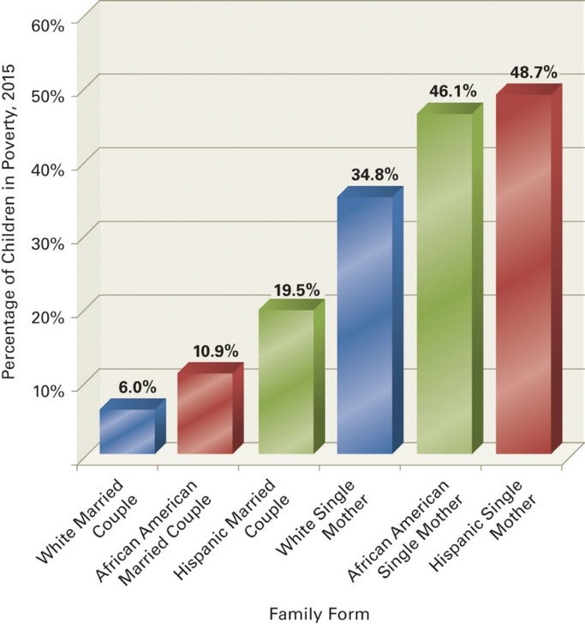
In the United States, what are a person’s odds of being born into poverty?

Slide 6
Poverty Rate in Texas, 2000 - 2018

Slide 7
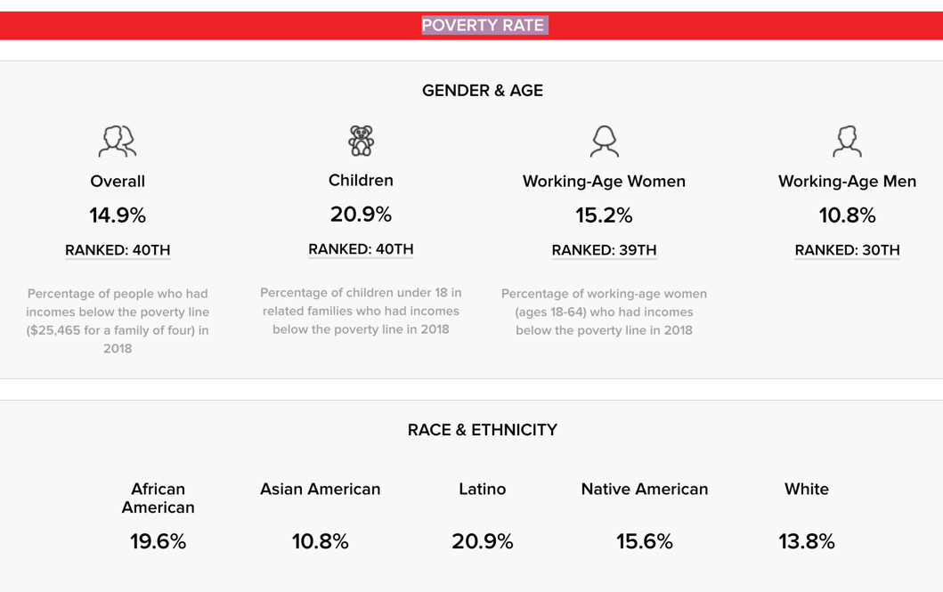
Poverty Rate in Texas, 2019
Population: 28,074,573 Number in Poverty: 4,180,675
Texas is ranked 40th overall in the percentage of population living below the poverty line.
20.9% of children living in Texas are living below the poverty line, ranking 40^{th.}
15.2% of working-age women living in Texas are living below the poverty line, ranking 39^{th.}

Slide 8
Distribution of Income and
Wealth in the United States

Slide 9
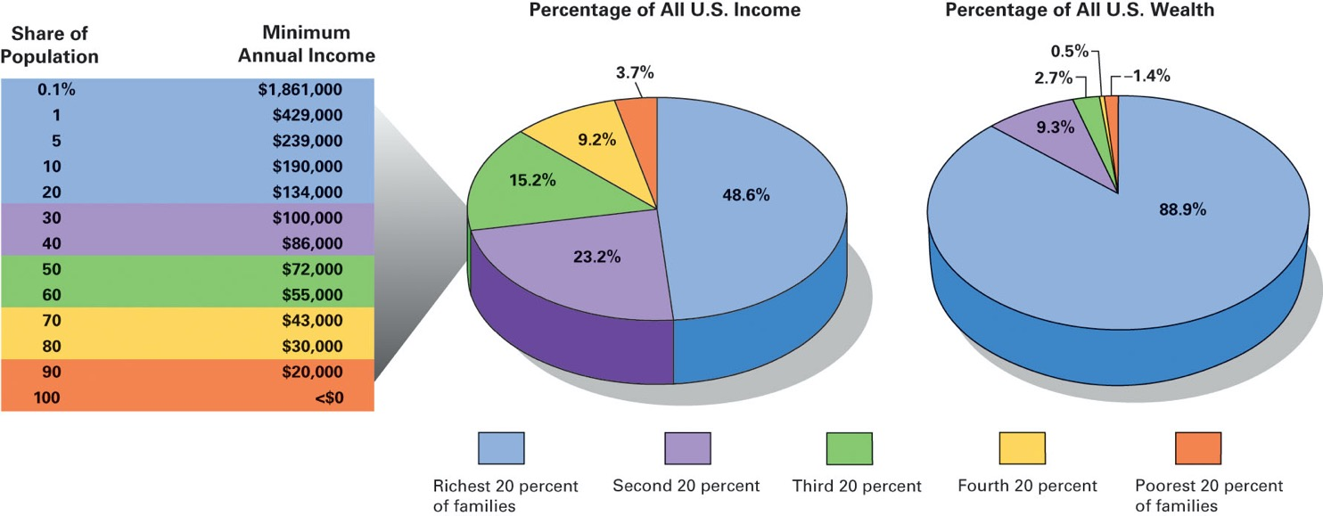
Distribution of Income and Wealth in the
United States, 2015
Notes:
Income and especially wealth are divided unequally in U.S. society.
Sources: Income data from U.S. Census Bureau (2016); wealth data based on Wolff (2014) and author estimates.

Slide 10
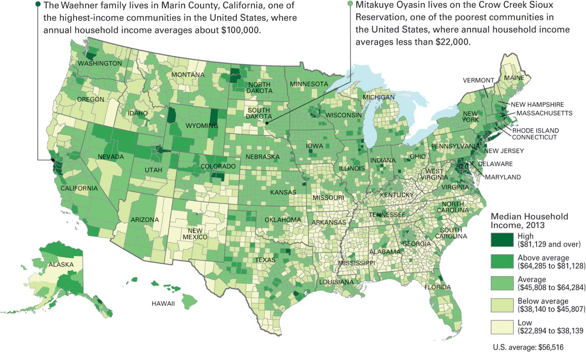
Household Income across the United States, 2015
Notes:
This map shows the median household income in the more than 3,000 counties that make up the United States for the year 2015.
The richest counties, shown in the darker shades of green, are not spread randomly across the country.
Nor are the poorest U.S. counties, which are shown in lightest shades.
Looking at the map, what patterns do you see the distribution of wealth and poverty across the United States?
What can you say about wealth and poverty in urban and rural areas?
Source: U.S. Census Bureau (2016).

Slide 11
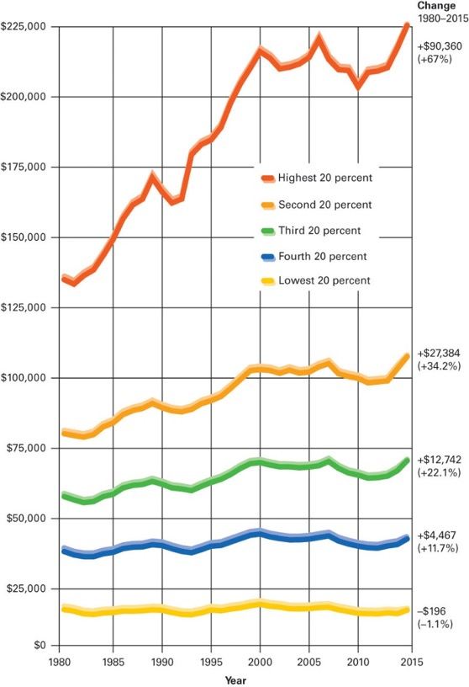
Mean Annual Income, U.S. Families, 1980–2015 (in 2015 dollars, adjusted for inflation)
Notes:
The gap between high-income and low-income families is wider today than it was in 1980.
Source: U.S. Census Bureau (2016).

Slide 12
Average Income in the U.S., 2015
Income disparities have become so pronounced that America’s top 10 percent now average
more than nine times as much income as the bottom 90 percent. Americans in the top 1 percent
average even higher: they average over 40 times more income than the bottom 90 percent.
But that gap pales in comparison to the divide between the nation’s top 0.1 percent and everyone
else. Americans at this lofty level are taking in over 198 times the income of the bottom 90 percent.

Slide 13
The Share of All Income Earned by the Richest 1%
1913–2015
The top 1 percent of America’s income earners have more than doubled their share of the
nation’s income since the middle of the 20th century. American top 1 percent incomes
peaked in the late 1920s, right before the onset of the Great Depression.

Slide 14
The Share of All Income Earned by the Richest .01%
1913–2015
Inequality in America is growing, even at the top. The nation’s highest 0.01 percent of
income-earners have, over recent decades, seen their incomes rise much faster than the
rest of the top 1 percent. Incomes in this top 0.01 percent increased 7.5 times between
1973 and 2007, from 0.8 percent to an all-time high of 6 percent. The Great Recession in
2008 did dampen this top 0.01 percent share, but only momentarily. The upward surge of
the top 0.01 percent has resumed.

Slide 15
Average Income of Top 400 U.S. Earners
1992 – 2014
The 1990s saw the annual incomes of the ultra rich explode in size. Between 1992 and 2002,
the 400 highest incomes reported to the Internal Revenue Service more than doubled, even
after the collapse of the dot.com bubble in 2000. In the early 21st century, the economic boom
driven by the real estate bubble would more than triple top 400 average incomes before the
2008 economic collapse.

Slide 16
The Congressional Budget Office defines after-tax income as “before-tax income minus federal
taxes.” After taxes, top 1 percent incomes are increasing even faster than before taxes. Before-tax
income growth for the top 1 percent has averaged 186.8 percent since 1979. The after-tax
increase: 192.2 percent. A progressive tax system should function to narrow income gaps
between the affluent and everyone else. Over recent decades, America’s tax system has not
narrowed.

Slide 17
In the United States today, unions have a much smaller economic presence than they did
decades ago. With unions playing a smaller economic role, the gap between worker and
CEO pay was eight times larger in 2016 than in 1980.

Slide 18
Relationship Between Productivity and a
“Typical Worker’s” Wages, 1948 – 2014
Productivity has increased at a relatively consistent rate since 1948. But the wages of
American workers have not, since the 1970s, kept up with this rising productivity.
Worker hourly compensation has flat-lined since the mid-1970s, increasing just 19.1
percent from 1979 to 2013, while worker productivity has increased 132.9 percent
over the same time period.

Slide 19
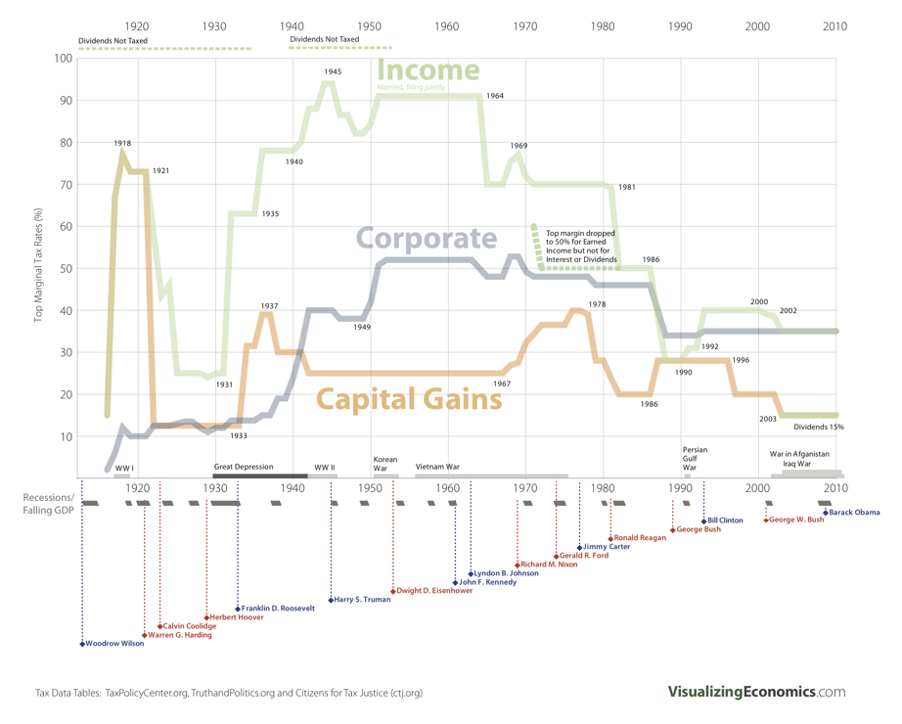
Top Marginal Tax Rates: 1916 – 2010
Notice that during times of economic prosperity,
the top marginal rate – the rate imposed on our
wealthiest citizens, was much higher than it is
today – and the wealthy argue that raising taxes
will “hurt” the economy – even though the economy
flourished with much higher rates:
1950 – 1964 = the tax rate was 90%
1964 – 1981 = the tax rate was 70%
1981 – 1986 = the tax rate was 50% (the Reagan years)
Corporate tax rates from 1950 until ~1985 was
roughly 50% . . . .

Slide 21
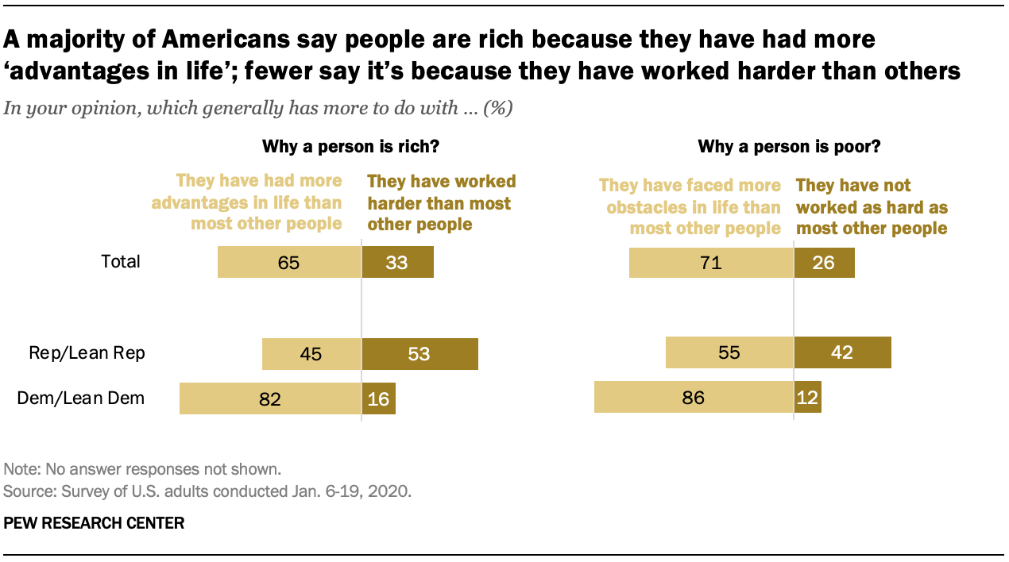
Why are Some People Rich, and Others Poor?
Large majorities of Democrats and Democratic-
leaning independents say advantages in life
have more to do with why someone is rich
(82%) and that having faced more obstacles
has more to do with why someone is poor (86%).
Opinions among Republicans and Republican
leaners are more divided: 53% say hard work
has more to do with why a person is rich, while
45% say it is because they have more advantages.
In views of why a person is poor, 55% of
Republicans say it is more because they have
faced obstacles most others have not, while 42%
say it is more because they have not worked as
hard as most others

Slide 22
The Costs of Being Poor
The Poor Pay More: see the article by DeNeen L. Brown, “The High Cost of Poverty: Why
the Poor Pay More,” Washington Post, May 18, 2009
Play the game Spent. It is a web-based interactive game that puts you in the position of
being down to your last $1,000. It’s just you and your elementary-school-age-child.
You have just lost your house (the fact that you previously owned a home meant that you
were middle to upper –middle class before the recession hit. You need to find a job and a
place to live – and to survive the month.
You will see that in order to make it through the month you will often have to choose between
two “bad” alternatives. In some instances you will have to do things that violate your morals
and your values. And if you do have some money left over at the end of the month, don’t
Forget that your rent is due the next day . . .

Slide 23
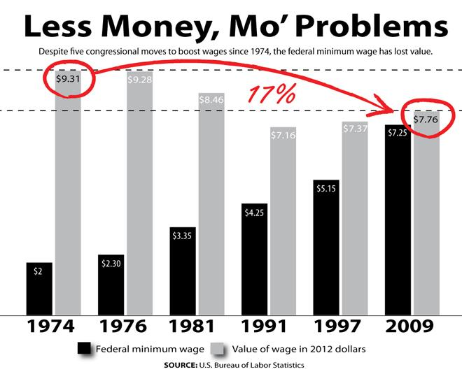
Over the past four decades, the federal minimum
wage has lost value and purchasing power

Slide 24
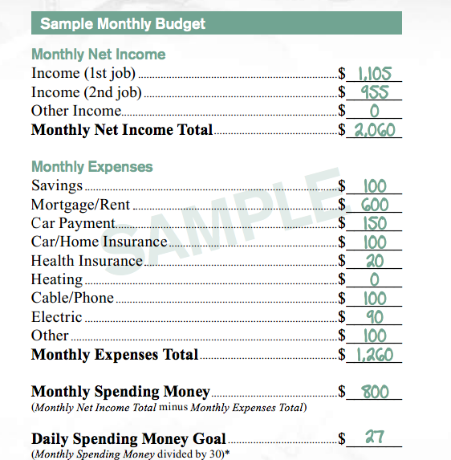
Brochure Distributed to Workers by McDonalds
Read the two brief articles discussing this that
are listed on the required readings page:
Jordan Weissmann, “McDonald's Can't Figure
Out How Its Workers Survive on Minimum Wage,”
The Atlantic, July 16, 2013
Timothy B. Lee, “That McDonald’s budget people are
making fun of isn’t cruel. It’s realistic.”
The Washington Post, July 16, 2013 at 2:37 p.m. CDT

Slide 26
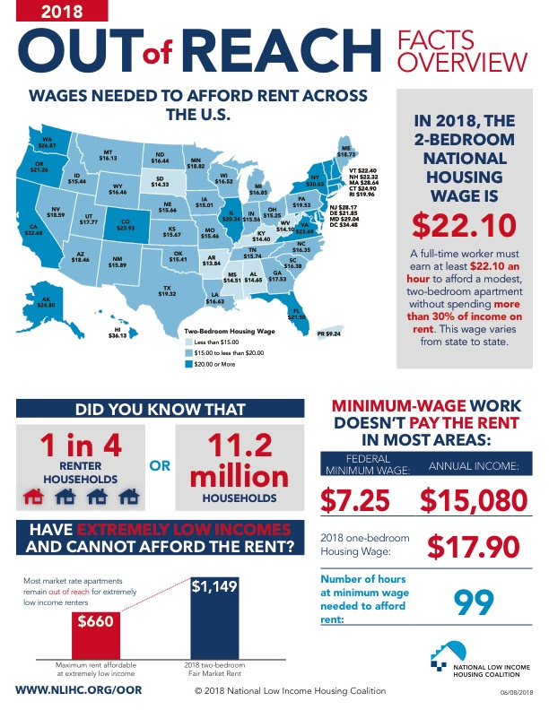
The Fair-Market Cost of Housing

Slide 32
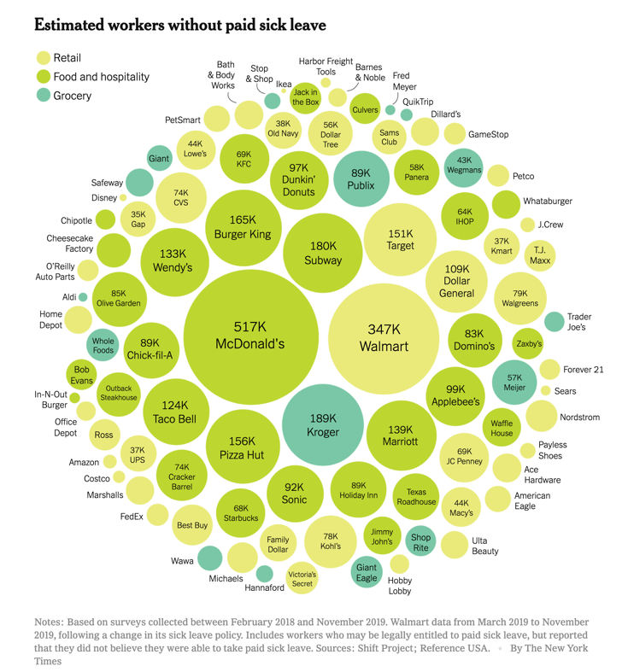
Editorial Opinion, “The Companies Putting
Profits Ahead of Public Health,” The New
York Times, March 14, 2020
“As the Coronavirus spreads, the public
interest requires employers to abandon
their longstanding resistance to paid
sick leave.”
This chart indicates the estimated number
of workers in retail, food and hospitality,
and grocery that are without paid sick
leave.

Slide 33
Paid Sick Leave: The Consequences of Social Class
Pew Research Center, March 12, 2020
According to the federal Bureau of Labor Statistics,
24% of U.S. civilian workers, or roughly 33.6 million
people, do not have access to paid sick leave.
As seen in this chart, paid sick leave, while nearly
universal at the upper ends of the wage distribution,
becomes scarcer the less money one makes. For instance,
92% of workers in the top quarter of earnings (meaning
hourly wages greater than $32.21) have access to some
form of paid sick leave, versus only 51% of workers
earning wages in the lowest quarter ($13.80 or less).
Among the lowest-earning tenth – those whose wages
are $10.80 an hour or less – just 31% have paid sick leave.

Slide 34
Paid Sick Leave: The Consequences of Social Class
Pew Research Center, March 12, 2020
In the U.S., only 12 states and the District of
Columbia currently require employers to provide
paid sick leave to their workers.
For more information, i.e., how access to sick leave
varies by occupation, read Drew Desilver, “As
coronavirus spreads, which U.S. workers have
paid sick leave – and which don’t?” on reading list.

Slide 35
The Widening Gap between the Rich and the Poor
“The rich get richer and the poor get (relatively) poorer.”
Access to Resources and Opportunities: Often it is not what you know, but who you know.
The Accumulation of Advantages and Disadvantages: How should rewards be distributed?
In a meritocratic manner whereby rewards are dispensed to those who “earn it” –
to those that perform the best according to rules that are evenly applied to all?
Or by favoritism?
The Poor Pay More: see the article by DeNeen L. Brown, “The High Cost of Poverty: Why
the Poor Pay More,” Washington Post, May 18, 2009

Slide 36
Factory Worker Salaries in the United States
The average Factory Worker salary in USA is $25,350 per year or $13 per hour. This
barely gets a family of four up to the poverty level which is $25,100
Entry level positions start at $18,525 per year, while most experienced workers make
up to $43,095 per year.
Yet here is how factory workers are portrayed to the public in “stock photographs” – worker
camaraderie and workers and bosses working together as one big happy family.

Slide 37
Factory Worker Salaries in the United States
The average Factory Worker salary in USA is $25,350 per year or $13 per hour. This
barely gets a family of four up to the poverty level which is $25,100
Entry level positions start at $18,525 per year, while most experienced workers make
up to $43,095 per year.
Yet here is how factory workers are portrayed to the public in “stock photographs” – worker
camaraderie and workers and bosses working together as one big happy family.

Slide 38
Factory Worker Salaries in the United States
The average Factory Worker salary in USA is $25,350 per year or $13 per hour. This
barely gets a family of four up to the poverty level which is $25,100
Entry level positions start at $18,525 per year, while most experienced workers make
up to $43,095 per year.
Yet here is how factory workers are portrayed to the public in “stock photographs” – worker
camaraderie and workers and bosses working together as one big happy family.

Slide 39
The Savar Building
Dhaka District, Bangladesh
April 24, 2013
Oversea sweatshop factory used by American companies as a source of cheap labor, collapses:
1,134 dead; approximately 2,500 injured.
The engineer report had concluded that the factory building was “constructed with substandard
materials and in blatant disregard for building codes”

Slide 40
The Savar Building
Dhaka District, Bangladesh
April 24, 2013
On April 23, cracks appeared in the building, shaking the structure enough that many workers
fled. An engineer who had been called to inspect the structure warned that it was unsafe. Yet the
owner and the factory bosses discounted any concerns and ordered their workers into the
building the next morning.

Slide 41
The Savar Building
Dhaka District, Bangladesh
April 24, 2013
Benetton, the Children’s Place, Walmart . . . Prada, Gucci

Slide 42
Safety Issues
At a meeting of retailers and NGOs a week after the collapse, a new Accord on
Factory and Building Safety in Bangladesh was created and a deadline of 16 May
was set to sign it. The agreement expands on a previous accord signed only by the
US-based PVH which owns Calvin Klein and German retailer Tchibo.
Walmart, along with 14 other North American companies, refused to sign the
accord as the deadline passed. As of 23 May 2013, thirty-eight companies had
signed the accord.
On 10 July 2013, a group of 17 major North American retailers, including
Walmart, Gap, Target and Macys , announced a plan to improve factory safety
in Bangladesh, drawing immediate criticism from labor groups who complained
that it was less stringent than an accord reached among European companies.
Unlike the accord joined mainly by European retailers, the plan lacks legally
binding commitments to pay for those improvements.

Slide 43
Upper Big Branch Mine Disaster
Montcoal, West Virginia
April 5, 2010
Closer to home . . . .
Twenty-nine out of thirty-one miners at the site were
killed.
A state funded independent investigation later found
Massey Energy directly responsible for the blast,
concluding that flagrant safety violations contributed
to the explosion.
The report found that the mine’s owner, Massey Energy,
had operated its mines in a “profoundly reckless manner.”
The U.S. Mine Safety and Health Administration reached
similar conclusions, blaming the deaths on an “intentional
and aggressive” effort by Massey to ignore safety rules.

