Slide 1
The Current State of Race Relations
in the United States
Public Opinion Polls Affirmative Action Programs
Hidden Bias White Privilege
Hate Crimes Hate Groups
White Supremacy Black Lives Matter
& Ethno-Nationalism
© 2013, Professor Larry Stern, Department of Sociology, Collin College
All material on this powerpoint presentation is for Collin College class use only. Any unauthorized
duplication or distribution is prohibited.

Slide 2
The Current State of Race Relations
in the United States
As you will expect – after all, I have been stressing this point throughout the entire
semester – people will have different perspectives when it comes to assessing the
state of race relations in the United States today. In fact, as you will see, folks with
different social backgrounds – which means different experiences – will strongly
disagree about whether a particular state of affairs actually exists, and then question
the legitimacy of those who disagree with them.
For the moment, let’s not think about which of the varying viewpoints is a more
accurate depiction of the actual state of affairs. Instead, think about the gap between
the varying positions. For example – and as you will see in a minute – 84% of blacks
believe that they are treated less fairly than whites are in dealing with the police, while
only 63% of whites – a 21% point difference – think that this is the case.
These different “definitions of the situation,” of course, poses a serious problem for
those working to improve matters. How can we work together to confront problems
if they are not defined as such by each of the parties involved?

Slide 3
Race Relations
Pew Research Center, February 2019
How do the perceptions of blacks and whites differ on the state of race relations today?
There are large gaps between blacks and whites
in their views of race relations and racial inequality
in the United States.
About six-in-ten Americans (58%) say race relations
in the U.S. are generally bad, a view that is held by
majorities across racial and ethnic groups.
Blacks (71%) are considerably more likely than
whites (56%) and Hispanics (60%) to express
negative views about the state of race relations.

Slide 4
Race Relations
Pew Research Center, February 2019
How do the perceptions of blacks and whites differ on the state of race relations today?
Overall, 53% of the public says race relations are
getting worse. Views are particularly pessimistic
among those who say race relations are currently
bad: 69% of this group says race relations are
getting even worse, and 22% say they’re staying
the same. Just 9% think they’re getting better.

Slide 5
Race Relations
Pew Research Center, February 2019
How do the perceptions of blacks and whites differ on the state of race relations today?
White Republicans and white Democrats differ
widely in their views of the country’s racial progress.
When asked to assess the extent to which equal
rights have been given to blacks in the United States,
53% of whites who either identify as Republicans
or are leaning toward the Republican party say that
it has “been about right,” while 31% say that it has
“gone too far.”
In contrast, only 30% whites who either identify as
Democrats or are leaning toward the Democrat
party say that it has “been about right,” while 64%
say that it has “not gone far enough.”

Slide 6
Race Relations
Pew Research Center, February 2019
How do the perceptions of blacks and whites differ on differential treatment?
Black and white adults have widely different
perceptions of how blacks are treated in America.
Although a majority of whites now agree that
blacks are treated less fairly than whites in
dealing with police (63%) and by the criminal
justice system (61%) the gap between white and
black opinions is still quite large: 84% of blacks
believe that they are treated less fairly in dealing
with the police – which is a 21 percentage points
difference with whites – while 87% believe that
they are treated less fairly than whites by the
criminal justice system – revealing a 26
percentage point gap between them and whites.

Slide 7
Race Relations
Pew Research Center, February 2019
How do the perceptions of blacks and whites differ on differential treatment?
“About six-in-ten blacks or more – but fewer than
half of whites – say blacks are treated less fairly
than whites in hiring, pay and promotions; when
applying for a loan or mortgage; in stores or
restaurants; when voting in elections; and when
seeking medical treatment. In each of these
realms, whites tend to say blacks and whites
are treated about equally; very small shares
say whites are treated less fairly than blacks.

Slide 8
Race Relations
Pew Research Center, February 2019
How do the perceptions of Republicans and Democrats differ on differential treatment?
“Across these different areas, there are gaps
ranging from 39 to 53 percentage points in how
white Democrats and white Republicans see the
treatment of blacks in the U.S.”
“About half or more white Democrats say blacks
are treated less fairly than whites in dealing with
the police (88% vs. 43% of white Republicans);
by the criminal justice system (86% vs. 39%);
in hiring, pay and promotions (72% vs. 21%);
when applying for a mortgage or loan (64% vs.
17%); in stores or restaurants (62% vs. 16%);
when voting in elections (60% vs. 7%); and
when seeking medical treatment (48% vs. 9%).”

Slide 9
Race Relations
Pew Research Center, February 2019
How do the perceptions of blacks and whites differ on differential access to resources
and opportunities?

Slide 10
Race Relations
Pew Research Center, February 2019
How do the perceptions of blacks and whites differ on the obstacles blacks face?

Slide 11
Race Relations
Pew Research Center, February 2019
How do the opinions of blacks and whites differ when asked whether too much or too
little attention is paid to issues of race?
“About four-in-ten Americans (41%) say there’s too much
attention paid to race and racial issues in the country
these days; 37% say there’s too little attention, and
21% say it’s about right. Whites are far more likely than
other racial and ethnic groups to say there’s too much
attention paid to race, while blacks are more likely than
other groups to say too little attention is paid to these
issues.”
“Half of whites say too much attention is paid to race and
racial issues these days, while smaller shares say there
is too little (28%) or about the right amount of attention
(21%). In contrast, about two-thirds of blacks (67%) say
there’s too little focus on race.”

Slide 12
Race Relations
Pew Research Center, February 2019
How do the opinions of blacks and whites differ when asked whether too much or too
little attention is paid to issues of race?
“Among whites, the view that the country is too focused on race
is more common among those who are older and without a
bachelor’s degree.
Opinions also differ considerably across party lines: Three-
quarters of white Republicans think there’s too much attention
paid to race and racial issues, compared with 21% of white
Democrats. About half of white Democrats (48%) say there’s
too little attention paid to these issues and 29% say it’s about
right. Black Democrats are far more likely than their white
counterparts to say there’s too little attention paid to race: 71%
say that’s the case.

Slide 13
Race Relations
Pew Research Center, February 2019
How do the opinions of blacks and whites differ when asked whether too much or too
little attention is paid to issues of discrimination?
“When it comes to racial discrimination, a majority of
Americans (57%) say the bigger problem for the
country is people not seeing discrimination where
it really exists, rather than people seeing racial
discrimination where it really does not exist (42%
say this is the bigger problem).”
“More than eight-in-ten black adults (84%) and
somewhat smaller majorities of Hispanics (67%) and
Asians (72%) say the bigger problem is people not
seeing racial discrimination where it really exists.
“Among whites, however, 52% say the bigger problem
is people seeing discrimination where it doesn’t exist.”

Slide 14
Race Relations
Pew Research Center, February 2019
How do the opinions of Republicans and Democrats, and those who differ in age and level of
education, differ when asked whether too much or too little attention is paid to the issue
Of discrimination?
‘Younger whites, as well as whites with a bachelor’s
degree or more education, are more likely than older
and less-educated whites to say the bigger problem
for the country is people not seeing racial discrimination
where it really exists.”
“Views also differ sharply by party, with white Democrats
and white Republicans offering views that are the mirror
image of each other: 78% of white Democrats say the
bigger problem is people not seeing discrimination
where it really exists, while 77% of Republicans say
the bigger problem is people seeing discrimination
where it doesn’t exist.”

Slide 15
Race Relations
Pew Research Center, February 2019
How do the perceptions of blacks and whites differ on the impact of the Trump Presidency on
the state of race relations today?
“Two years into Donald Trump’s presidency,
56% of Americans say Trump has made race
relations worse."
“A relatively small share (15%) say the
president has made progress toward
improving race relations, and 13% say
he has tried but failed to make progress.”

Slide 16
Race Relations
Pew Research Center, February 2019
How do the perceptions of blacks and whites - and Republicans and Democrats – differ
on President Trump’s handling of race relations?
“Assessments of the president’s performance on race
relations vary considerably along racial and ethnic
lines. Most blacks (73%), Hispanics (69%) and
Asians (65%) say Trump has made race relations
worse, compared with about half of whites (49%).”
“Democrats and Republicans have widely different
opinions of the president’s handling of race
relations. Fully 84% of Democrats say Trump has
made race relations worse, compared with 20%
of Republicans. And while 34% of Republicans
say Trump has made progress toward improving
race relations, virtually no Democrats (1%) say
the same.”

Slide 17
Race Relations
Pew Research Center, February 2019
How do the perceptions of blacks and whites - and Republicans and Democrats – differ
on President Trump’s handling of race relations?
”Majorities across racial and ethnic groups say it has
become more common for people to express racist or
racially insensitive views since Trump was elected,
but blacks (76%) and Hispanics (75%) are more
likely than whites (60%) to say this is the case.”
“Democrats are twice as likely as Republicans to say it
has become more common for people to express
racist or racially insensitive views since Trump was
elected (84% vs. 42%). Half of Republicans – vs. 12%
of Democrats – say people expressing these views is
about as common as it was before, while small
shares in each group say it is now less common than
before Trump’s election.”

Slide 18
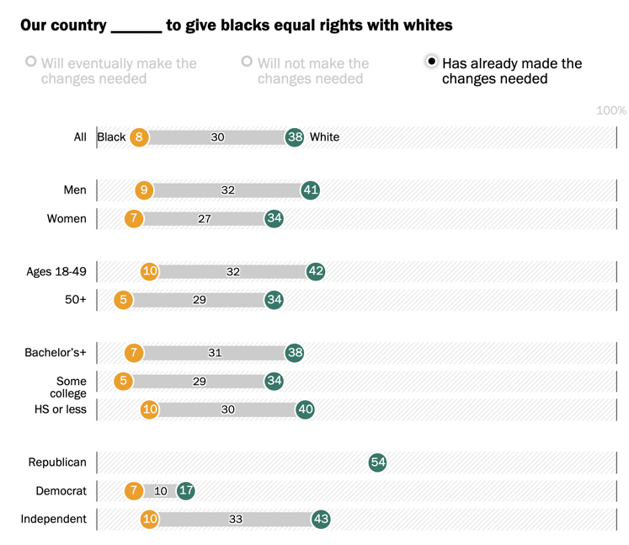
Race Relations
Pew Research Center, February 2019
When asked if our country has already made the
changes needed to give blacks equal rights with whites,
more than four times as many whites (38%) agreed
than did blacks (8%) that this was true.
This chart shows the wide gaps between blacks and
whites broken down by sex, age, educational
attainment, and political affiliation. As can be seen,
the percentage point differences are considerable.
54% of white Republicans believed that our country
has already made the changes needed to give blacks
equal rights with whites, while only 17% of white
Democrats agreed with this statement.
This difference, of course, has serious consequences
when it comes to legislative matters directed toward
increasing equal rights.

Slide 19
Affirmative Action Programs
(& Nepotism)
Affirmative action” refers to the positive steps that are taken to increase the representation
of minorities in areas of employment, education, and culture from which they have been
historically excluded.
Today, the typical criteria for affirmative action are race, disability, gender, ethnic origin, and age.
When those “affirmative” steps involve preferential selection—selection on the basis of race,
gender, or ethnicity—affirmative action programs tend to generate intense controversy.

Slide 20
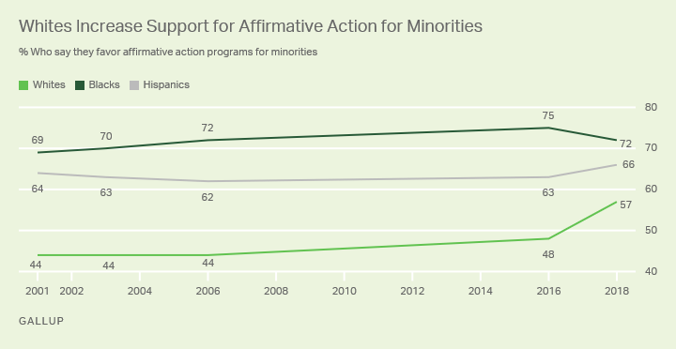
Affirmative Action Programs
According to a recent Gallup Poll from February 2019, Americans’ support for affirmative action
programs has risen these past few years. Although still 15 percentage points below the support
of Blacks, for the first time, a majority of whites – 57% – supports these programs.

Slide 21
Affirmative Action Programs
This slide, however, digs deeper. The Pew
Research Center asked a representative
sample of American citizens to gauge the
extent to which they believed that certain
groups were targets of discrimination.
This chart, which takes political party
affiliation into consideration, shows the
percentage of respondents who answered
“A lot” and “Some.”
The differences in appraisals between
Democrats and Republicans are quite revealing.

Slide 22
Affirmative Action Programs
Adding the “a lot” and “some” answers
together, we find that Republicans in this
survey were more apt to say that “Evangelical
Christians” were discriminated against
roughly to the same extent that Muslims
were, but were discriminated against more
than were Jews, Women, members of the LGBT
community, Hispanics and Blacks.
They were also more likely to believe that
“Whites” were discriminated against more
so than Jews and Women, and to the same
extent as Hispanics and the LGBT community.

Slide 23
Affirmative Action Programs
So, even though the trend shown in the Gallup Poll is somewhat encouraging, it is
nevertheless the case that many white folks complain that they are now the victims
of reverse discrimination and, feeling victimized, they take their case to court – often
as far as the Supreme Court.
So, how does this work? One of the arguments against affirmative action programs is
that they place unqualified individuals in jobs for which they are not qualified. Not
only does this affect the smooth functioning of the workforce, it also, some argue,
sets the individual up for a major disappointment when they realize that they can’t
handle the job.
But look at the next slide . . .

Slide 24
Affirmative Action Programs
√
White applicant
Minimum standards for hiring
√
Minority applicant
This slide indicates the minimum standards for someone to be hired, and shows where
two applicants – one white, the other a minority – fall on the rating scale. In an affirmative
action program, can the minority applicant, who scores lower than the white applicant,
be given preferential treatment and hired instead of the white applicant? The answer
is “no,” because the minority candidate does not meet the minimum standards.

Slide 25
Affirmative Action Programs
√
White applicant
√
Minority applicant
Minimum standards for hiring
What about this situation, where both applicants meet the minimum standards. Now can
a minority applicant, who scores lower than the white applicant, be given preferential
treatment and hired instead of the white applicant? And here the answer is “yes.” But
notice that it is not an “unqualified’ applicant that got the job, but a “less qualified”
applicant. And, since the applicant does meet the proper standards, who is to say that
they will not perform as well as the other candidate?

Slide 26
Nepotism
√
Minority applicant
Minimum standards for hiring
√
White applicant
Still, white folks get angry when this happens and, as mentioned before, sometimes take
their case to court.
Curiously, they don’t appear to feel the same way about nepotism. The practice of nepotism
involves giving preferential treatment to relatives, friends, and friends of friends and is
typically found in hiring practices. It can be summed up in the common phrase, “Quite
often, it’s not what you know, but who you know.” That this is a common and widely known
phrase is itself quite revealing.

Slide 27
Nepotism
√
Minority applicant
Minimum standards for hiring
√
White applicant
And perhaps white folks don’t get angry about this because they are, for the most part,
the beneficiaries of this preferential treatment. Because, to be a beneficiary of nepotism,
all you have to do is to know someone who is in a position to offer you a position – or
can recommend you to someone else they know who can offer you a position. And it
goes without saying that people of color are less likely than white folks to be in this
situation.

Slide 28
Nepotism
√
Minority applicant
Minimum standards for hiring
√
White applicant
But please notice that in cases of nepotism it is quite possible that, unlike in cases of
affirmative action, the person hired can be, and often is, unqualified for the position.
And more to the point, a white person who was passed over for a job that was given by
the boss to a less qualified – or unqualified – family member, friend, or friend of a friend,
will not challenge the decision. No one is going to sue and take a case like this to court.
But let’s move on to an area that has caught the public’s eye: Affirmative Action Programs
in the field of education.

Slide 29
Affirmative Action Programs in Education
Pew Research Center, February 25, 2019
A survey conducted by the Pew Research Center in
February, 2019 found that “Although majorities
across racial and ethnic groups agree that race
should not be a factor in college admissions, as
you might expect, white adults are particularly
likely to hold this view: 78% say this, compared
with 65% of Hispanics, 62% of blacks and 58%
of Asians.”
Moreover, “there are also large partisan gaps on
this issue. Republicans and those who lean toward
the Republican Party are far more likely than
Democrats and Democratic leaners to say that
race or ethnicity should not be a factor in college
admissions (85% vs. 63%).”

Slide 30
Affirmative Action Programs in Education
Pew Research Center, February 25, 2019
But there are a number of things that are taken into consideration when applicants are
judged by college and university selection committees, and it would probably help us
understand the process better by examining a concrete case to see how equitable the
process actually is. Are there biases smuggled in that have nothing to do with race?
In the Supreme Court case Gratz v. Bollinger (2003), the lawyers for two white students
that were denied admission to the University of Michigan argued that their denial was
due to an affirmative action policy that granted extra points to members of racial and
ethnic minority groups in the application process.
Let’s examine the "Selection Index Worksheet" that was used by the University of
Michigan.

Slide 31
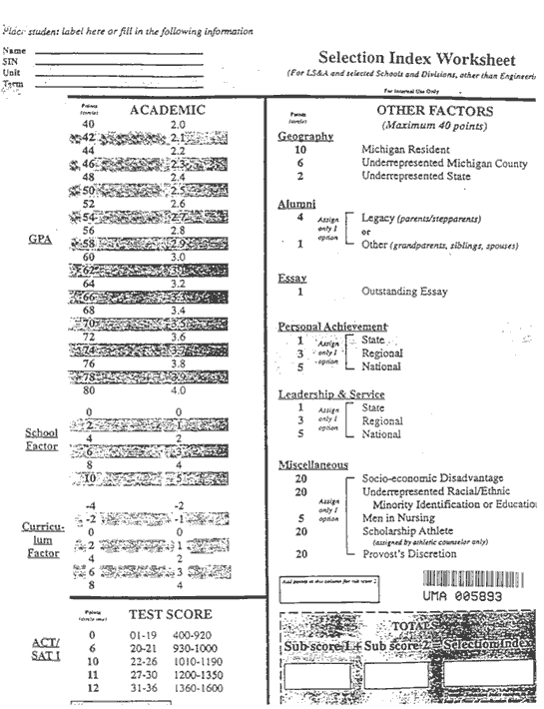
Gratz v. Bollinger (2003)
You will note under the heading "Miscellaneous" that
"Underrepresented Racial/Ethnic Minorities are given
20 points simply for their racial designation – regardless
of their academic qualifications.
This, as you know, is what led to lawsuits and eventually
to the Supreme Court.
Why, many white folks asked, should “they” get 20 extra
points while we don’t?

Slide 32
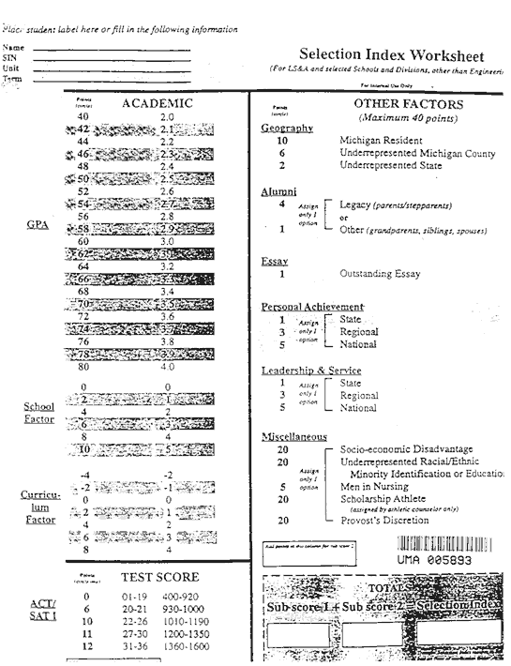
Gratz v. Bollinger (2003)
Of course, the underlying assumption here is that “those”
people are getting “something for nothing” and that this
“muddies the water” in what is otherwise a clear, pristine,
and equal selection process. But this has never been the
case: there has always been a built-in bias that favors
students who come from more affluent backgrounds –
upper-middle class and above – students who are apt to
be white.
And let’s leave aside the fact that "Scholarship Athletes”
get the same 20 points regardless of their academic
qualifications; no one seems to be suing over this.
Nor does anyone seem to sue if their son or daughter
was passed over for another student who was less
qualified but, with the additional 20 points, was
nevertheless admitted due to the Provost’s Discretion.

Slide 33
Gratz v. Bollinger (2003)
Instead, let’s look at some of the other categories that
allocate points and see how “equal” things are.
Most folks will agree that a student’s grade-point-
average (GPA) is an important indicator of a student’s
past performance and a good predictor of their future
performance and, as a result should most definitely be
taken into account by an admissions committee.
The higher your GPA, the more points you accumulate.
On the Selection Index Worksheet used at Michigan a
4.0 GPA gets you 80 points – the highest number on
the chart – which reflects its importance.

Slide 34
Gratz v. Bollinger (2003)
Is it true, however, that a GPA is a good indicator of
one’s educational ability?
We know that all sorts of environmental factors can
affect how well one does in school. Some students
don’t have to work while attending their high school
classes and are thus able to devote a good deal of
time to their studies. Other students, however, those
coming from less affluent backgrounds, might have
more demands upon their time. They might have to
work, devoting at least 20 hours a week to their job,
or perhaps take care of their younger siblings after
school since both parents are working.
And remember that not everyone owns a personal
computer or has access to the internet – which does
come for free. Can these circumstances affect one’s GPA?

Slide 35
Gratz v. Bollinger (2003)
But put this aside for the moment. Let’s look instead
at some of the ways that points are allocated, as seen
by examining the worksheet.
First, consider this: Many (if not most) schools in
affluent areas have Advanced Placement Programs
which use a different – an enhanced – grading scheme.
Students taking these courses can earn up to a 5.0 GPA.
Consider, then, the following three scenarios:
Scenario 1: You are an excellent student who has
“aced” your freshman courses and you enroll in a
series of AP (Advanced Placement) courses where
your GPA rises to somewhere between 4.5 and 5.0.
Even though your GPA is higher than 4.0, the Michigan
selection committee will not give you more than the
80 points. There is no change here.

Slide 36
Gratz v. Bollinger (2003)
Scenario 2: You are a good student who earned a 3.5
GPA your freshman year. You enroll in a series of AP
(Advanced Placement) courses and, due to the enhanced
scoring scheme, your GPA rises from 3.5 to somewhere
between 4.0 and 4.5.
Had you not taken the AP courses, the Michigan
selection committee would have given you 70 points
for your 3.5 GPA. But since you had access to AP
courses, you were able to raise your GPA to 4.0 or
better and, as a result, you receive 80 points from the
selection committee. You were given the opportunity
to gain ten full points on your application score.
Of course, you had to earn these points – some
students might “crash and burn,” finding the work too
difficult. But the main point is that you were given the
opportunity to earn these extra points.

Slide 37
Gratz v. Bollinger (2003)
Scenario 3: But not all schools have these programs;
they are less common in schools located in less affluent
areas. This means that students that attend these
schools are not given the opportunity to earn extra
points. If your GPA is 3.5, you still get your 70 points,
but unlike comparable students in more affluent
schools, you are not given the same chance to earn
the 10 extra points that they can.
This is a situation where you don’t automatically get
extra points – again, you have to earn them – but you
are at least given the opportunity to do so. Turn now, to
the next two categories, where points are automatically
allocated to some but not others, regardless of the
amount of effort they put into their studies.

Slide 38
Gratz v. Bollinger (2003)
Look, for example, at the two headings “School Factor”
– which refers to such things as the number of books
and computers available to students, the percentage
of faculty with advanced training and graduate degrees,
and graduation rates – and “Curriculum Factor” – which
refers to the quality of the materials taught in the school.
Notice that those schools located in affluent areas will
score high on both of these while schools located in
impoverished areas will score lower. If your
neighborhood school is located in an affluent area you
receive 10 points for school factor and 8 points for
curriculum factor – taken together, 18 points – just for
walking through the door, regardless of your grades,
even if you never open a book! And if you attend a
school in an impoverished area, you can actually lose
4 points!

Slide 39
Gratz v. Bollinger (2003)
So, yes, an underrepresented racial minority identification
automatically gets you 20 points, but a white person
living in an affluent area automatically gets 18 points –
and is given the opportunity to earn 10 more points if
they take AP classes.
But there is still more . . .
Who is more likely to have the money to take a SAT
preparation course? If this raises your score 80 points –
a 5% increase – from a 930 to a 1010, you receive an
additional 4 points.
If one of your parents went to the University of Michigan,
you receive an additional 4 points. Given past enrollment
patterns, who do you think nearly all of these points will
go to?

Slide 40
Gratz v. Bollinger (2003)
You will also receive between 1 and 5 points if you have
won a state, regional or national award – say, for a
science fair project or some other competition – and
another 1 to 5 points if you had any leadership or
service experience at the state, regional or national
level – such as being in student government or doing
volunteer work.
Once again, who is more likely to have the time and
resources to pursue these options?
So, what do you think?

Slide 41
Gratz v. Bollinger (2003)
Was the admissions process used at Michigan – and
elsewhere in the United States – a fair and equitable
process before race was considered as an additional
factor? Or was there a systematic bias that privileged affluent
students who are more apt to be white?
Which is more unfair? The 20 points given to minority
students, or the 18 points given to white students for
simply walking into a school that is located in an affluent
area? And add on the opportunity given to these students
to earn upwards of 10 points for taking AP courses,
another 4 points if they took an SAT prep class, another
4 points if either of their parents attended the school,
and somewhere between 2 and 10 points if they won
an award, served in student government of did volunteer
work . . .

Slide 42
Hidden Bias
“Hidden bias” refers to an individual’s unconscious, or automatic, biases. Please be certain to
go to ”Project Implicit” - the web address is on the web page that lists the readings, web page
visits and videos to view for this unit – and take the "Implicit Association Test.” It won’t
take more than 10-minutes, and it should be enlightening for you. You will receive your score –
whether you have a strong, medium, or slight bias - and you will see the scores for more than
a million others who have taken the test. Think about the implications: if someone’s bias is
hidden to them – that they don’t recognize that they are biased to some extent – how can we
it be reduced?
In addition, I also strongly urge that you watch the two short segments of the film, The Color of
Fear,” and then go through the brief PowerPoint I have posted that provides a brief.
analysis of the segments.
The next three slides provides examples of the unconscious nature of many biases – and
especially how they might be affected by our language and the words we use.

Slide 43
Language & Labels: The Power of Words
“Whiteness” and “People of color”
In America, “whiteness” is conventionally considered a cultural default setting, the automatic
point of comparison for any kind of difference, thereby constituting the standard of normality
against which other ethnic or racial identities come to be conceptualized.
The term "person of color" is primarily used today in the United States to describe any person
who is not considered white – as if “white” isn’t a color . . .

Slide 44
Language & Labels: The Power of Words
“Flesh Tone”
Band-aids and crayons as “flesh tone.”
Whose flesh?

Slide 45
Language & Labels: The Power of Words
The color “nude””
Oscar Awards, 2018, trend “sparkly nude dresses.”

Slide 46
Please read these three brief readings, listed on the reading assignment page.
Peggy McIntosh, “White Privilege: Unpacking the Invisible Knapsack”
Robert Jensen, "White Privilege Shapes the U.S." and "More thoughts on why the system of white privilege is wrong.”
Tim Wise, "Reflections on Racism, Both Individual and Systemic," Sociological Images, February 26, 2013

Slide 47
Race Hatred, Hate Groups,
White Supremacists and
Ethno-Nationalists

Slide 48
Race Hatred
Within weeks of President Obama being sworn in as our nation’s 44th President, a
picture of the White House with its “newly” created “watermelon patch” circulated
on the internet.
Then, during the height of the “birther” movement, Marilyn Davenport, an Orange
County Republican Central Committee member, circulated this picture with the
caption, “Now you know why no birth certificate.”

Slide 49
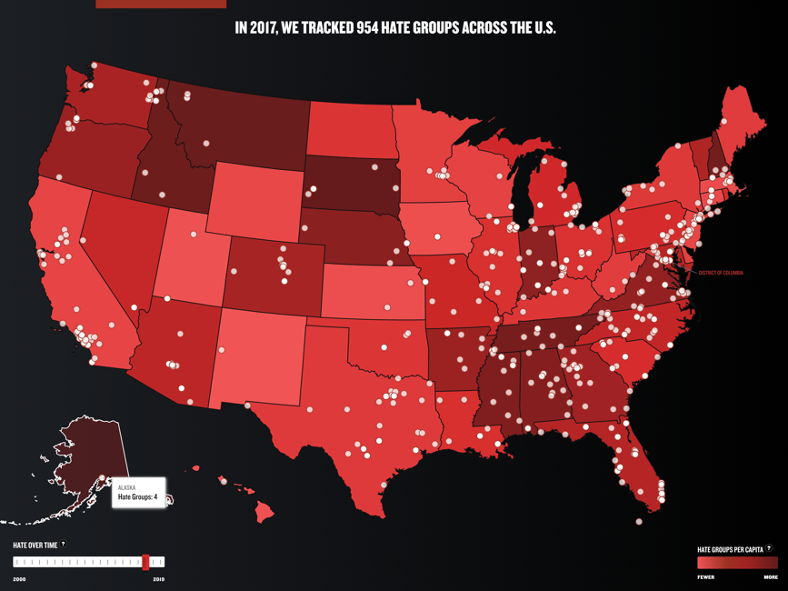
Hate Groups
Southern Poverty Law Center
“The Southern Poverty Law Center is dedicated to fighting hate and bigotry and to seeking
justice for the most vulnerable members of our society. Using litigation, education, and other
forms of advocacy, the SPLC works toward the day when the ideals of equal justice and equal
opportunity will be a reality.

Slide 50
White Supremacists and Ethno-Nationalists

Slide 51
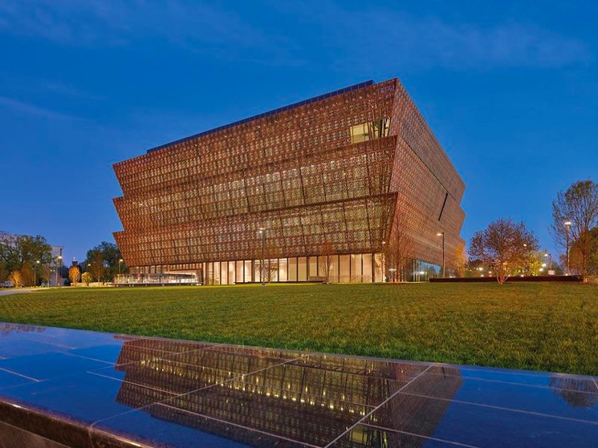
Hate Crimes
Nooses on Campus
In May 2017 tourists visiting the National Museum of African American History and Culture
found a noose in an exhibition on segregation.

Slide 52
Hate Crimes
Nooses on Campus
Nooses have also been recently found hanging from trees on dozens of college campuses, including
Duke University (2015), American University (2017), Kansas State University (2017), the University
of Maryland (2017), University of South Alabama (2018), University of Illinois (2019), Stanford
University (2019), Auburn University (2019) and Oregon Health & Science University (2019).

Slide 53
Black Lives Matter Movement
The Black Lives Matter movement is a politically polarizing issue.

Slide 54
Black Lives Matter Movement
As seen here, a large partisan divide exists between
Republicans and Democrats support for the Black
Lives Matter movement.
While 64% of white adults say that they either
strongly or somewhat support the movement,
more than one-half – 52% - of Republicans say
that they either strongly or somewhat oppose
the movement.

Slide 55
Black Lives Matter Movement
The phrase “black lives matter” was first used by a black community organizer, Alicia Garza, in a
Facebook post following the July 2013 acquittal of George Zimmerman in the shooting of Trayvon
Martin, a 17-year-old African American.
Since that time, the hashtag #BlackLivesMatter has been used nearly 30 million times on Twitter,
an average of 17,002 times per day, according to a Pew Research Center.
Its use accelerated in August 2014 when Michael Brown, an 18-year-old African American man,
was fatally shot by a white police officer in Ferguson, Missouri, and then again in July 2016 after
Alton Sterling was fatally shot by police officers in Baton Rouge, Louisiana.

Slide 56
Black Lives Matter Movement
A typical response by critics of the Black Lives Matter movement is that “All Lives Matter.”
And the typical response to this statement is, “Yes, of course they do. I’m glad that you feel
that way. But now, walk the walk rather than simply talk the talk. Because research indicates
that, in many cases, black lives are not taken to matter as much as do white lives – or blue
lives.”

