Slide 1
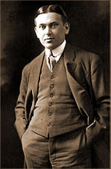
The Sociological Study of Social Problems
For every major problem in this nation, there is a simple
solution – and it is wrong.” H. L. Mencken
H.L. Mencken (1880 - 1956)
journalist, editor, critic
© 2020, Professor Larry Stern, Department of Sociology, Collin College
All material on this PowerPoint presentation is for Collin College class use only. Any unauthorized
duplication or distribution is prohibited.

Slide 2
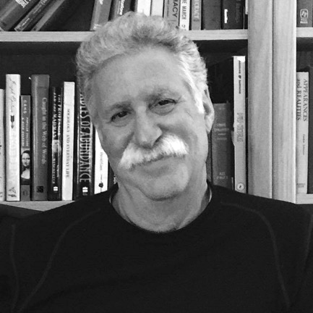
The Sociological Study of Social Problems
The reason that every simple solution is wrong, of course, is because
the many problems that plague our social world are incredibly
complicated. Social living – and life in general – is so complex that
it defies easy answers. If this was not the case, we would have solved
our problems long ago.
It is my contention that the most serious social problem that we
face in today’s contentious time centers on how we think about
social problems – how some conditions come to be defined as
social problems while others are not, how we handle differences
of opinion concerning their causes, persistence, consequences,
and the potential policies to reduce the extent to which they exist.
In this PowerPoint, then, I will not discuss any specific cases of social
problems but will, instead, set out the “issues” that must be
Confronted if we are to deal with our problems with some degree of
success. Although we will never solve all of our social problems, we
can reduce the extent to which these circumstances occur . . .
Larry Stern
(Remember me?)

Slide 3
The Sociological Study of Social Problems
The application of a sociological perspective will help us understand:
1. the kinds, sources, persistence, and varying consequence of social problems;
how and why some circumstances rather than others come to be defined as
social problems;
why some programs rather than others are implemented to address these
problems;
4. what factors – all apart from the severity of the problem – affect the likelihood
that proposed programs will successfully reduce the extent to which the
problem exists.
that social problems will never be totally solved – we will never get the crime rate down
to zero, we will never eradicate prejudicial attitudes and discriminatory actions, and we
will never fully stop harmful behaviors and actions. But we can reduce the extent to which
these circumstances occur – and this matters . . .

Slide 4
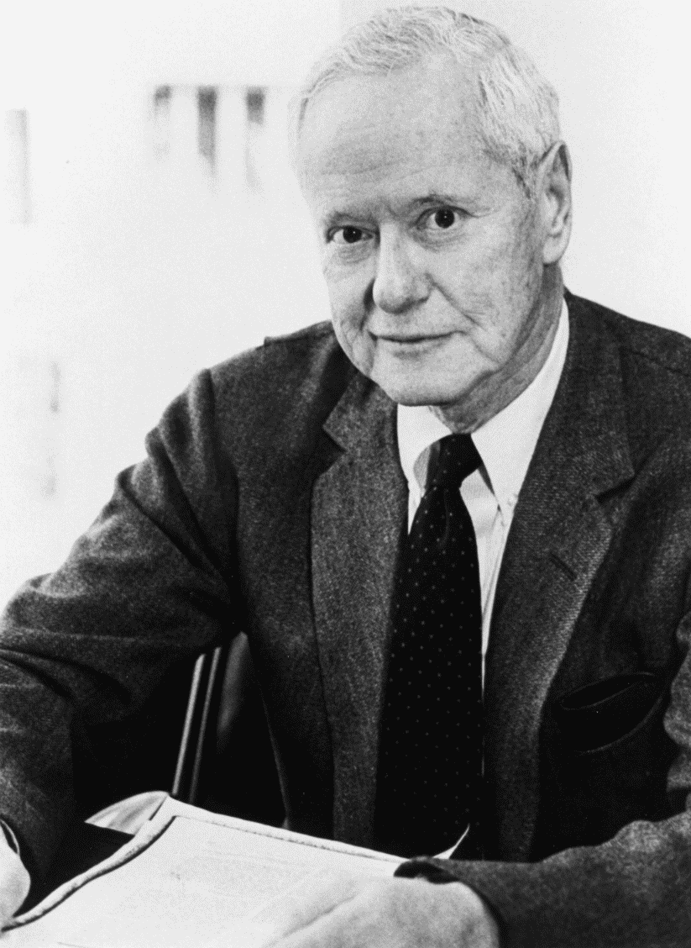
What is a Social Problem?
Social Problems Have Both Objective & Subjective Elements
“Social problems are not only subjective states of mind; they are also objective states of affairs.”
“A social problem exists when there is a sizeable
discrepancy between what is and what people
think ought to be.”
manifest social problems – those that are fully recognized and agreed to be social problems by
the public and politicians
latent social problems – those that are real – they
exist – but they are unnoticed by most people and must be brought to their attention.
Robert K. Merton
1910- 2003

Slide 5
What is a Social Problem?
Social Problems Have Both Objective & Subjective Elements
“One of the tasks of sociologists is to identify latent social problems – conditions that are at odds with current interests and values but not generally recognized as being so – thereby alerting people to pending difficulties."
By making latent social problems manifest – by discovering unwanted consequences of institutionalized arrangements – the sociologist inevitably becomes a social critic.
As shall be seen, this is not easy . . . .
Robert K. Merton
1910- 2003

Slide 6
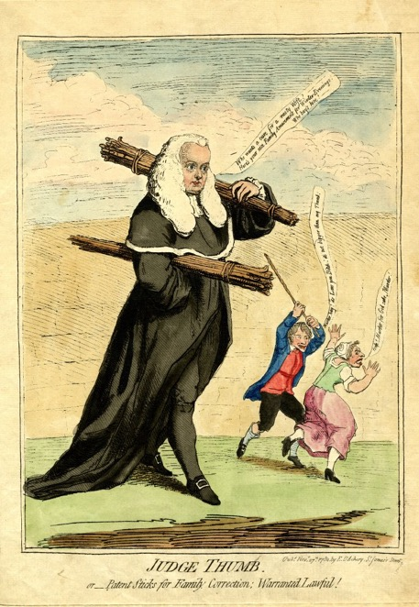
What is a Social Problem?
Social Problems Have Both Objective & Subjective Elements
Every set of conditions that is recognized as a
social problem existed for some time before it
came to be “defined” as such.
Historically, unjust conditions have been taken
for granted as part of the natural and inescapable
order of things - i.e., the treatment of women, the
poor, Native Americans and African-Americans.
It was legal in the 18th century, for example, for husbands to beat their wives with a stick “as long as it was not thicker than the length of his thumb – thus
the term. “rule of thumb.”
Cartoon by James Gillray satirizing Sir Francis
Butler, 1782: "Judge Thumb; or, Patent Sticks
for Family Correction: Warranted Lawful!"

Slide 7
What is a Social Problem?
Social Problems Have Both Objective & Subjective Elements
The act of defining a phenomenon as a social problem implies that the situation is undesirable and that something should be done to remedy it.
A major process is involved in transforming an objective problem condition into one that is in the forefront of the public’s consciousness.
And even when a problem is brought to the public’s consciousness, rarely does a complete consensus occur in society as to whether that given condition does or does not constitute a social problem.
In most instances, consensus on social problem matters is virtually impossible to obtain.
Why is this so? Let’s put the sociological perspective to work.

Slide 8

What is a Social Problem?
Throughout the semester I have argued that legitimate disagreements are to be found nearly everywhere; that, given our different experiences and different perspectives, we will not all share the same views or be attentive to the same flow if information. Due to the tremendous diversity of our population, it quite simply couldn’t be any other way. These disagreements are ubiquitous and they are built-in to the very fabric of the social world.
We should expect, then, that there will be serious disagreements – legitimate disagreements – over whether or not something constitutes a genuine social problem.
Larry Stern

Slide 9
What is a Social Problem?
In some cases, these disagreement are over whether the circumstances that some see and define as problematic, actually exists. There are some folks, for example, who believe that “alien abductions” is the most serious social problem that humans on earth face – that it is a prelude to invasion.
I suspect that most of you do not share this view – that you do not believe that the phenomenon of alien abductions exists – despite all sorts of evidence that our government has “allegedly” collected over the years.

Slide 10
What is a Social Problem?
But, on a more serious note, recall that a significant percentage of our population – those, as it turns out, that either self-identify as being Republicans or are leaning Republican – that does not believe that women face more obstacles than men as they strive to attain their goals or that “substantial” discrimination (what is the threshold?) exists in our society. And if it doesn’t exist, they argue, how can you think that it is a social problem?
But now consider a case where there exists a large degree of consensus that a particular objectively identified state of affairs qualifies as a social problem. Despite this agreement, folks will still disagree on how important the problem is relative to others – social problems are typically rank-ordered and prioritized – and this, of course, will affect whether resources will be devoted to attempts to reduce the extent to which the problem exists.
Larry Stern

Slide 11
What is a Social Problem?
And even when there is agreement that something not only qualifies as a social problem but is also serious enough to merit our immediate attention, there will likely be disagreements over the causes of the social problem.
And if there is a disagreement over the cause of the problem – is it rooted in the characteristics or personalities of individuals or is it due to the manner in which society is operating? – then there will of course be disagreement over the potential solutions that are designed to address the problem.
Disagreements – sociologically predictable disagreements – will be found every step along the way . . .
Larry Stern

Slide 12
What is a Social Problem?
Let’s go back to Merton’s definition and look at it, piece by piece.
“A social problem exists when there is a sizeable discrepancy between what is and what people think ought to be.”
It is an “objective” condition: it is real, tangible, and measurable.
Who determines “what is?”
Social scientists? Those directly affected?
How accurate are our statistical measures?
What constitutes a “sizeable” – as compared to an
acceptable – discrepancy? What is the threshold?
Who decides “what ought to be?”
Robert K. Merton
1910- 2003

Slide 13
What is a Social Problem?
Other definitions of social problems include other
elements. Some say that there must be an ”objective” condition that is “undesirable” - that it “adversely affects
a significant number of people – or a small number of significant people.
The point here is that what adversely affects one group can, and often does, privilege another group.
Another definition stresses that a situation will become an officially recognized or certified social problem only when people who are strategically located in a society’s power structure acknowledge its existence.
As you can see, it’s complicated . . . And the process that
leads to one set of circumstances rather than another being defined as a social problem is of critical importance.
Larry Stern

Slide 14
What is a Social Problem?
“What constitutes a social problem,” then, is the outcome of an extended set of social negotiations between different groups with markedly different sets of legitimate beliefs, values, attitudes, perceptions, interests, and power.
These differences affect not only why some social circumstances rather than others come to be defined and acknowledged as social problems, but also how these social problems, once recognized, are prioritized, and why some proposed solutions rather than others are implemented.
Larry Stern

Slide 15
Early Notions about Social Problems
Prior to the emergence of sociology, individual and societal problems have been variously attributed to:
“Original Sin” and/or the sinfulness of a particular individual
God’s will – and sometimes, God’swrath
malevolent spirits
insanity, either moral or physical
an inferior heredity
the inevitable result of natural law

Slide 16
Fatalistic Viewpoints
“Nothing Can Be Done” “Nothing Should Be Done”
Fatalism refers to the belief that all events are predetermined and therefore inevitable.
According to this view, unwanted social conditions cannot be prevented or controlled.
In medieval days, it was argued that the existence and persistence of problems
is God’s will; that these are God-given conditions of man.
By the 19th century, some evangelism religious leaders, such as Dwight L. Moody, rejected
the notion that such things as poverty were God’s will and that, instead, turning to God
would lead to social reform.

Slide 17
Religious Perspectives
Dwight L. Moody and American Evangelism
Moody believed that poverty was caused by personal sin. Therefore,
a laborer’s only rescue from deprivation was Christian conversion which inevitably led to personal responsibility and moral uplift, qualities that many at the time believed that the poor most often lacked.
It was Moody’s belief that Christian conversion would make lazy, poor
men into energetic and hard-working persons who become prosperous.
Once wanderers came “home” and the poor acquired the sense of
responsibility found in strong Christian families, poverty would cease.
Individual conversions, Moody believed, would eventually bring social reform.
Dwight L. Moody
1837-1899

Slide 18
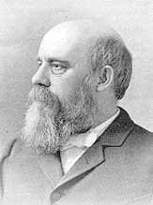
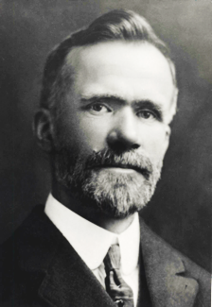
Religious Perspectives
The Social Gospel Movement
Although the cause and cure for such social ills as poverty were
seen as being related directly to the initiative of the individual, many Christian workers rejected Moody’s belief that “one should not carry
a loaf of bread in one hand and a Bible in the other lest someone think only of the bread and ignore the word.” Instead, they proposed to uplift the sinner and save his soul.
The Social Gospel Movement sought to make the Christian churches even more responsive to social problems, such as poverty and prostitution. Leaders of the movement – Washington Gladden and Walter Rauschenbusch – argued that Jesus’ message was as much about social reform as about individual approaches to salvation.
This record of Christian social service, in an era when social reform was not popular, was as impressive as that of almost any other group in the country.
Washington Gladden
1836 - 1918
Walter Rauschenbusch
1861 - 1918

Slide 19
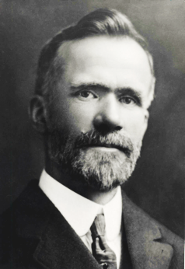
The Social Gospel Movement
Christians in the Social Gospel movement emphasized the immanence of God’s Kingdom on earth and the responsibility of a Christian society to bring it about; they believed that the Second Coming could not occur until humankind rid itself of social evils . They needed to create the Kingdom of Heaven on earth.
Many had in common their pursuit of social justice and a mission to apply the teachings of Jesus as recorded in the New Testament,
especially in his “Sermon on the Mount.”
They applied Christian ethics to social problems, focusing generally on issues of social justice, and most particularly upon inequality and the
pathological consequences of poverty, such as:
unsanitary living conditions in the slums, poor working conditions in the factories, child labor, poor schools,
alcoholism, prostitution, and crime, racial and ethnic tensions.
Washington Gladden
1836 - 1918
Walter Rauschenbusch
1861 - 1918

Slide 20
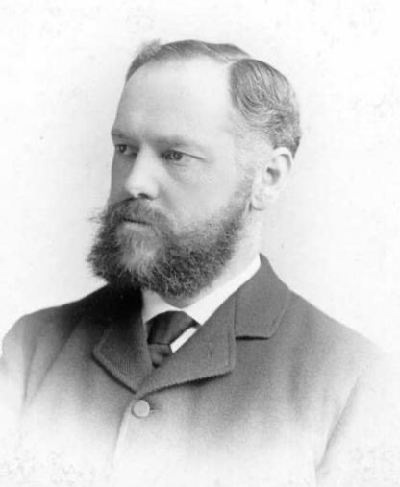
The Social Gospel Movement
The emergence of sociology as a discipline was directly related to a
growing concern about social problems. Some of the early sociologists were children of Protestant ministers, a few were ministers themselves. Many – but not all – had liberal political beliefs and had joined various reform organizations. The goal for these early sociologists was to study and explain social problems in order to devise a practical means for eliminating them
Francis G. Peabody, for example, became the first Professor of Social
Ethics in the United States at the Harvard Divinity School in 1880. This was later transformed into the Department of sociology
Peabody taught courses on such topics as prisons, labor, charity, the “social question,” and the responsibility of the modern state.
One of his major books was Jesus Christ and the Social Question: An Examination of the Teaching of Jesus in Its Relation to Some of the Problems of Modern Social Life (1900).
Francis G. Peabody
1847 – 1936

Slide 21
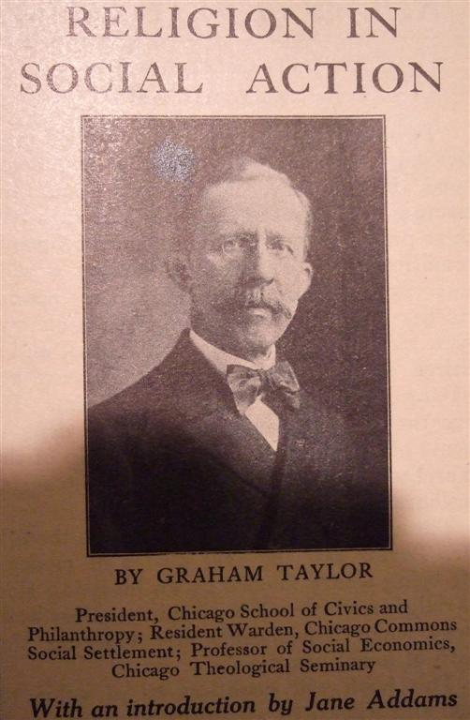
The Social Gospel Movement
& Settlement Houses
The American Institute for Christian Sociology was founded in 1893 and “Christian Sociology” was considered to be “mainstream” sociology at this time.
In addition, ministries founded dozens of rescue missions, homes for fallen women, and relief programs while also working to help immigrants secure jobs.
Preaching the Gospel was always the central aim, but social and
evangelical work went hand in hand.

Slide 22
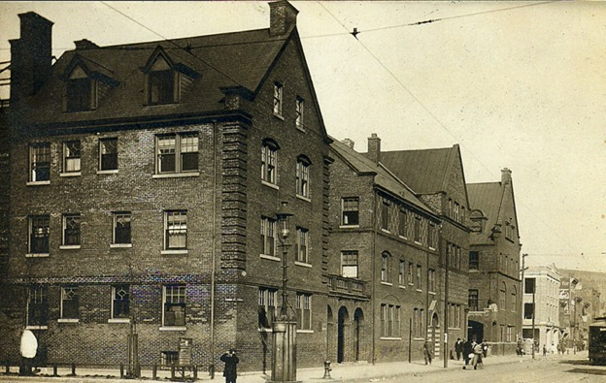
Jane Addams & Hull House, Chicago, 1889
Founded by Jane Addams and Ellen Gates Starr, Hull House was the most visible and
consequential settlement house.
The “clientele” for Hull House were, for the most part, immigrants living in squalor
in the shadow of Chicago’s huge meat-packing industry.
At the turn of the century, Chicago's meatpacking industry employed more than
25,000 people and produced 82 percent of the meat consumed in the United States.
Meatpacking houses were killing between five and six thousand hogs a day.

Slide 23
Jane Addams & Hull House, Chicago, 1889
The working conditions for the thousands employed at the Armour Stock Yards were
abhorrent. Laborers on the killing floors had to work amidst the stench and piercing
shrieks of animals being slaughtered while standing on blood-soaked floors. They
worked long hours – usually ten to twelve a day in temperatures exceeding 100 degrees
in the summertime. Stockyard employers could keep wages low and withhold benefits
due to the ready supply of immigrant workers desperate to earn a living; the average
weekly wage at Armour was $9.50.

Slide 24
Jane Addams & Hull House, Chicago, 1889
The primary goal of Hull House was
“To provide a center for a higher civic and social life; to institute and maintain educational
and philanthropic enterprises, and to investigate and improve the conditions in the industrial
districts of Chicago. . .

Slide 25
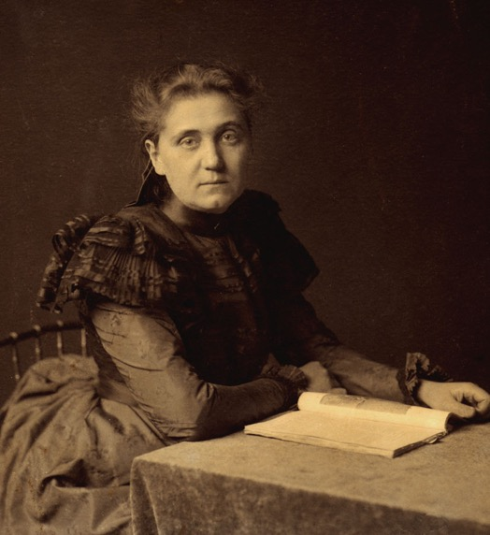
Jane Addams & Hull House, Chicago, 1889
Influenced by the new Department of Sociology at the University
of Chicago, Addams wanted to combine scientific and objective
observation with ethical and moral values to generate a just and
liberated society.
For Addams, Hull House was more than a community center
for immigrants, young adults, and children. It became a
center for social activism, creating programs in social work,
citizenship, and social reform.
Religion was not a prime concern. Addams wanted to avoid
the denominational competition and conflicts rampant in
nineteenth-century Protestantism, and divisions among
Roman Catholics, Jews, and Protestants, and reach that part
of religion that supported the spiritual dimensions with
which all individuals were endowed.

Slide 26
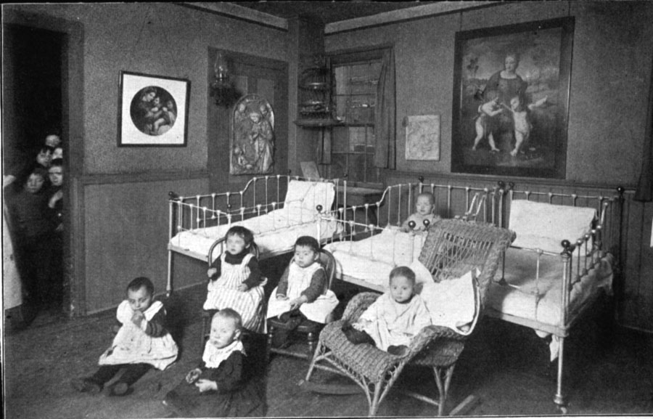
Jane Addams & Hull House, Chicago, 1889
Since child-care services for immigrant workers were non-existent, Hull House provided
a nursery for immigrant working-class families.

Slide 27
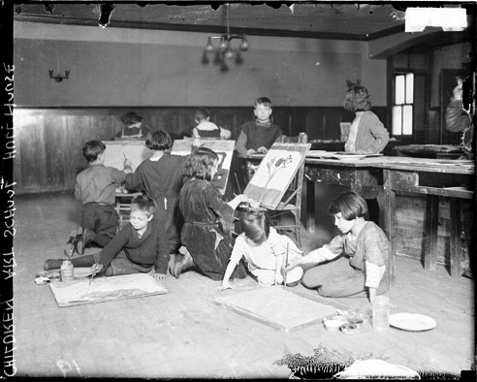
Jane Addams & Hull House, Chicago, 1889
Since parents worked long hours, Hull House provided after-school art classes for children.

Slide 28
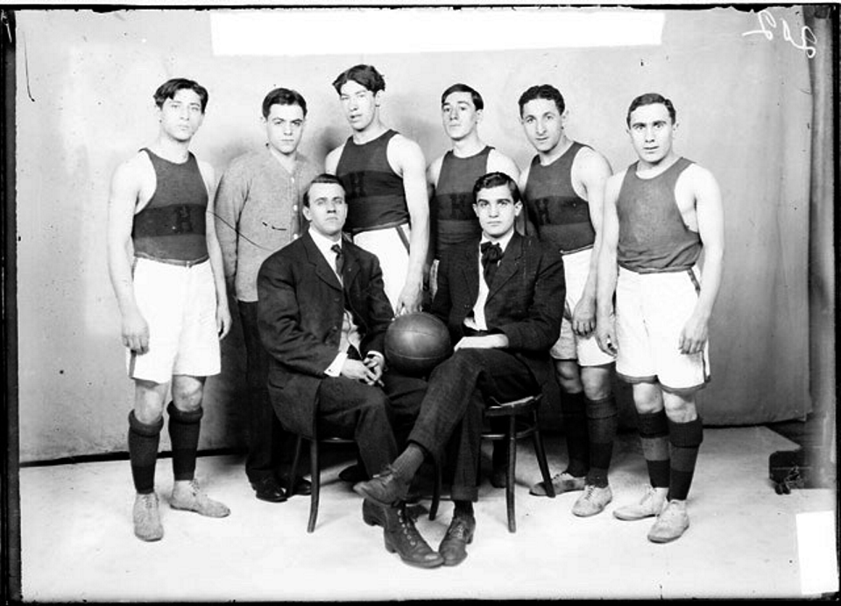
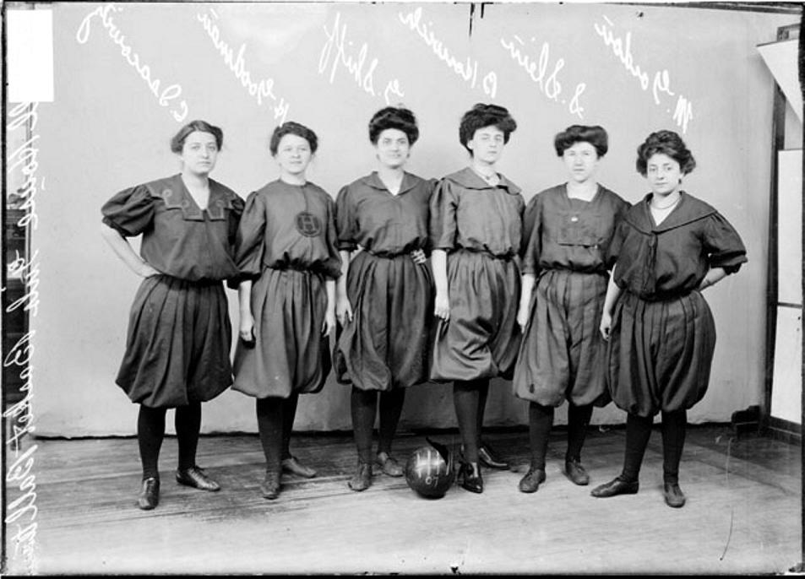
Jane Addams & Hull House, Chicago, 1889
For older students, Hull House had both a men’s and a women’s basketball team to play
against other organizations.

Slide 29
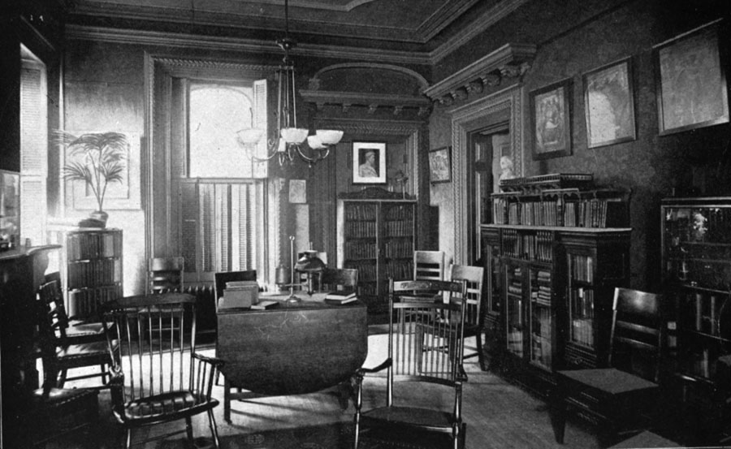
Jane Addams & Hull House, Chicago, 1889
Since parents needed educational training and help with citizenship classes, Hull House
provided a library.
As the next slide shows, Hull House was responsible for initiating all sorts of programs
for immigrants in the area.

Slide 30
Hull House 1sts
* First Social Settlement in Chicago
* First Social Settlement with men and women residents
* Established the first public baths in Chicago
* Established the first public playground in Chicago
* Established the first gymnasium for the public in Chicago
* Established the first little theater in the United States
* Established the first citizenship preparation classes
* Established the first public kitchen in Chicago
* Established the first college extension courses in Chicago
* Established the first group work school
* Established the first painting loan program in Chicago
* Established the first free art exhibits in Chicago
* Established the first fresh air school in Chicago
* Established the first public swimming pool in Chicago
* Established the first Boy Scout troop in Chicago

Slide 31
Hull House 1sts
Of equal importance were the sociological investigations conducted in the surrounding
neighborhoods. Influenced by the new Department of Sociology at the University of
Chicago, affiliates of Hull House conducted studies of
truancy children’s reading newsboys
sanitation typhoid fever tuberculosis
midwifery infant mortality social value of the saloon
Their investigations led to the creation and enactment of the first factory laws in Illinois,
the creation of the first model tenement code, the first factory inspector and the first
probation officer.
Residents of Hull House were also involved in the organization of labor unions, such as the
Women’s Shirt Makers, the Women’s Cloak Makers, and the Chicago Women’s Trade Union
League.

Slide 32
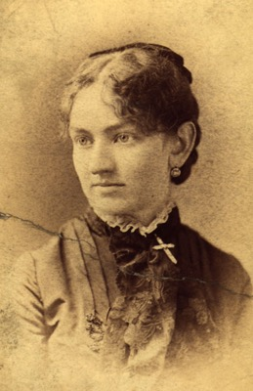
Hull House Residents – Early Women Sociologists
As mentioned before, the emergence of sociology as a discipline was directly related to a
growing concern about social problems. The goal for early sociologists was to study and
explain social problems in order to devise a practical means for eliminating them. Rarely
do these women get much attention in sociology textbooks. Although they were never
given teaching positions in departments of sociology housed in universities or colleges,
they nevertheless qualify as, at the very least, women-pioneers in the discipline. Here is
a short sketch of some of these remarkable women.
In addition to teaching at Hull House, Ellen Gates Starr was active
in the campaign to reform child labor laws and industrial working
conditions in Chicago. Starr, a member of the Women's Trade Union
League, helped organize striking garment workers in 1896, 1910
and 1915. In 1930 she retired to a Roman Catholic convent in
Suffern, New York County.
Ellen Gates Starr
1859 - 1940

Slide 33
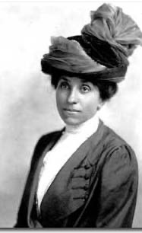
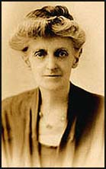
Hull House Residents – Early Women Sociologists
In 1893, Julia Lathrop was appointed as the first woman member of
the Illinois State Board of Charities. In 1912, President William Taft
appointed Lathrop as the first head of the newly created Children’s
Bureau. Over the next nine years Lathrop directed research into child
labor, infant mortality, mother mortality, juvenile delinquency,
mothers' pensions and illegitimacy.
While living at Hull House (1907-1920) Sophonisba Preston
Breckinridge played a leading role in the development of the
Immigrants' Protective League, National Consumer's League, the
Women's Trade Union League and the Children's Bureau. A strong
supporter of women's suffrage she was a member of the American
Woman Suffrage Association. An advocate of African American civil
rights, Breckinridge helped to establish the National Association for
the Advancement of Colored People in 1909.
Julia C. Lathrop
1858 - 1932
Sophonisba Preston Breckinridge
1866 - 1948

Slide 34
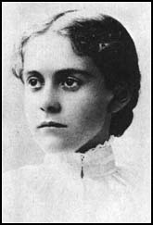
Hull House Residents – Early Women Sociologists
In the typhoid fever epidemic in Chicago in 1902, Alice Hamilton, a
professor of pathology at the Women's Medical College at Northwestern
University in Chicago, made a connection between improper sewage
disposal and the role of flies in transmitting the disease. Her findings led
to reorganization of the Chicago Health Department.
She then noted that the health problems of many of the immigrant poor
were due to unsafe conditions and noxious chemicals, especially lead
dust, to which they were being exposed in the course of their employment.
At the time there were no laws regulating safety at work and employers
routinely fired sick workers and replaced them with new ones looking for
jobs. Hamilton used this evidence to pressure politicians to pass workmen’s
compensation laws and factory owners to provide safer working conditions.
Alice Hamilton
1869 - 1970

Slide 35
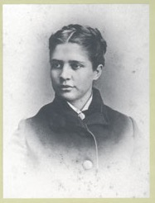
Hull House Residents – Early Women Sociologists
In 1893, Florence Kelley was appointed as the state of Illinois’ first
chief factory inspector. In 1894, Kelley persuaded the State Legislature
to pass legislation controlling child labor.
This included a law limiting women and children to a maximum eight-
hour day. In 1899, Kelley helped establish the National Consumer’s
League, whose main objective was to achieve a minimum wage and
a limitation on the working hours of women and children.
Florence Kelley
1859 - 1932

Slide 36
The Sociological Study of Social Problems
Social problems are not all of a kind. The term social problem does not refer to a single entity, but rather, to a large array of behaviors and socially patterned circumstances that produce harmful consequences. There are many problems and each will have its distinctive causes.
And there is never one universal cause: be wary of any doctrine that argues for a single cause of social problems, whether it be original sin, human nature, economic structure, genetic deficiencies, environmental defects, or the patterned breakdowns, contradictions and conflicts that inevitably occur in society’s key institutions.
Moreover, no one theoretical perspective in sociology – structural-functional analysis, the conflict perspective, symbolic interactionist approach – can provide a definitive account of each and every set of circumstances that comes to be defined as a “social problem.” Each perspective, I hope you recall, focuses upon different aspects of the same phenomenon and
these differing theories often complement each other rather than being inevitably opposed.

Slide 37
The Sociological Study of Social Problems
One last sociological insight before we move on:
It is not the case that everything we dislike in the social world results from somebody’s deliberate evil-doing, or that only good can beget good and only evil can beget evil.
To believe this is to confuse one’s purposes with the actual outcomes of their actions.
This does not take into account the sociological maxim that all actions have multiple consequences, the most important of which are the unintended consequences of social action.
In our discussion of this point in Unit 3 on theory, I introduced the German concept "Schlimmbesserung," which refers to “an effort to make something better that actually makes things worse.” A similar American saying is that "The road to hell is paved with good intentions."
In fact, sociologists have found many instances where a program which was introduced to reduce the extent to which a problem existed, though successful, inadvertently led to the emergence of an altogether different social problem. Ironic, isn’t it?

Slide 38
Different Types of Social Problems
Most sociologists divide the field of social problems into different categories:
Deviance: Problems of Social Inequality:
Crime, Violence, and Criminal Justice Social Class: Poverty and Wealth
Sexuality Racial & Ethnic Inequality
Alcohol and Other Drugs Gender Inequality
Physical and Mental Health Aging and Inequality
Problems of Institutions: Global Problems:
The Family Population and Global Inequality
The Economy Issues of Technology
The Polity War and Terrorism
Education
Health & Medicine
Mass Media
Urban Living

Slide 39
Individual Choice, Responsibility & Free - Will
vs.
Social Circumstance Beyond One’s Control
Earlier in the semester we discussed these two types of explanations of human action and
behavior: Individual Choice, Responsibility & Free – Will vs. Social Circumstance Beyond One’s
Control. Hopefully, you will recall that I argued that this was a false question – that it is not
one or the other but that each, under specifiable circumstances, can take prominence.
There seems to be a marked tendency, however, for many to rely upon the individual
explanation when they try to understand why people make poor choices in life.
William Ryan discusses this in his book, Blaming the Victim.

Slide 40

Blaming the Victim
William Ryan
According to Ryan, there is a marked tendency in our society for
people in fortunate circumstances to “blame” people in less fortunate
circumstances for their plight. Rather than focus on broader social
factors—factors that are often beyond the immediate control of
individuals—that might contribute to ones’ situation, people seek to
explain it by referring to some sort of character failing. The poor, for
example, are often thought of as defective personalities or deficient
moral types. They are people who do not share “our” values; they
are not “like” us. Their impoverishment is their own fault. They
are “deserving” of their situation and thus “undeserving” of our
society’s aid. “If only they worked harder. . . .”

Slide 41
Blaming the Victim
William Ryan
According to Ryan, blaming the victim involves four simple steps:
Pick a social problem
Decide how people who suffer from the problem differ from
everyone else.
Define these differences as the cause of the problem.
4. Respond to the problem by trying to change the victims, rather
then the larger society.

Slide 42
Blaming the Victim
William Ryan
Blaming those in unfortunate circumstances for their situations serves
to reduce others’psychic discomfort. It reinforces the consoling notion –
for those in fortunate circumstances – that life is fair., that people get
what they deserve.
They believe that “That couldn’t possibly happen to me because I am
not like them. I’m responsible. I work hard. Bad things only happen to
bad people.”
To acknowledge that bad things can happen to good people – that
circumstances beyond one’s control can or might put them in the
same unfortunate situation – is far less consoling.

Slide 43
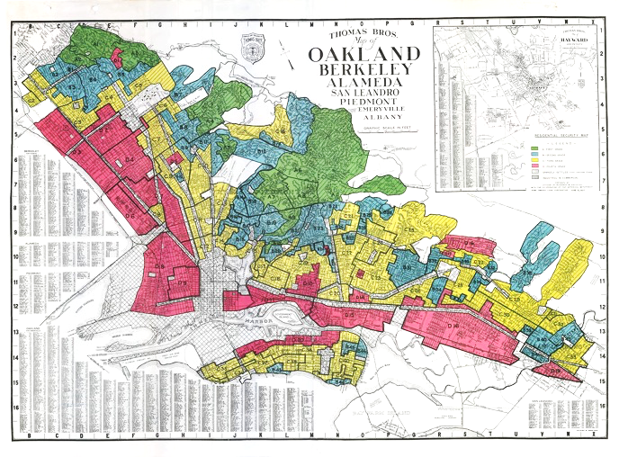
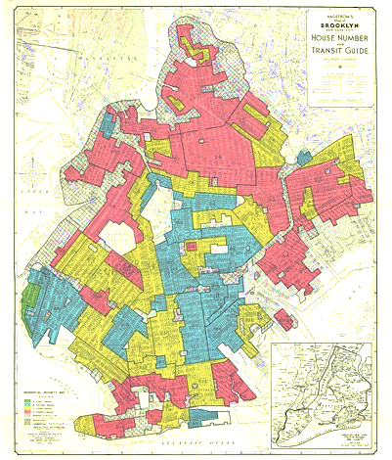
Social Circumstance Beyond One’s Control
Earlier in the semester we discussed a number of examples of how circumstance beyond one’s
control can have a serious impact on one’s life. We talked about a government policy that led to
“redlining” and that between 1934 and 1962, the federal government backed $120 billion of home
loans, with more than 98 percent of the funds going to white folks and that of the 350,000 new
homes built with federal support in Northern California between 1946 and 1960, fewer than
100 - 0.0002857% - went to African Americans.

Slide 44
Social Circumstance Beyond One’s Control
As of today – 16 April – more than 20 million people have been laid off due to the COVID-19
pandemic and have filed for unemployment in the last three weeks. Many have lost their health
insurance along with their jobs.
Due to bureaucratic glitches, grants that were intended for small business owners so that they
would be able to pay their employees have been held up . . .

Slide 45
The “Social” Origins of Social Problems
What types of social factors lead to the existence of social problems?
The influence of other people:
significant others – including parents, role models, peer groups;
Social disorganization:
rapid social and technological change;
Institutional breakdowns:
family, economy, polity, religion, education;
Structural strains and internal contradictions:
social structure and anomie; institutional ambivalence
Unanticipated consequences of well-intentioned actions:

Slide 46
“Solutions” of Social Problems
“To get the bad Customs of a Country chang’d, and new ones, though better, introduce’d, it is necessary first to remove the Prejudices of the People, enlighten their Ignorance, and convince them that their Interest will be promoted by the propos’d Changes; and this is not the Work of a Day.”
Benjamin Franklin to Alexander Small, September 28, 1787

Slide 47
“Solutions” of Social Problems
As mentioned before, social problems will never be totally solved – we will never get the crime rate down to zero, we will never eradicate prejudicial attitudes and discriminatory actions, and we will never fully stop harmful behaviors and actions. But we can reduce the extent to which these circumstances occur – and this matters . . .
I also mentioned that sociologists have found many instances where a program which was introduced to reduce the extent to which a problem existed, though successful, inadvertently led to the emergence of an altogether different social problem.
Trying to solve or reduce the extent to which a problem exists is a process that is affected by various factors.
Let me remind you of one that we talked about in the beginning of the semester: cultural notions of “time.”

Slide 48

“Solutions” of Social Problems
Earlier this semester I presented a thought experiment to you
that was intended to illustrate both the complexity of dealing
with social problems and how our cultural expectations in the
U.S. – in this case our notion about time – poses serious
obstacles.
I started by asking you how angry you would be if you had to
walk over to the television every time that you wanted to change
the channel; or, how you would feel if your microwave breaks
down, or how you feel when you see that “spinning wheel” on your computer (imagine back in the days when we had to use “dial-up”
to get on the internet).
For Americans, as the phrase goes, “time is money.” When do we
want what we want? Yesterday! When should we solve problems? Immediately.
Such is the American cultural view on time.

Slide 49
“Solutions” of Social Problems
So, I said let's assume that every living being on the planet hears a voice at exactly the same time (in their native language) and let’s, for the sake of the argument, stipulate that everyone agrees that it is the voice of God – their deity, the one they worship. And this deity, in a fatherly/motherly – not wrathful – manner, expresses its displeasure. “I am not happy,” the deity says,” about the way things are going. People on the planet are dying of starvation every four-seconds, and yet there is more than enough food to feed everyone. Some people are killing other people over artificial boundaries in the land, or because of racial and/or ethnic differences. Some people are exploited – taken advantage of – by others. Some people, feeling hopeless, are turning to alcohol, opioids, and other drugs.” And the list goes on . .

Slide 50
“Solutions” of Social Problems
The deity, having gotten everyone’s attention, now tells our specie how we can change things – how we can solve all of the problems and live productive, just, and peaceful lives. There is no miracle, no prayer, no religious ritual to follow, just a “blueprint” of what we should do. And there is no question that if everyone follows the blueprint, it will work. After all, it’s the plan of a deity who knows all.
And every single human being decides to follow the blueprint.
And the question I then asked was, “How long will it take before the plan bears fruit? How long will it take before our social problems have been solved?

Slide 51
“Solutions” of Social Problems
During our discussion, we agreed that it would take, at the very least, five-to-ten-years, and most likely a complete generation – that there were no “quick-fixes.” Just think about the logistics of making food available to everyone – again, there is no divine intervention.
I then asked you to think about this and apply it to our political situation. Party A defeats Party B in the Presidential election, arguing, in part, that Party B didn’t make good on its promises to deal with – to solve – the major problems that we faced a s a nation. Party A now offers its programs to deal with the problems that Party B was unable to solve – its solutions – and gets to work.
But were Party B’s policies given enough time to work? Can the problems we face be solved within the confines of a four-year Presidential cycle?

Slide 52
“Solutions” of Social Problems
Or think, once more, about the COVID-19 pandemic that we are all experiencing . . . I don’t need to remind you of the grim death statistics and the impact this has had on the economy.
And I know that you are aware that there are some politicians who have grown weary of “waiting” for the numbers to change so that we could “open up the country” and all go back to normal.
“Time is money . . .” “Time heals all wounds . . .” Which is it?
How much time will our culture give to the pandemic before it decides – perhaps prematurely – to go back to “business as usual?”

Slide 53
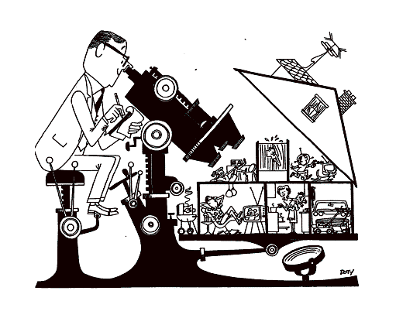
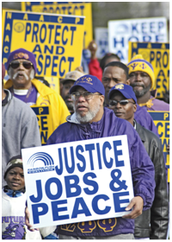
“Solutions” of Social Problems
The Role of Sociologists
What is the proper role of a scientist? Should a scientist be a totally “objective” analyst, providing the facts of the case without “advocating” a particular position?
Or, does the expertise of social scientists possess give them a special obligation to comment on the problems of their times?

Slide 54
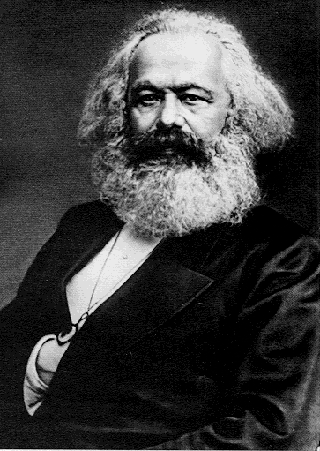
Sociologists as Social Activists
From its inception, the discipline of sociology has grappled with these questions. On the one side are those sociologists who exhibit a critical stance toward existing social arrangements, seek to pinpoint the causes and consequences of social problems, and offer remedies they believe would reduce the extent to which these problems exist. They typically share a commitment to greater social equality and the
collective use of reason to create a better and more just social world.
For many on this side, the ideas of sociology, reform and activism are
so tightly enmeshed as to be inseparable. Though not necessarily
Marxist in approach, they adhere to his famous maxim that
“Philosophers have hitherto only interpreted the world in various ways; the point is to change it.”
Karl Marx
1818 - 1883

Slide 55
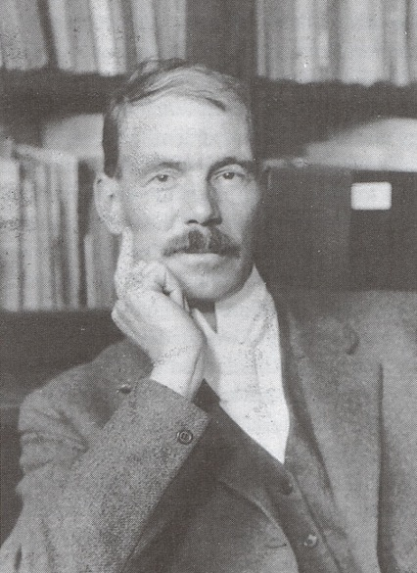
Sociologists as Social Activists
Many sociologists simply argued that it was their moral responsibility to share their expertise with both politicians as
well as the public. E. A. Ross, an eminent sociologist at Stanford,
for example, believed that the primary purpose of the field of sociology was to identify and cure the ills of society, in particular social problems created by the rapid industrialization and urbanization at the turn of the century.
He writes:
“I cannot with self-respect decline to speak on topics to
which I have given years of investigation. It is my duty as
a sociologist to impart, on occasion, to sober people, and in
a scientific spirit, my conclusions on subjects with which I
am expert . . .
The scientist’s business is to know some things clear to the bottom, and if he hides what he knows he loses his virtue.”
E. A. Ross
1866 – 1951

Slide 56
Sociologists as Objective Analysts
But there is another side, and these sociologists are more apt to subscribe to William Ogburn’s comment, delivered in his presidential address to the American Sociological Society in 1929:
“Sociology as a science is not interested in making the world a better place in which to live . . . Science is only interested in one thing only, to wit, discovering new knowledge.”
These sociologists argue that in order for the discipline to be taken seriously as a legitimate area of inquiry – for it to attain and retain some degree of intellectual authority – sociology must be seen as a thoroughly scientific and objective enterprise. If sociology wants the public to trust what it says about society it must, like all pure sciences, deal with “facts,” not morals or ethics, and be seen as disinterested, detached, value-free, and apolitical.
William F. Ogburn
1886 – 1959

Slide 57
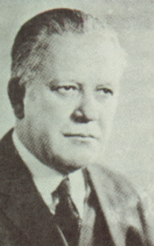
Sociologists as Objective Analysts
Robert Park expressed it this way:
“The role of the sociologist is to be the calm, detached scientist who investigates race relations with the same objectivity and
detachment with which the zoologist dissects the potato bug.”
Robert Park
1864 – 1944

Slide 58
Is Sociology “Value-Free”
There is little doubt that sociological research is increasingly employed as one basis for
forming or justifying social policy. The main question, then, is whether or not sociology –
as well as the other social sciences – is value free? Is it possible to obtain objective
knowledge about social phenomena? Or do sociologists’ values taint their research?
There is also little doubt that values clearly affect the substantive problems sociologists
choose to examine, how they formulate the questions that is the focus of their work, and
the hypotheses or conceptual schemes they choose to employ in the research being
conducted. These choices are unavoidable and, in this sense, a sociology that is wholly
value-free is impossible.
But there is a crucial distinction between problem-selection and problem-solving.
Once chosen, the problem must be studied in strict accordance with the methodological
mandates of the discipline. Once published, the work is subjected to the critical
examination and evaluation by competent peers – others working in the same area with the
same rules of the game. Each time you publish, you are putting your reputation on the line.

Slide 59
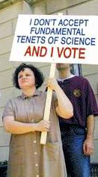
Anti-intellectualism in America
and the Distrust of the Social Sciences
It seems rather clear that in the past three years, a strong strain
of anti-intellectualism has become evident in the U.S.
This term intellectual – and especially the term “the intellectual
elite” – has lately been used with disparaging intent – as an
epithet – implying that so-called intellectuals are not only
out-of-touch with ordinary people, but also that they “think
that they are smarter than us folks.”

Slide 60
Anti-intellectualism in America
and the Distrust of the Social Sciences
The Verdict is In: Sociology and Political Science Deserve the Hatchet
As can be seen here, there are many who distrust the social sciences in particular.

Slide 61
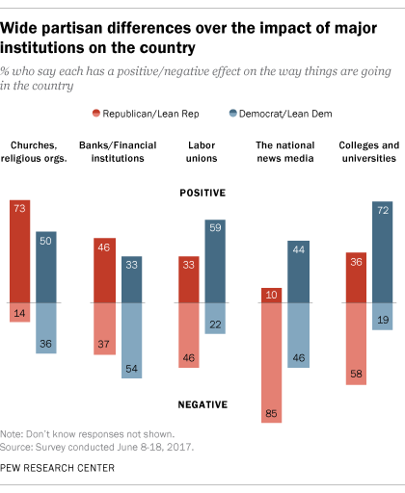
Anti-intellectualism in America
and the Distrust of the Social Sciences
It is of more than passing interest to see that partisanship –
which political party you either identify with or lean toward –
affects whether you believe that the news media and
colleges and universities have a positive or negative effect
on the way things are going in the country.
As seen on this chart, 85% of Republicans view the news media negatively, while 58% believe that colleges and universities have a negative effect on the way things are going in the country.
In contrast, 72% of Democrats believe that colleges and
Universities have a positive effect on the way things are going in the country.

Slide 62
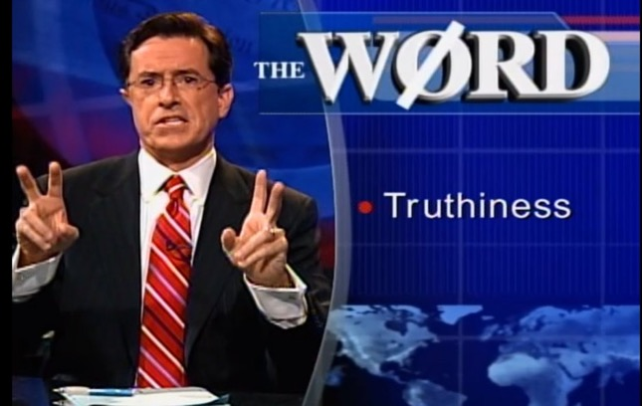
Truthiness
The notions of “truth” and of ”facts” have changed considerably and this, of course, has strongly
affected the discourse among competing sides to any issue.
To illustrate this change, Stephen Colbert introduced the term “truthiness” in 2005 (prior to
the Trump Presidency). He defined it as an emotional quality of a particular statement – it
just “feels” true – without regard to logic, factual evidence, or close examination.
Put another way, the truthiness of a claim is based on one’s intuition, “from the gut,” or
strongly held opinion, rather than the facts generally known to be true in some objective,
verifiable sense.

Slide 63

Truthiness
According to Colbert, “We are divided between those who think with their head, and those who
know with their heart.”
The word took root in our culture: the American Dialect Society selected “truthiness” as the
2005 word of the year, and in the year 2010, truthiness entered the latest edition of the
respected New Oxford American Dictionary.

Slide 64
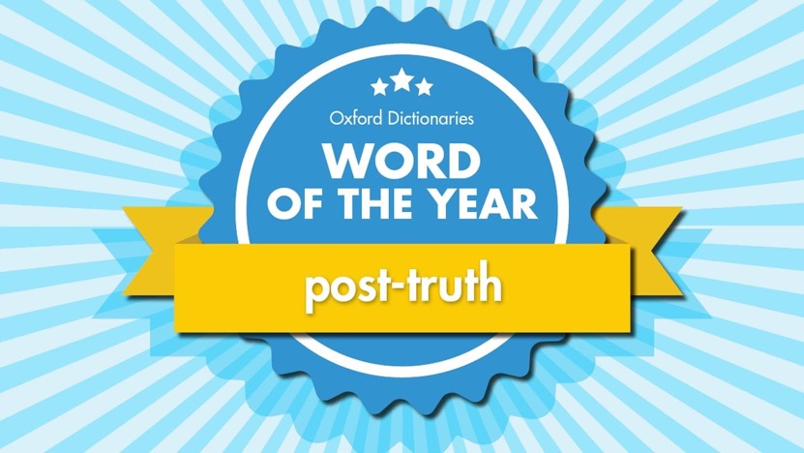
Post–Truth
Another term, “post-truth,” was introduced years later after Trump took office. According to the New Oxford American Dictionary, post-truth refers to “a political culture in which objective facts are less influential in shaping public opinion than appeals to emotion and personal belief.”
Challenging, but not supplanting, the popularity of truthiness, the term “post-truth” has been chosen by Oxford as the 2016 word of the year

Slide 65
Facts – “Ours” & “Theirs”
Unfortunately, it has gotten to the point where, as this cartoon shows, people categorize
so-called “facts” as “our facts,” “their facts,” disputable facts,” and even those facts that are
“unsubstantiated” (which makes it an oxymoron). And this, of course, has serious
consequences when disagreements arise concerning whether or not a set of behaviors or
circumstances constitute a social problem and, if so, what its causes might be, and then how
it should be dealt with.

Slide 66
“Confirmation Bias”
Making things more difficult is what cognitive psychologists refer to as “confirmation bias,”
which refers to a tendency to notice or search out information that confirms what one already
believes, or would like to believe, and to avoid or discount information that’s contrary to one’s
beliefs or preferences.
It is a general process that affects all people – men and women, rich and poor, people of light
or dark complexion, liberals and conservatives, fundamentalists and atheists, intellectuals and
anti-intellectuals – and this tendency is believed to be “hard-wired” in the brain.
What it does, of course, is reinforce the “truthiness” of our prior beliefs.
This can be seen in the next slide, which indicates which media outlets both Republicans and
Democrats trust and where they get their news.

Slide 67
“Confirmation Bias”
Pew Research Center, January 17, 2020
As seen here, party identification makes a big difference
concerning which news outlets are trusted and serve as
a source of information.
Unsurprisingly, Republicans indicated that they both
trusted Fox News and used it as a source of information
by wide margins.
Democrats’ trust of news outlets, on the other hand, was
more evenly divided among the news outlets. CNN was
chosen most frequently as their source of information.

Slide 68
Rhetorical Tactics that capitalize on
Anti-intellectual tendencies
Samuel Clemens, best known by his pen name Mark Twain, once
said,
“It’s easier to fool people than to convince them that they
have been fooled.”
Over the years – which is to say that this is not a new phenomenon –
politicians, public policy analysts and corporate leaders have been
using certain rhetorical strategies to convince opponents – and
the public in general – to see things their way on important issues
when the scientific data indicated otherwise.

Slide 69
Agnotology
Agnotology is the study of the tactics and strategies
special interest groups deliberately use to suppress
truth by manufacturing doubt and creating confusion
during debates of societally important issues.
It is the deliberate creation of ignorance and
uncertainty.
Memos written by executives of the cigarette
industry, for example, clearly indicate that their
main goal during investigations of the safety of
smoking was to “spread confusion about whether
smoking caused cancer.”
In many instances agnotology simply involves
emphasizing that “experts disagree” – even if it is
actually less than 10% of the experts that disagree

Slide 70
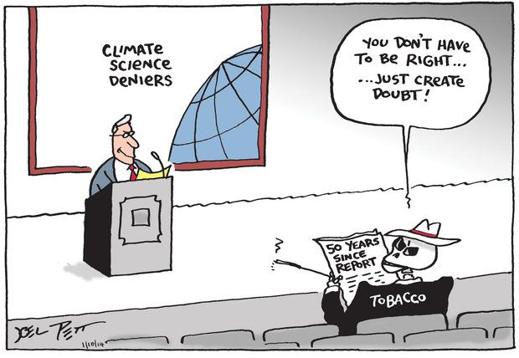

Agnotology
An ongoing case is the controversy surrounding climate change.

Slide 71

Agnotology
According to Robert Proctor, who coined the term “agnotology,
“We live in a world of radical ignorance, and the marvel is that any kind of truth cuts
through the noise. Even though knowledge is ‘accessible’, it does not
mean it is accessed.

Slide 72
Paltering
Another strategy that is used to deceive is paltering, which refers to the deliberate use of
truthful statements to convey a mistaken impression. It is to mislead by telling the truth
and, as such, is somewhat diabolical.
Paltering is an active form of deception that is distinct from lies of commission – telling
outright lies – because it involves only truthful statements.
It is also different from lies of omission, in that it involves actively misleading others rather
than passively omitting to share relevant information.
An example would be a politician characterizing his or her opponents as “soft on defense”
because they voted against a particular defense-spending bill – which is true – when, in
actuality, the opponents supported a different piece of legislation that provided more
support for the military at a greater cost.

Slide 73
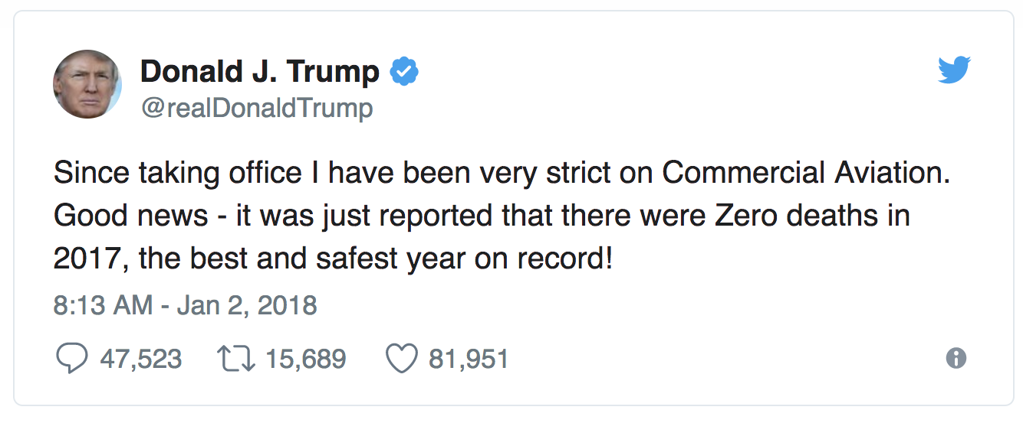
Paltering
Another example of paltering: it is true that there were zero commercial aviation
deaths in the U.S. in 2017 which, of course makes it “the best and safest year on
record” – which is, of course, also true; what could be safer than zero deaths?
President Trump, however, attributes this “good news” to the fact that since taking
office he has been “very strict on Commercial Aviation.” Perhaps he has been strict.
But does this account for the results? It is certainly the impression that he is trying
to create. But other facts that have been purposefully withheld – that the number
of commercial aviation fatalities in 2016, 2015, 2014, 2013, 2012, 2011, and 2010
were also zero – would cast doubt on the impression he wanted to create.

Slide 74
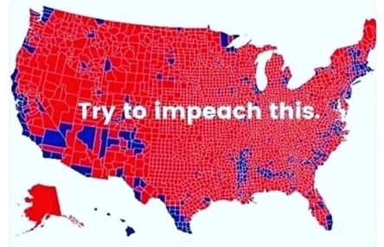


Paltering
One last example, taken from earlier this semester: Each of these three electoral maps from the
2016 Presidential election are accurate – each is a version of the “truth” – but convey very
different impressions.
The map on the left is the conventional electoral map, with each county won by Trump in red, those
won by Clinton in blue. This conveys the impression that Trump’s victory was overwhelming.
The middle map resizes each of the states relative to the others based on population, and colors
those counties won by a candidate by 1% or less, lavender.
The map on the right factors in “population density.” Do these last two maps convey the same
impression as the first?

Slide 75
Logical Fallacies
Our last topic concerns logical fallacies, which are common
errors in reasoning that undermine the logic of one’s
arguments which, as a result, either weakens or
invalidates, the argument. These fallacies are very common
and come in several types.
Each time one of these fallacies starts operating, rational
discussion begins to suffer. Exasperation rises, tempers
flare and communication breaks done. And all the while,
we typically do not recognize what’s happening . . .
And all too often, important decisions that need to be
made to confront social problems are derailed as
negotiations break down with each advocate blaming the
other.
With self-awareness and training one can learn to avoid
the pitfalls that logical fallacies often lead to. Here are a few to consider:

Slide 76
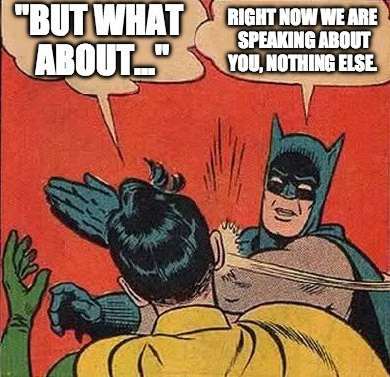
Logical Fallacies: Whataboutism
“Whataboutism” is not merely the changing of a subject
("What about the economy?") to deflect away from an
earlier subject as it is a political strategy; it is
essentially a reversal of an accusation, the argument
that an opponent is guilty of an offense just as
egregious or worse than what the original party was
accused of doing, however unconnected the offenses
may be.
“Whataboutism” involves charging your accuser with
whatever it is you've just been accused of rather than
refuting the truth of the accusation made against you.
Whether or not the original accuser is likewise guilty
of an offense has no bearing on the truth value of the
original accusation. Whataboutism merely muddies
the water.

Slide 77
Logical Fallacies: Straw Man Argument
A “straw man” argument involves distorting or
misrepresenting someone’s argument in order to
make it easier to defeat.
For example, the claim that democrats want to abolish
the second amendment and take everyone’s guns
away or that they want “open borders” for all
immigrants.

Slide 78
Logical Fallacies: Red Herring Argument
A “red herring” argument is one that is not relevant to the issue
being discussed and is often intended to mislead or distract. Unlike
the “straw man” argument, which involves an exaggerated distortion
of the other party’s position, the red herring argument is a seemingly
plausible, though ultimately irrelevant, diversionary tactic, often
used by politicians as a rhetorical strategy to dodge difficult
questions.

Slide 79
Logical Fallacies: False Equivalency
False equivalence is a logical fallacy that occurs when someone incorrectly asserts that two
or more things are equivalent, simply because they share some characteristics, despite the
fact that there are also notable differences between them. A common expression of false
equivalency is "comparing apples and oranges.”
A number of of false equivalencies appear daily in discussions about the COVID-19 pandemic,
which as of today, April 17th, has claimed roughly 32,000 lives. Appearing on Fox News’ Laura
Ingraham show on April 16th, “Dr. Phil” McGraw – who is clearly not a specialist in epidemiology –
argued that 45,000 people a year die from automobile accidents, 480,000 from cigarettes,
150,000 from lung cancer, “but we don’t shut the country down for that. But yet we’re doing it
for this?”
Are these equivalent cases? Are any of the things Dr. Phil mentioned “contagious?” Is the number of
deaths growing exponentially?
Others are comparing COVID-19 to seasonal flu: somewhere between 24,000 and 62,000 deaths
occur each year. But again, once flu season hits, the death rate does not rise exponentially.
Moreover, the mortality rate from the flu is 0.1%, while for COVID-19, it is between 1 and 5 percent.

Slide 80
Logical Fallacies: Fallacy of Dramatic Instance
The fallacy of dramatic instance refers to the tendency to overgeneralize, to use one, two,
or three cases to support an entire argument. This mistake is common among people
who discuss social problems. It may be difficult to counter because the limited number
of cases often are a part of an individual’s personal experience.
For example, in discussing the racial problem in the United States, someone might say:
“Blacks in this country can make it just as much as whites. I know a black businessman
who is making a million dollars a year. He has a better house and a better car than I have.”
If you point out that this successful businessperson is an exception, the person might
still dismiss the point: “If one guy can make it, they all can.” The fallacy of dramatic
instance mistakes a few cases for a general situation. This fallacy is difficult to deal with
because the argument is based partly on fact.

Slide 81
Logical Fallacies: Personal Ad Hominem Attack
Attacking an opponent on personal grounds during an argument –
an ad hominem attack – is a tactic frequently used when one is
unable to support their position by reason, logic, or facts. Diverting
attention from the issue, it is remarkably effective in avoiding the
use of reason or the consideration of evidence in discussing social
issues.
In some instances – as in the case of “blaming the victim” discussed
earlier – people’s character are attacked and they are portrayed as
“disreputable” and, as a result, not deserving aid.

Slide 82
Logical Fallacies: The Slippery Slope
“In a slippery slope argument, a course of action is rejected
because, with little or no evidence, one insists that it will
lead to a chain reaction resulting in an undesirable end or
ends. The slippery slope involves an acceptance of a
succession of events without direct evidence that this course
of events will happen.”
For example, many gun enthusiasts claim that if ownership
of semi-automatic weapons would be restricted, there is
nothing to prevent the next step where the government
will confiscate all such weapons. And the next step will be to
take away high-caliber rifles and guns, and then hunting rifles,
and then they will come for knives, and scissors . . . .
Others strongly oppose any sort of gun registration because
they fear that once the government knows who owns the guns,
it will be easier to confiscate them.

Slide 83
Final Words
I started this unit by by sharing my belief that the most serious social problem that we
face today centers on how we think about social problems – how some conditions rather
than others come to be defined as social problems, how we handle the inevitable – and
legitimate – differences of opinions that arise concerning their causes, persistence,
consequences, and potential policies intended to reduce the extent to which they exist. In
most instances, a complete consensus on these matters is virtually impossible to obtain.
Since every set of conditions that comes to be recognized as a social problem existed for
some time before it came to be “defined” as such, we need to examine the major processes
that are involved in transforming an objective problem condition into one that is in the
forefront of the public’s consciousness.
3. What constitutes a social problem, then, is the outcome of an extended set of social
negotiations between different groups with markedly different sets of legitimate beliefs,
values, attitudes, perceptions, interests, and power.

Slide 84
Final Words
4. I also stressed that social problems are not all of a kind. The term social problem does not
refer to a single entity, but rather, to a large array of behaviors and socially patterned
circumstances that produce harmful consequences. There are many problems and each
will have its distinctive causes.
This being the case, be wary of any doctrine that argues for a single cause of social problems,
whether it be original sin, human nature, economic structure, genetic deficiencies,
environmental defects, or the patterned breakdowns, contradictions and conflicts that
inevitably occur in society’s key institutions.
Moreover, no one theoretical perspective in sociology – structural-functional analysis, the
conflict perspective, symbolic interactionist approach – can provide a definitive account
of each and every set of circumstances that comes to be defined as a “social problem.”
Each perspective focuses upon different aspects of the same phenomenon and these
differing theories often complement each other rather than being inevitably opposed.

Slide 85
Final Words
I also mentioned that these past few years a strong strain of anti-intellectualism has become
evident in the U.S. and that there are many who distrust the social sciences in particular.
This is likely due to the fact that one of the tasks of sociologists is to be a critic of society;
to identify social conditions and institutionalized arrangements that systematically
privilege some categories of people at the expense of others.
Unfortunately, the notions of “truth” and of “facts” have changed considerably and it has
gotten to the point where people now categorize so-called “facts” as “our facts,” “their facts,”
disputable facts,” and even, as ridiculous as it sounds, “unsubstantiated facts” And this, of
course, has serious consequences when disagreements arise concerning whether or not a
set of behaviors or circumstances constitute a social problem and, if so, what its causes
might be, and then how it should be dealt with.
9. Take seriously the tactics and strategies that politicians (as well as your friends, relatives,
co-workers, bosses, and teachers) use – the art of agnotology and paltering – and the
logical fallacies that are smuggled into arguments. Navigate through the fog of ignorance
and confusion and think carefully – and more critically – about important issues.

Slide 86
Final Words
And last, understand that social problems will never be totally solved – we will never
get the crime rate down to zero, we will never eradicate prejudicial attitudes and
discriminatory actions, and we will never fully stop harmful behaviors and actions.
But we can reduce the extent to which these circumstances occur – and this matters . . .
Be aware that certain institutionalized arrangements are so organized that that they
systematically inflict pain, humiliation, suffering, and deep frustration upon particular
groups and strata.
And please don’t allow the “noise” that accompanies disagreements about social problems
to deflect attention from the intense feelings of pain and suffering that are the experience of
some people caught up in certain patterns of social life.

